Slide 1
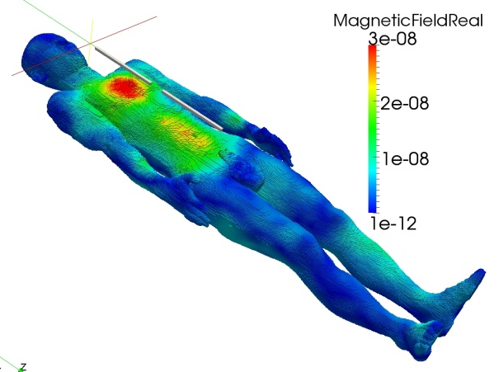
Study for Electromagnetic Field Analysis Using High Precision Calculation
International HPC Summer School 2018
July 8-13, 2018, Ostrava, Czech Republic
Koki Masui (Nagoya University, Japan) and
Masao Ogino (Nagoya University, Japan)
Develops an efficient iterative method for solving complex symmetric linear equations
Uses double-double precision arithmetic
Targets high-frequency electromagnetic field analysis by using edge finite element method
Electromagnetic field simulation for hyperthermia therapy
Notes:
Good afternoon, everyone. I am Koki Masui, from Nagoya University in japan.
Today, I’d like to talk about high precision calculation and the relationship of residual norm and the solution.

Slide 2
Progress to date
Implement double-double (DD) precision complex numbers
define a new structure variable (AoS, in-house code)※1
implement basic mathematical operations for DD-DD, DD-double
implement COCG [van der Vorst & Melissen ’90], COCR [Sogabe & Zhang ‘07], QMR_SYM [Freund ‘92], MINRES-like_CS [Ogino et al. ’16] methods w/ Jacobi, SSOR, shifted IC(0), shifted IC(1) preconditioners
develop mixed-precision variants of iterative methods
Evaluate computational performances with other implementation
typedef struct {double hi; double low;} dd_real;
typedef struct {dd_real real; dd_real imag;} dd_complex;
library | precision | complex type | time ratio
non-use (C) | double | double _Complex | 1
in-house code (C) | DD | AoS ※1 | 6.9
QD library (C++) | DD | complex<dd_real> | 8.1

Slide 3
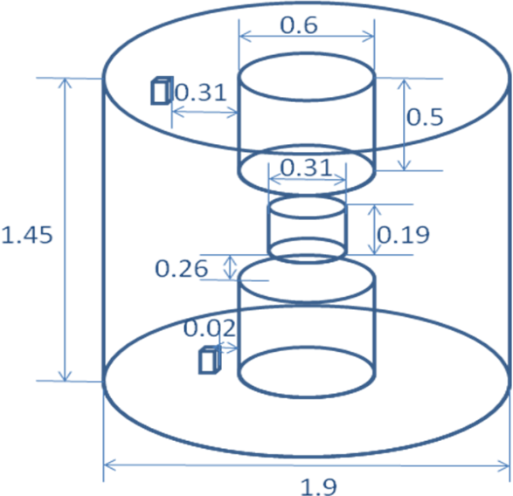
Numerical experiments
Edge finite element equation for vector wave equation
$$\int_{Ω}{rot E_{h}⋅μ^{−1}rot E_{h}^{∗}dΩ}−\int_{Ω}{\left(ω^{2}ε^{′}−iωσ\right)E_{h}⋅E_{h}^{∗}dΩ}=iω\int_{Ω}{J_{h}⋅E_{h}^{∗}dΩ}$$
where $E_{h}$ (V/m) is edge element approximation of electric field, $E_{h}^{∗}$ (V/m) test function satisfying $E_{h}^{∗}×n=0 on ∂Ω$, $J_{h}$ (A/m²) P1 element approximation of current density, $μ$ (H/m) permeability, $ε′$ (F/m) real part of complex permittivity, $σ$ (S/m) electric conductivity, $ω=2πf$ (rad/s) single angular frequency, $f$ (Hz) frequency, $n$ outward normal vector on the boundary, and $i$ imaginary unit.
coefficient matrix is complex symmetric, non diagonally dominant, and like a positive semidefinite
TEAM Workshop Problem 29
whole body cavity resonator model
$ε^{′}=$ 80.0 (F/m)
$σ=$ 0.52 (S/m)
$f=$300 (MHz)
problem size
# of rows, columns: 134,573
# of nonzeros: 2,123,849
sensing coil
Phantom
feeding coil
3
TEAM29 model

Slide 4
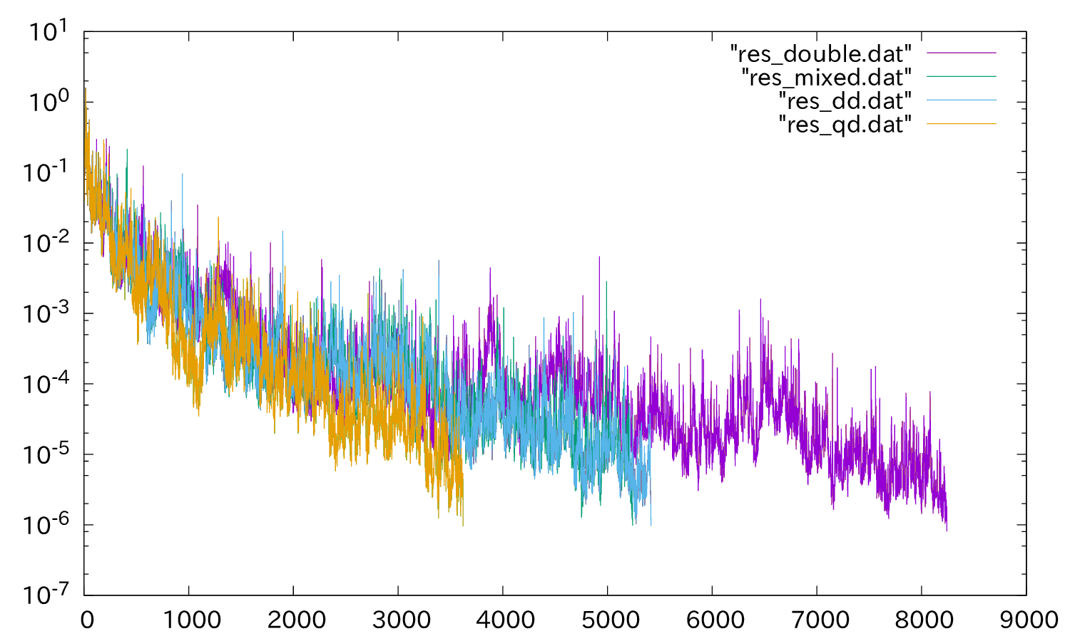
Results in COCG w/ different preconditioners
Precond. | Precision | Iteration counts | Time [sec]
Jacobi | Double | 39,275 | 687
 | Mixed(DD/D) | 26,138 | 959
 | DD | 26,143 | 1,025
SSOR | Double | 21,025 | 775
 | Mixed(DD/D) | 14,730 | 1,078
 | DD | 14,691 | 1,248
IC(0) | Double | 8,421 | 431
 | Mixed(DD/D) | 5,420 | 734
 | DD | 5,416 | 770
ー double
ー mixed
ー DD
(ー QD : Quad Double)
convergence history
(IC(0))
Succeeded to reduce iteration counts by about 2/3 and increase total calculation time by about 1.7 times at worst by DD precision calculation
[Findings!] multiple-precision iterative methods can expect to reduce total computation time compared to double-precision by performance optimization

Slide 5
Future plans
Optimize the performance for recent computers
SIMD instructions
many-core processor
Examine the effect of multiple-precision calculation on
the condition number
choice of iterative methods
Propose a new iterative method for our complex symmetric linear systems
Apply for larger problems or more complicated problems
hundreds of million degrees of freedom human body model

