Slide 1
Scalable Solution Strategies in HOMA Solver
HOMA: High-Order Multilevel Adaptive
Behzad R. Ahrabi
University of Wyoming
IHPCSS 2017
Boulder, CO

Slide 2
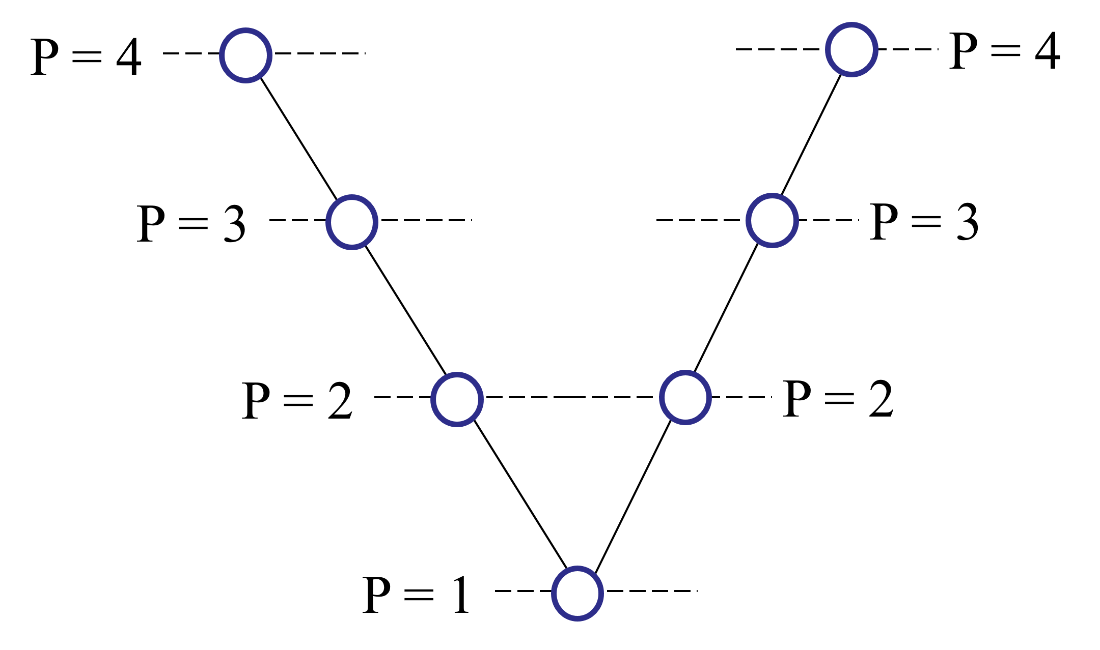
Objective
Goal: Development of a solution algorithm which is able to deliver h and p independent convergence rates and minimizes the cost of each iteration.
Strategy: Using a non-linear p-Multigrid method with a robust and scalable CGC* at the coarsest level.
Effective smoothers at fine levels
Preconditioned NK with PTC**
Scalable Preconditioners:
Implicit line relaxation methods
AMG (Algebraic Multigrid)
* Coarse Grid Corrector
** Pseudo Transient Continuation
5

Slide 3
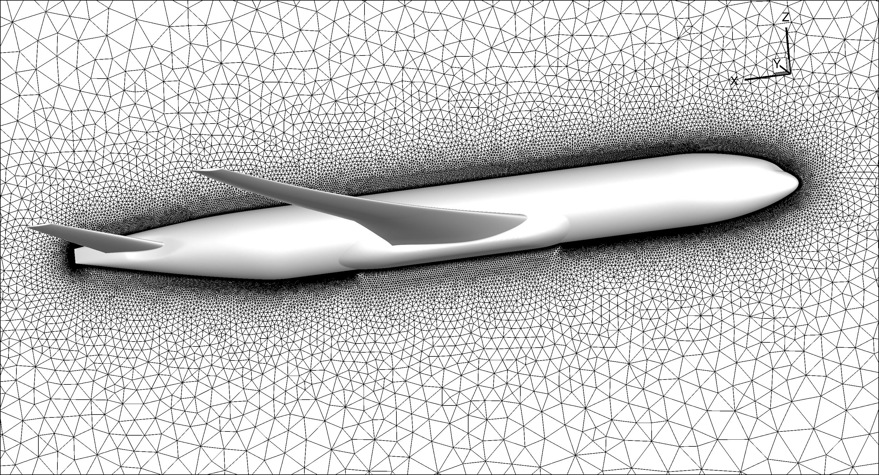
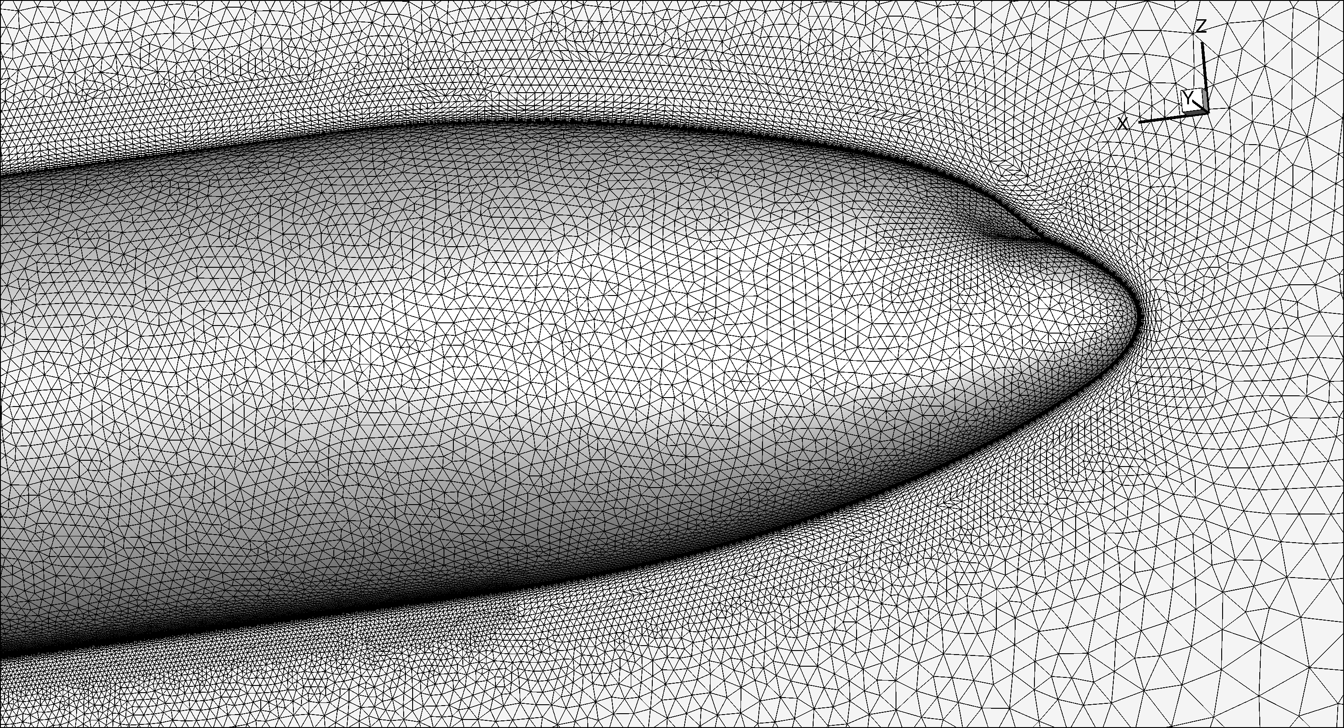
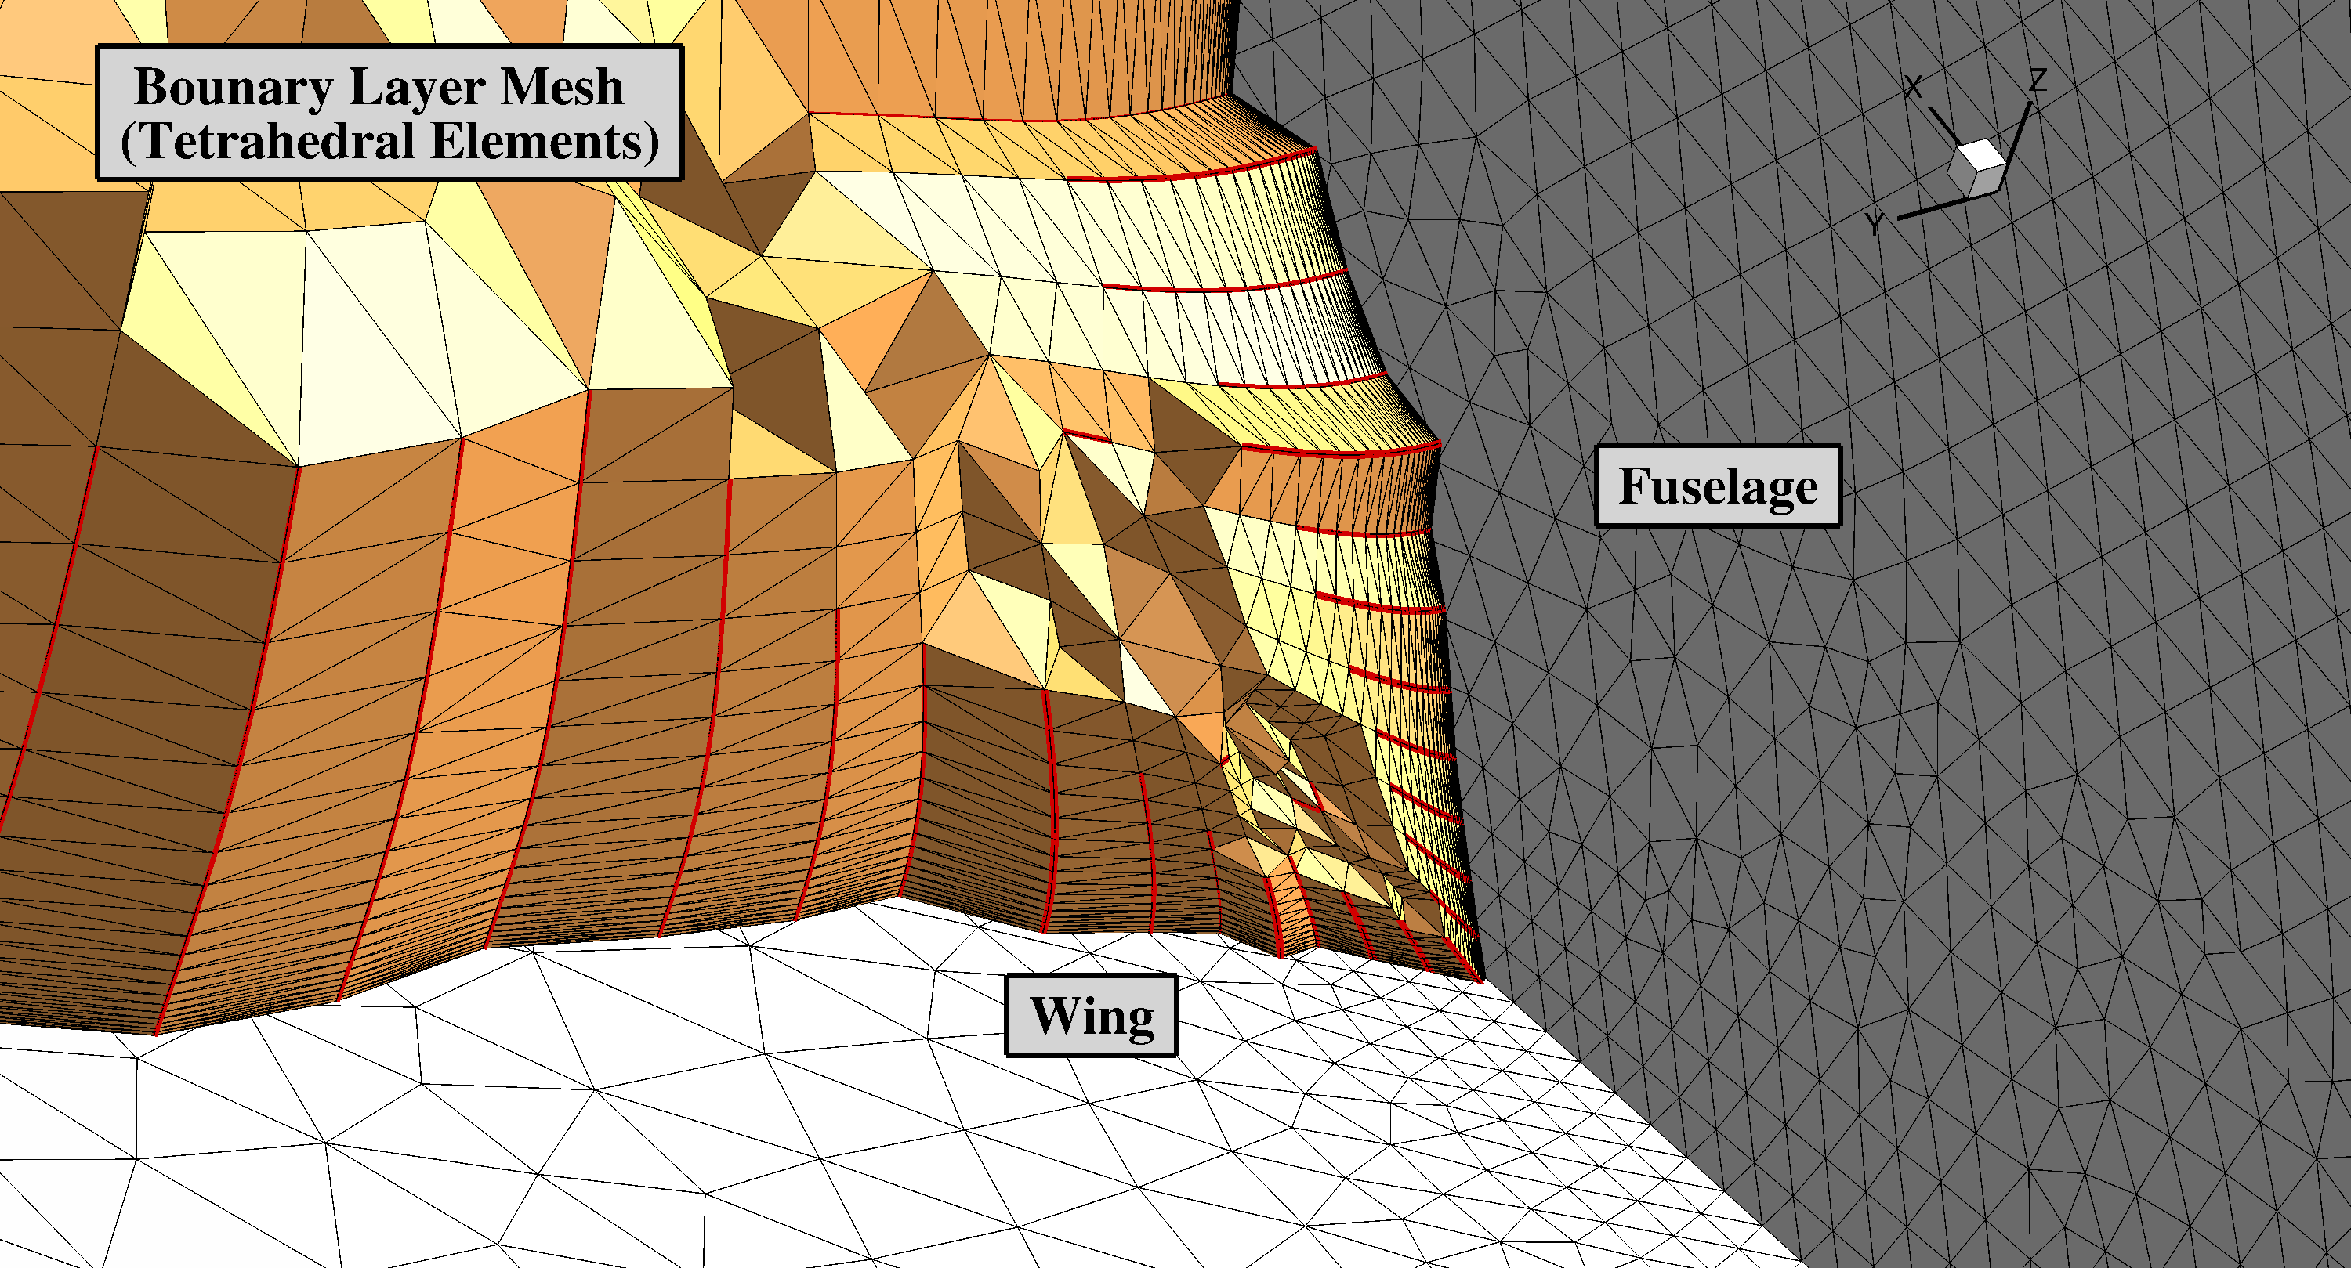
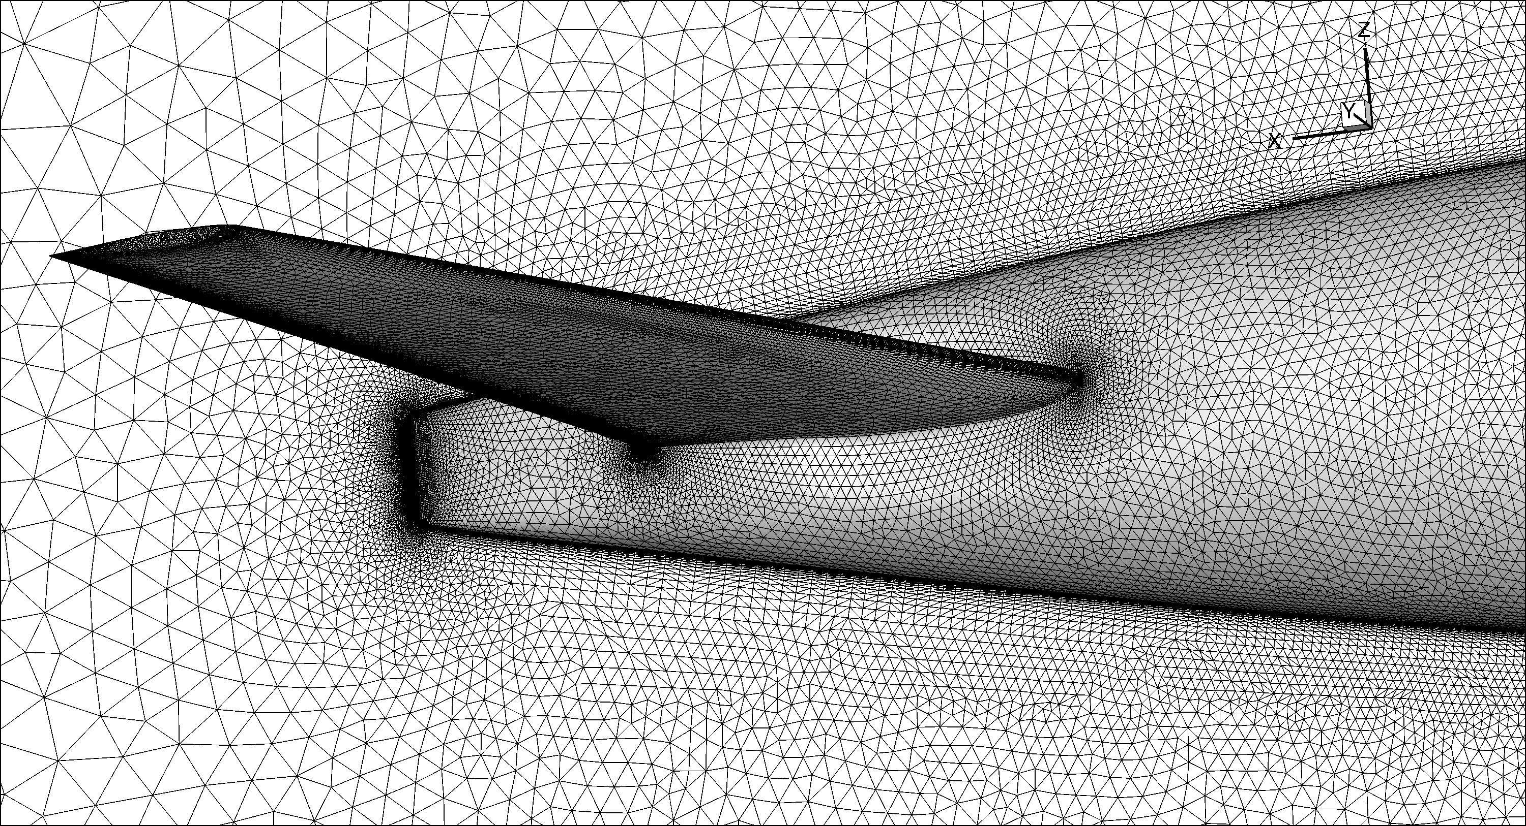
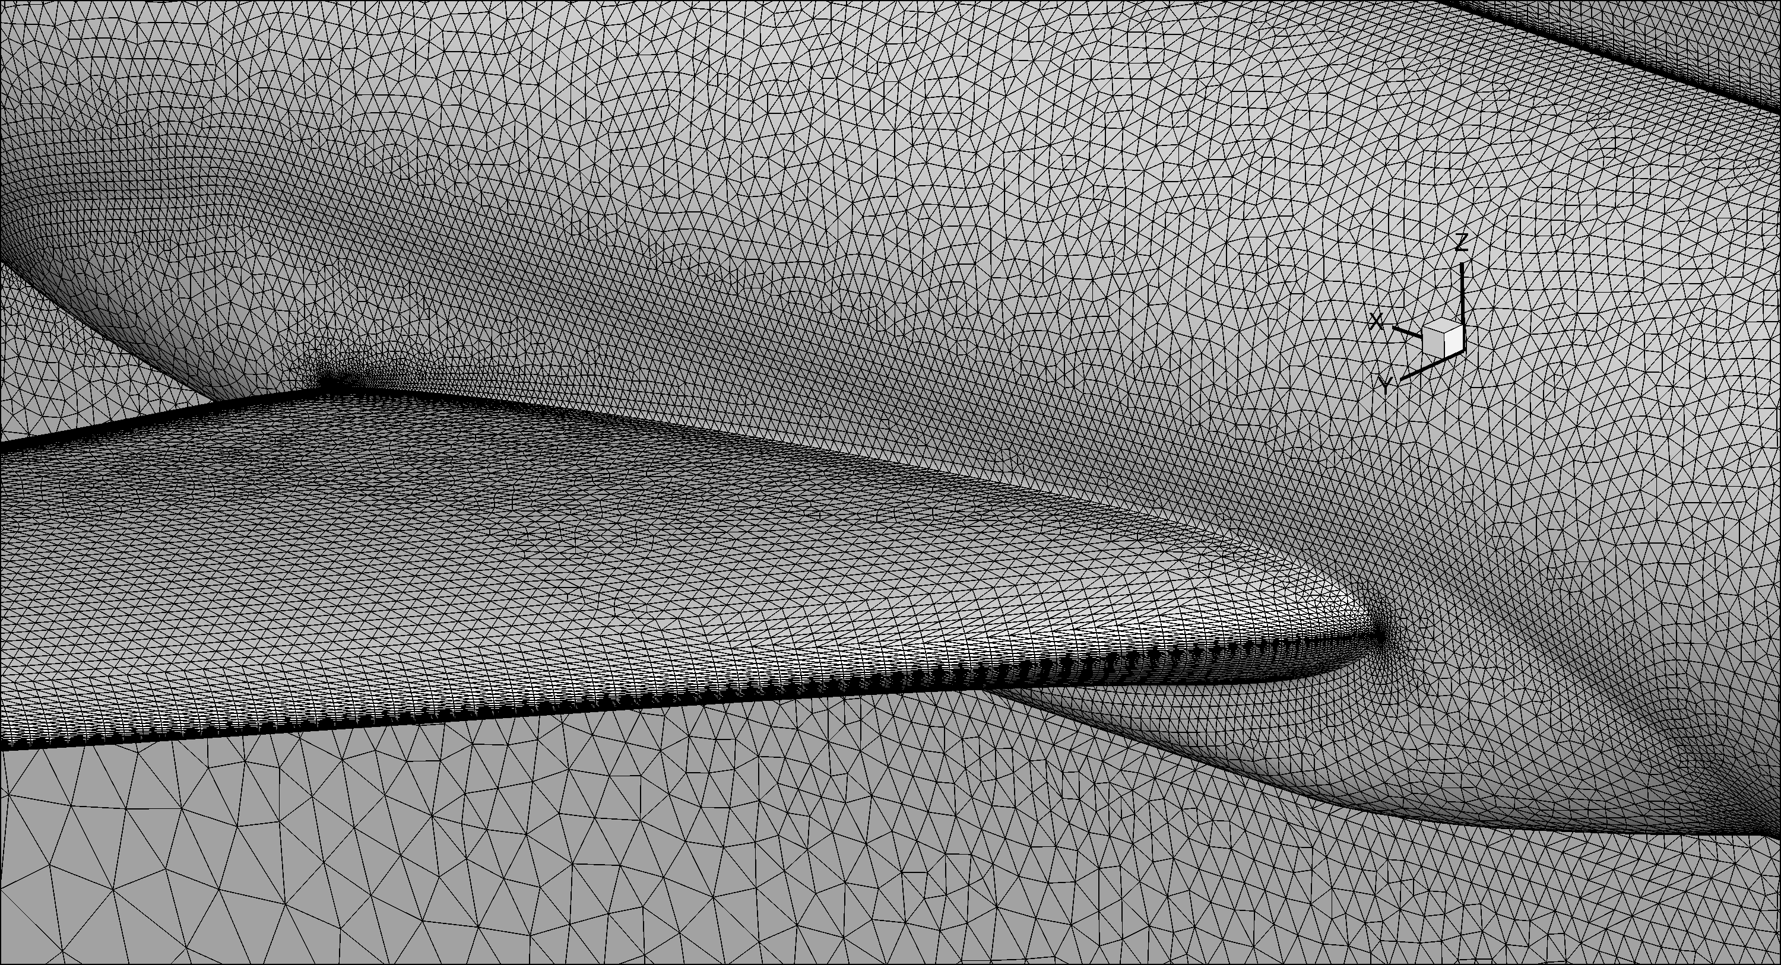
Transonic Turbulent Flow over DPW-4 Geometry
Computational Mesh
Boundary Layer Mesh (Tetrahedral Elements)
Fuselage
Wing
17

Slide 4
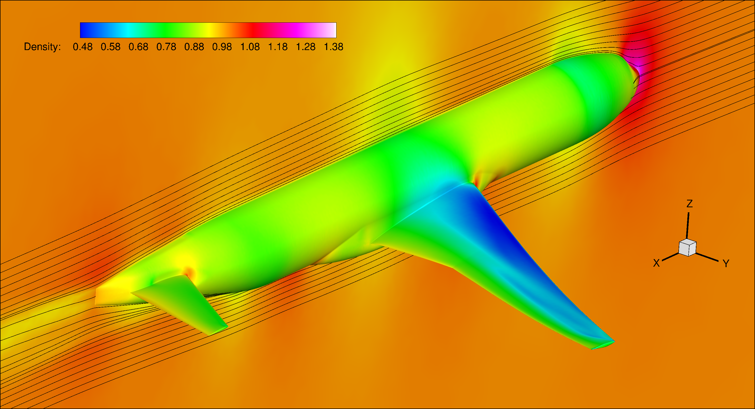
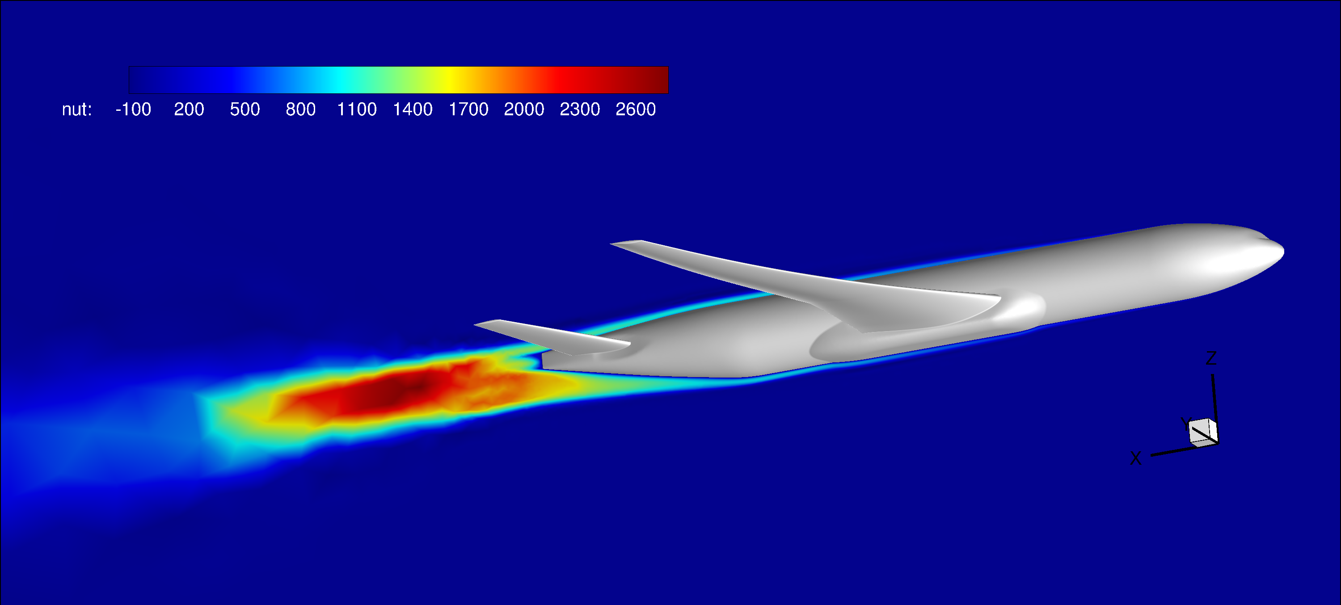
Transonic Turbulent Flow over DPW-4 Geometry
Contour of Density and Turbulence Working Variable
19

Slide 5
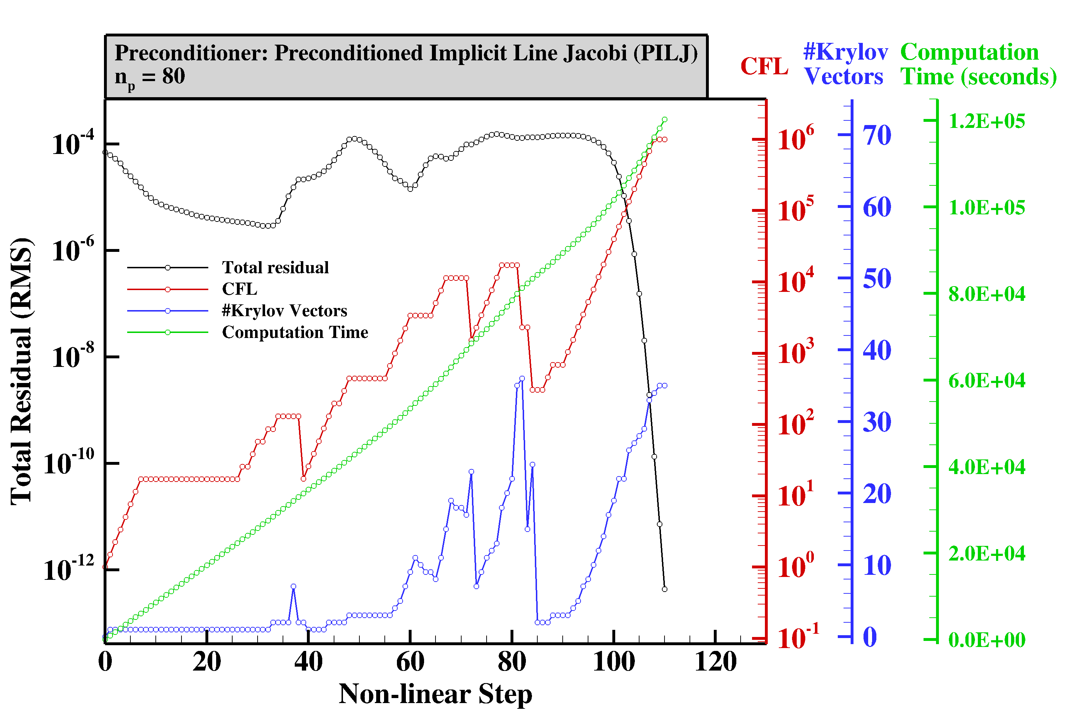
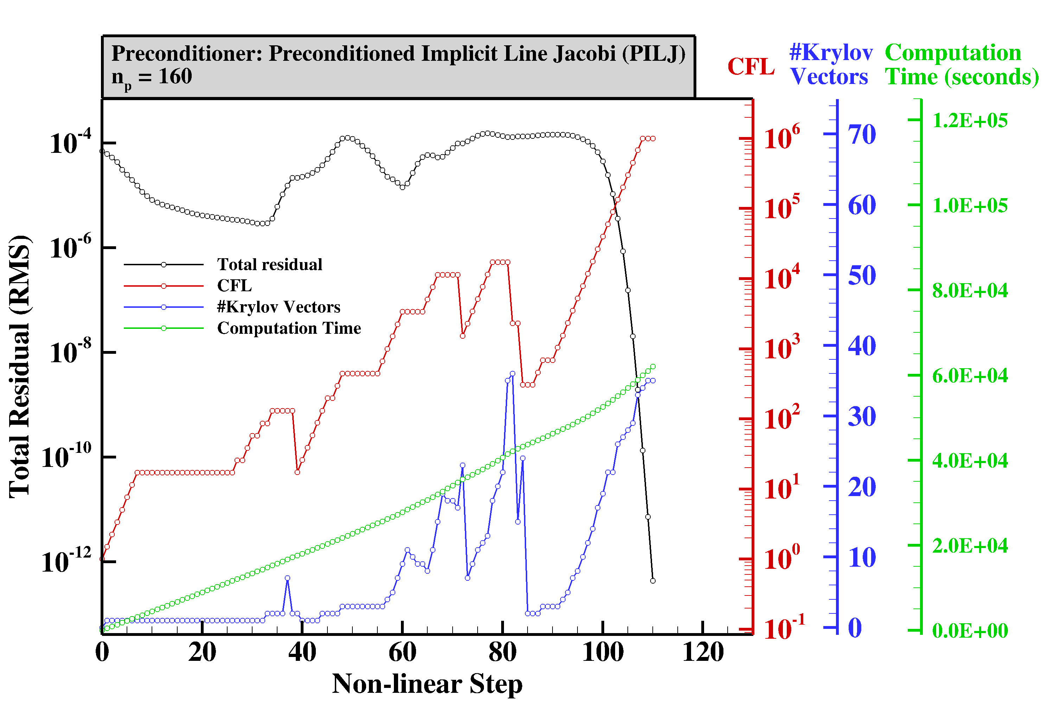
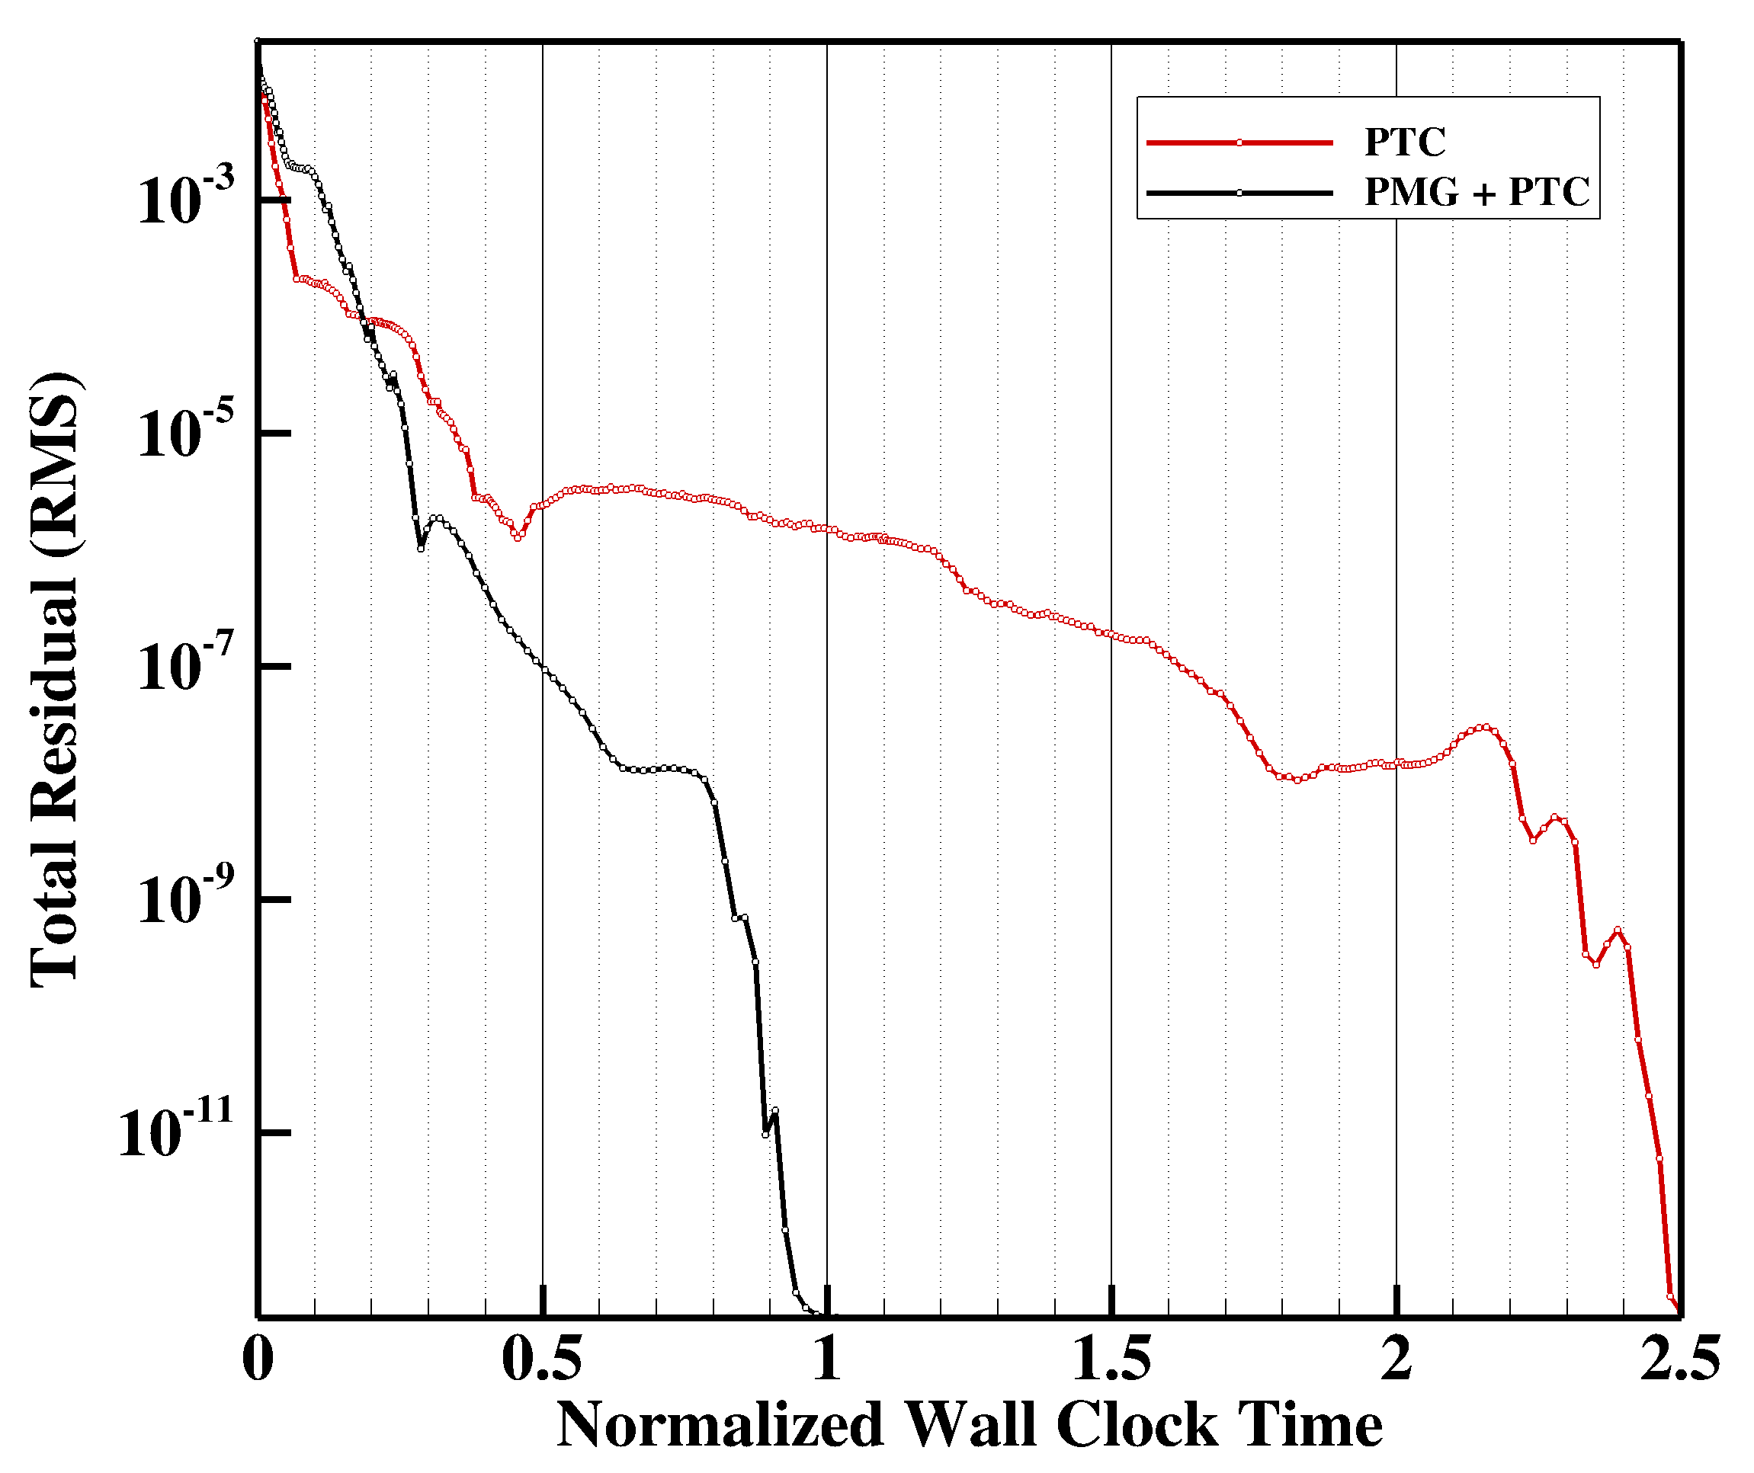
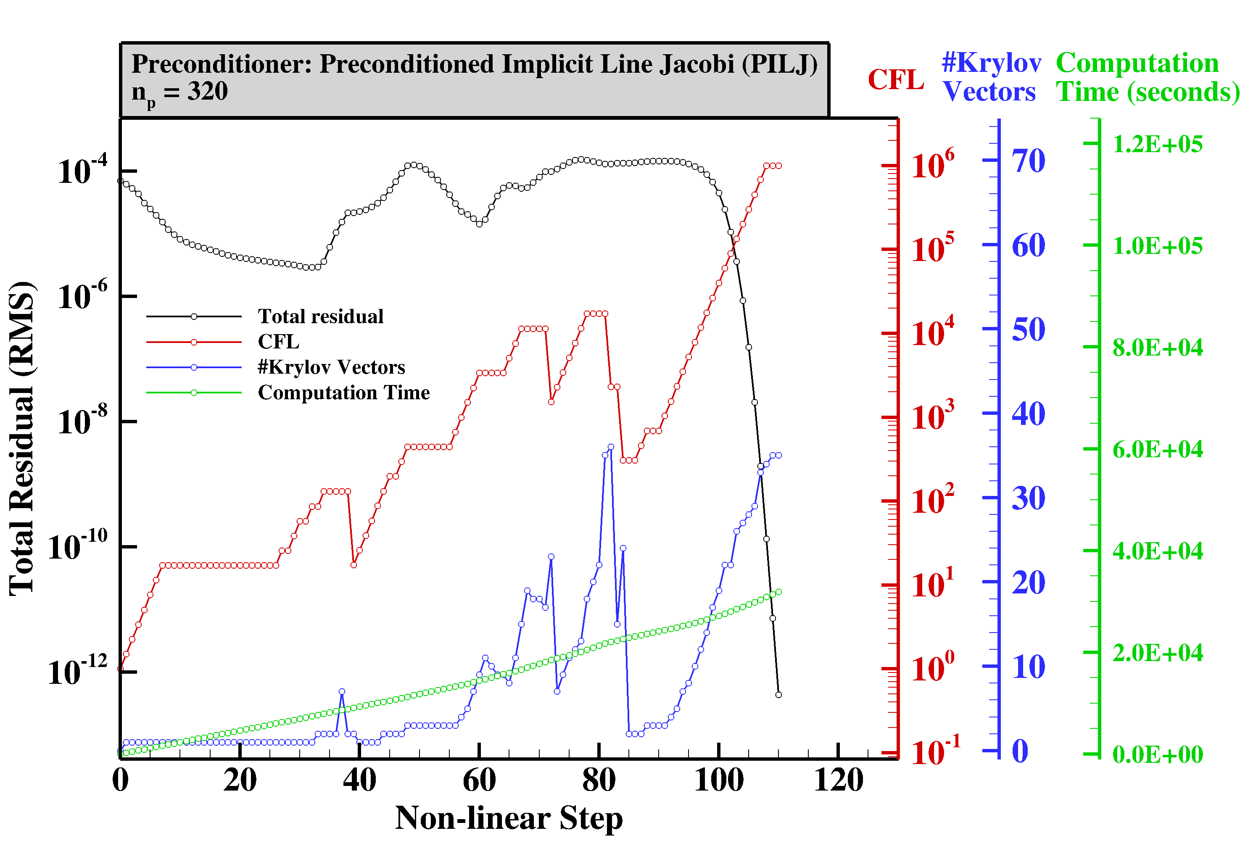
Transonic Turbulent Flow over DPW-4 Geometry
Convergence Histories
21

Slide 6
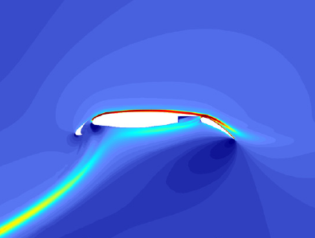
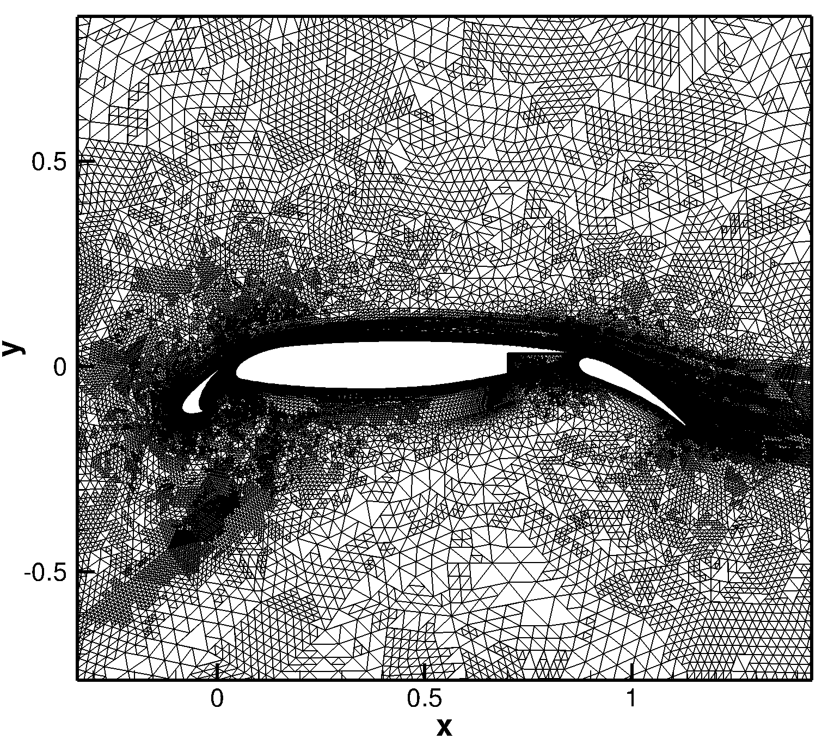
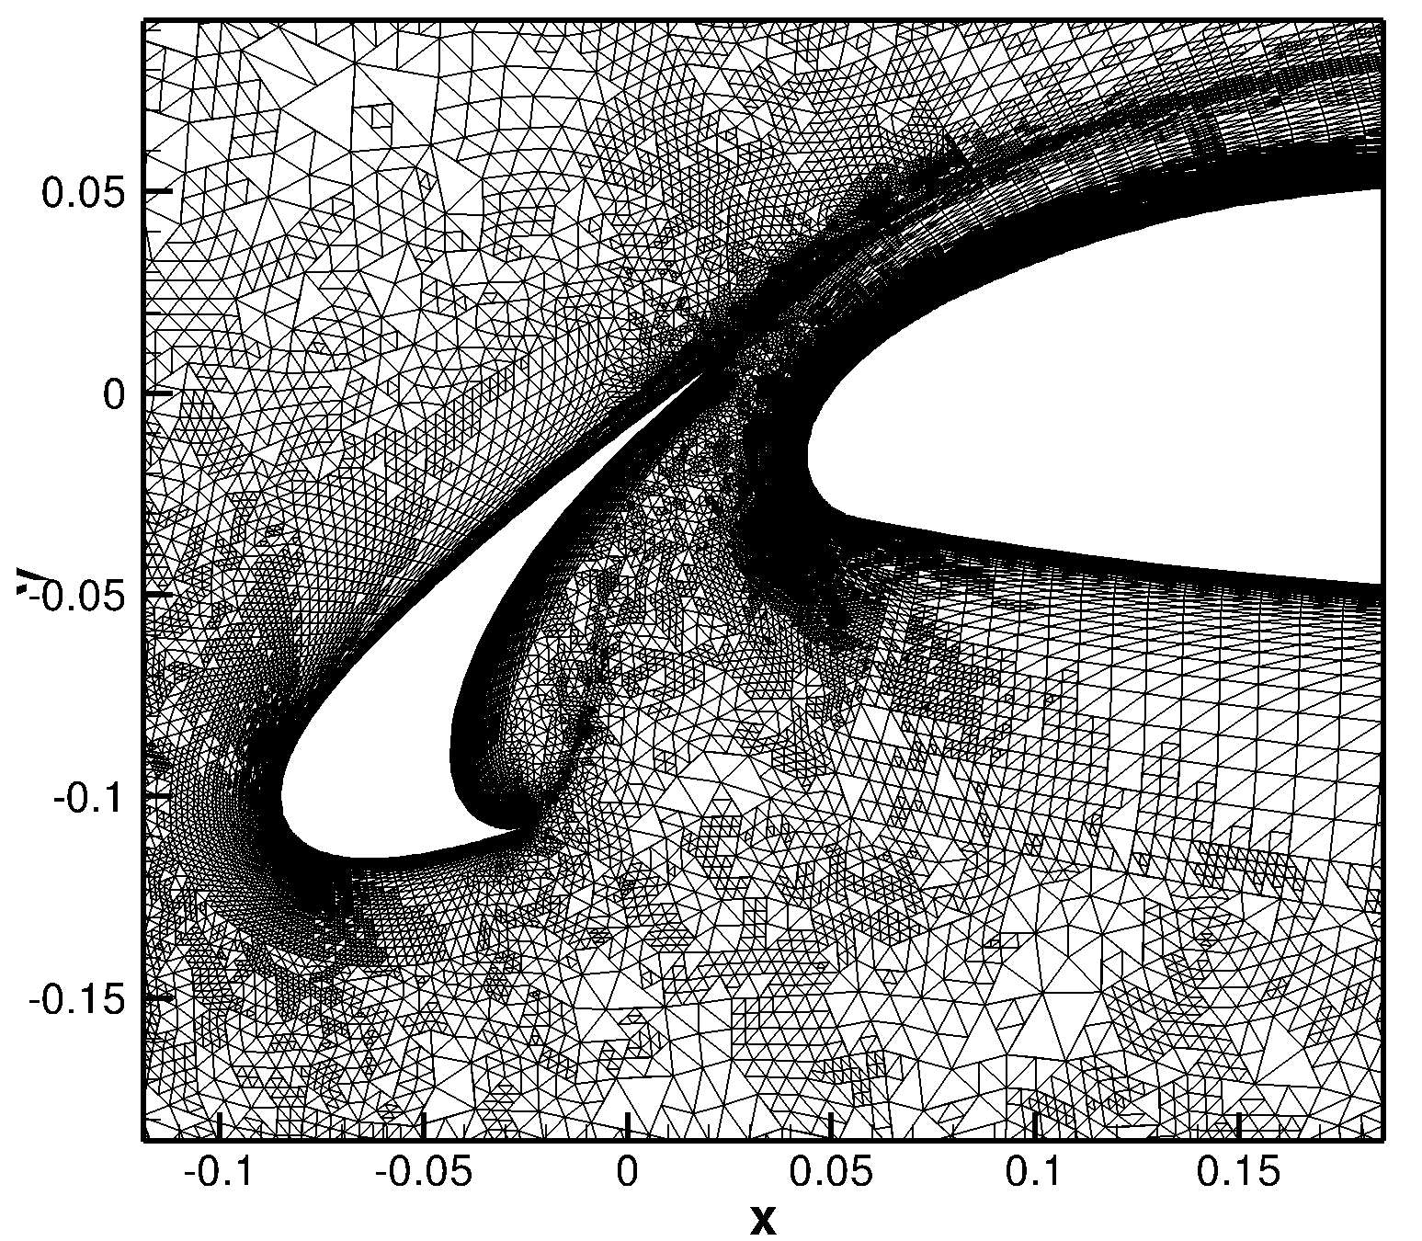
Adaptive Mesh Refinement
21

