Slide 1
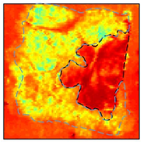
Visualization of Terahertz Interaction with Breast Cancer Tissue using High performance Computing
Amir Shariffar, Magda El-Shenawee Department of Electrical Engineering, University of Arkansas, Fayetteville, AR
International HPC Summer School 2017
Boulder, Colorado
25-30 June 2017
Background and Motivation
In 2017s, an estimated 250,000 new cases of breast cancer are expected to be diagnosed. A significant challenge in the diagnosis and treatment of this disease is tumor localization. In many cases (20-40%) cancerous cells are left behind after the lumpectomy surgery. Thus, a second surgery is required to remove the remaining cancer, which could be devastating. This research aims at removing the entire tumor in the first surgery while the patient is in the operating room. We will use the new technology of pulsed terahertz to image the margins of excised breast tumors. Current results show that terahertz imaging is capable of distinguishing between cancerous and healthy tissues.
In the proposed project, a three dimensional computational electromagnetic model will be developed to simulate the interactions between the terahertz signals and breast tumor tissues. The computational resources required to achieve this goal could be prohibitive. We propose to implement a parallelized version of the finite difference time domain method using the graphics processing units (GPUs) clusters. The visualization of the transmitted and reflected terahertz signals from the excised breast tumor will help us understand the way this wave interacts with the tissues, leading to significant advancement in tumor margin assessment.
Negative margin
Positive margin
tissue
tissue
margin
margin
cancer cells
cancer cells
THz Image of a positive margin tissue
Healthy tissue
T. Bowman, M. El-Shenawee, and L.K. Cambell, “Terahertz transmission vs reflection imaging and model-based characterization for excised breast carcinomas” Biomed. Opt. Express vol. 7, no. 9, pp. 3756-3783, 2016.
cancer cells

Slide 2
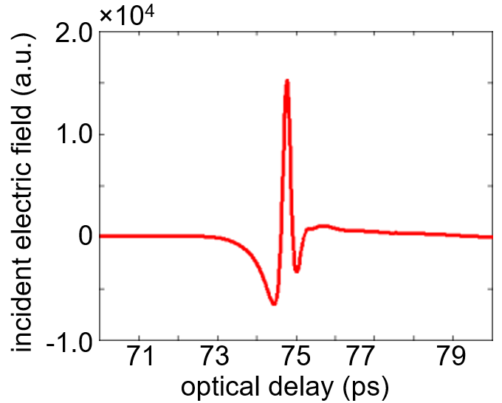
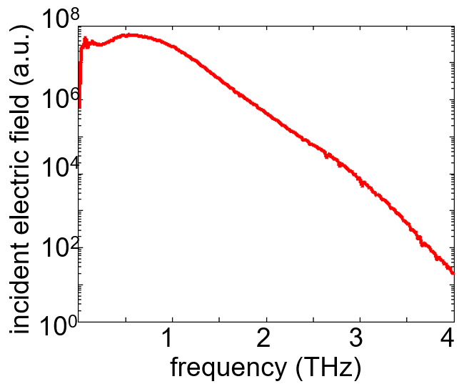
Microwaves
Terahertz gap
Infrared
Ultraviolet
X-ray
Radiowaves
Gamma rays
300 MHz
1 m
3 GHz
10 cm
30 GHz
1 cm
300 GHz
1 mm
3 THz
100 um
30 THz
10 um
300 THz
1 um
3 PHz
100 nm
30 PHz
10 nm
300 PHz
1 nm
3 EHz
100 pm
30 EHz
10 pm
300 EHz
1 pm
THz Imaging
The electromagnetic spectrum in the range of 100 GHz (wavelength of 3 mm) to 10 THz (wavelength of 30μm) is named the region of THz, which is between millimeter and infrared frequencies. Terahertz (THz) imaging has proven effectiveness in distinguishing between cancer and the non-cancer tissue. Thus THz technology is proposed for breast cancer margin assessment during lumpectomy operations, where surgically excised tissue must be examined to determine if cancer is present on the surgical edge (positive margin) or absent (negative margin). THz has many properties that make it well-suited for biological applications:
THz signal
Strong interaction with water content in tissue
Improved resolution over microwave imaging (300 μm at 1 THz)
Deeper penetration into fat and skin tissue than optical/infrared imaging
Biologically safe due to low signal power and non-ionizing radiation
Tyler Bowman, Narasimhan Rajaram, Keith Bailey, Magda El-Shenawee. Terahertz Pulsed Imaging of Freshly Excised Xenograft Breast Cancer Tumors in Mice. Poster session presented at: Arkansas Academy of Sciences 101st Annual Meeting; 7-8 April 2017 Conway, AR.

Slide 3
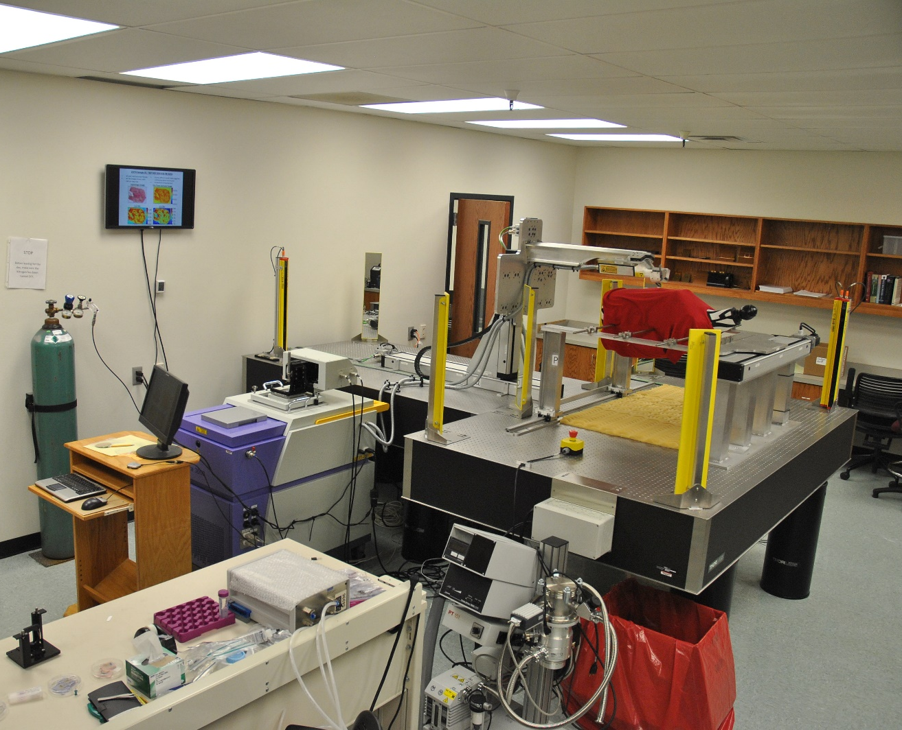
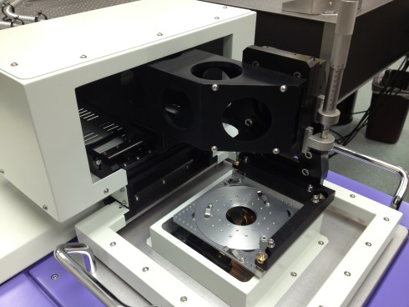
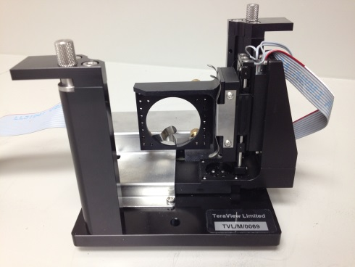
Terahertz Imaging and Spectroscopy Lab at University of Arkansas
Reflection Module
Transmission Module
Emitter Receiver
THz core system
Spectroscopy & imaging
up to 2.5cmx2.5cm
Sample holder
50 μm resolution
Dynamic Range: ~70 dB
Ti:Sapphire
fs laser (800 nm)
THz emitter
THz radiation
Sample mounted on movable stage
Frequency range: 0.06 to 4 THz
Pulse width: <500 fs
Output power: ~1 μW
Optical delay
THz receiver
TPS Spectra 3000 from Teraview, Ltd., UK
Reflection module
Computer

Slide 4
Maxwell’s equations:
Finite-difference time-domain (FDTD) Iteration Cycle:
E: Electric field
H: Magnetic field
$ε$: Permittivity
$μ$: Permeability
$σ$: Electric conductivity
$ρ$: Magnetic resistivity
Initial Condition
$$\vec{E}= \vec{H}=0$$
$$\frac{∂\vec{H}}{∂t}=\frac{−1}{μ}∇×\vec{E} −\frac{ρ}{μ}\vec{H}$$
$$\frac{∂\vec{E}}{∂t}=\frac{1}{ε}∇×\vec{H} −\frac{σ}{ε}\vec{E}$$
Time steps
Finished
Post-Processing
Finite-Difference Approximation
Not Finished
z
$E_{x}, E_{y}$, $E_{z}$
can be calculated in parallel
$$H_{y}$$
Update E from H
$$\vec{E}← \vec{H}$$
$$E_{z}$$
Record Data
$$H_{x}$$
$$H_{x}$$
$$H_{z}$$
Inject the source to E or H
$$H_{y}$$
$$H_{z}$$
$$E_{y}$$
$$H_{z}$$
$$E_{x}$$
$H_{x}, H_{y}$, $H_{z}$
can be calculated in parallel
Update H from E
$$\vec{H}← \vec{E}$$
$∆$/2
$$H_{x}$$
(i,j,k)
$$H_{y}$$
Loop over time
y
$$Discritized space into cells with size(∆)$$
Show simulation status
A. Taflove, A. Oskooi and S. Johnson, Advances in FDTD computational electrodynamics.
x

Slide 5
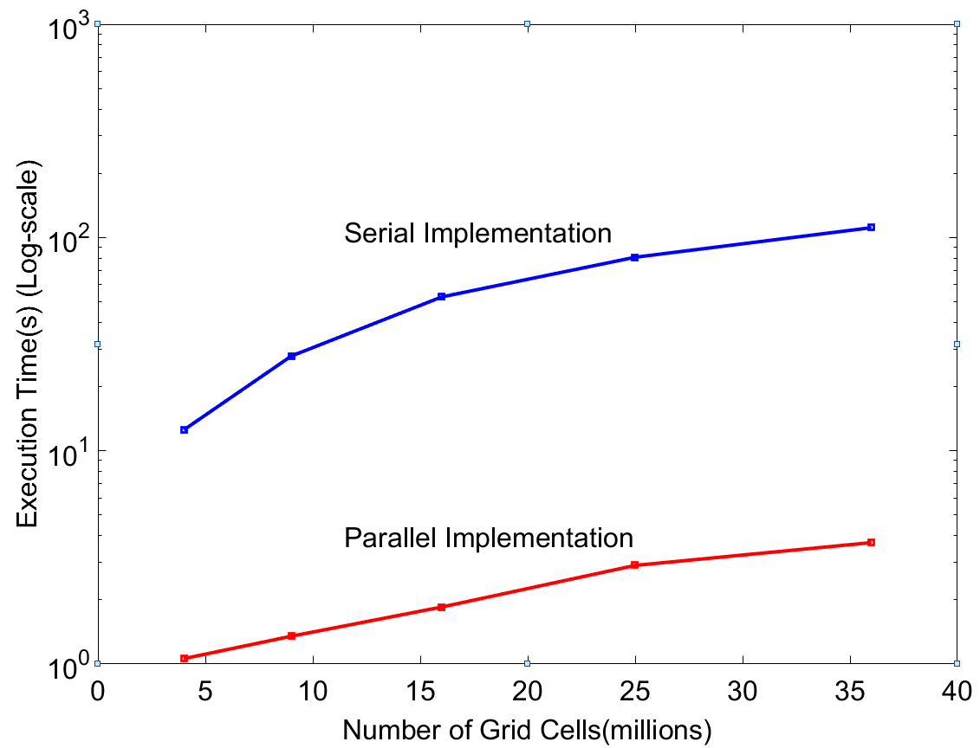
Implementation of a Two-Dimensional FDTD Code in Parallel Using Pthread
Conclusions
The finite-difference time-domain (FDTD) method is a robust tool to solve a various kinds of electromagnetic problems. However, for the optimum operation the FDTD is numerically restricted to the space discretization. FDTD method in nature is suitable for parallelization on available processors. Two dimensional FDTD is parallelized and implemented using pthread which shows great reduction in execution time. In addition, we plan to implement a parallelized version of the FDTD method using the graphics processing units (GPUs) clusters. In this project, supercomputer needs to be used to speed up the 3D-FDTD algorithm in order to investigate the interaction between THz signals and breast tumors.
The computational domain is divided into distinct, non-overlapping regions and assign different processors to update the fields in those regions. This way fields in each of the regions can be updated simultaneously. Every 9 cells calculations run in parallel, 9 threads used in each specific time step.
Parallel vs. Serial Implementation
2D grid is subdivided by each 9 cells
Time Steps (iterations): 200
Magnetic Field (Hx)
Electric Field (Ez)
Magnetic Field (Hy)
Acknowledgments
This work was Funded in part by NSF/ECCS award #1408007 and NIH award R15CA208798. The pulsed THz system was funded by NSF/MRI award #1228958.
In the 2D-FDTD, the field components ( $E_{z}{, H}_{x}, H_{y}$) in each cell can be calculated in parallel and all cells inside the subdomain can also go in parallel.

