Slide 1
Utilizing Visualization and Interactivity to Analyze Scientific Data
Colleen Heinemann

Slide 2
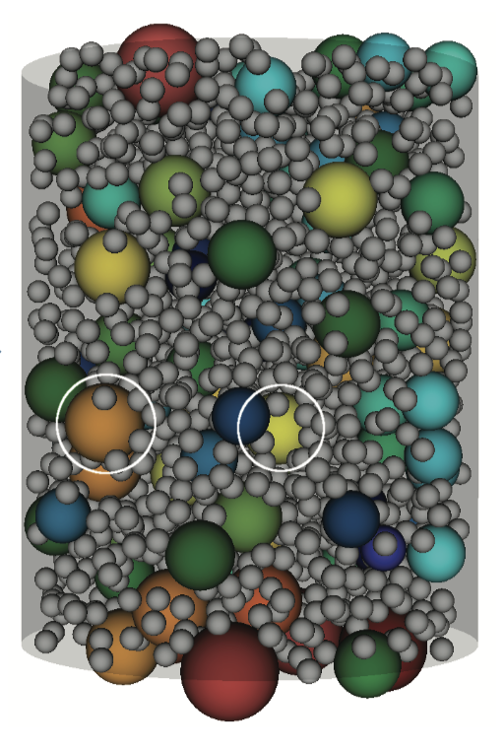
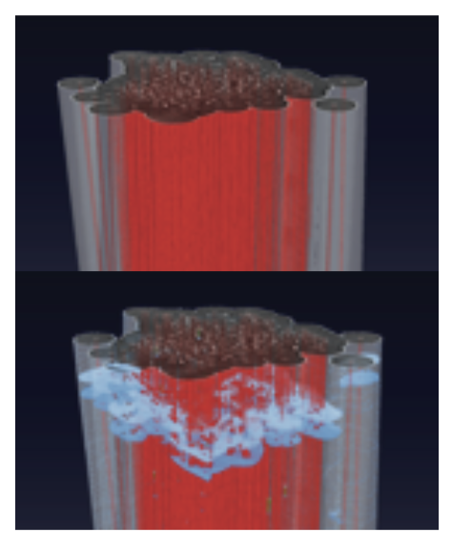
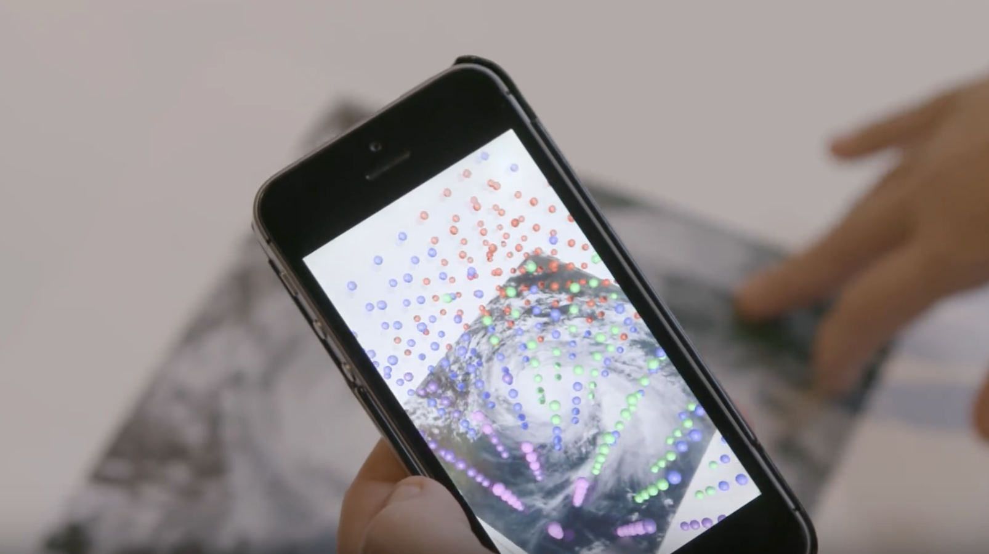
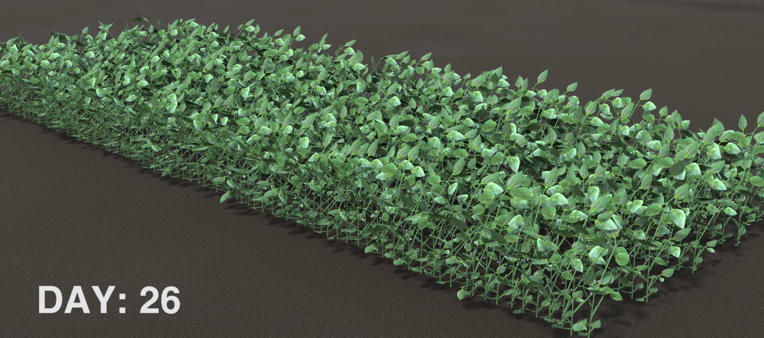
Abstract/Goals
Bridge the gap between 1) running simulations on HPC platforms to 2) visualizing the resulting data and 3) interact with that data through VR and AR
Work with various scientific domains to determine best approach for numerous areas
Analyze bottlenecks of VR and AR to increase performance to run faster and with larger/more complex data

Slide 3
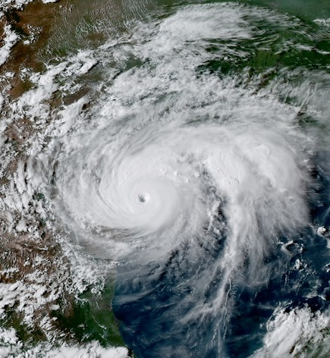
Process
0 1 0 0 1 1 1 1 1 0 0 0 1 1 0 0 1 1 0 1 0 1 1 1 1 0 0 0 1 1 1 1 0 0 1 0 1 0 0 1 0 0 1 1 0 1 1 0 1 1
Step 1
Step 2
Step 3
Step 1: Run scientific simulations with HPC; generate data to be visualized
Step 2: Visualize certain aspects of data from HPC simulations
Step 3: Use methods of interactivity (VR/AR) to allow exploration of additional information

