Slide 1
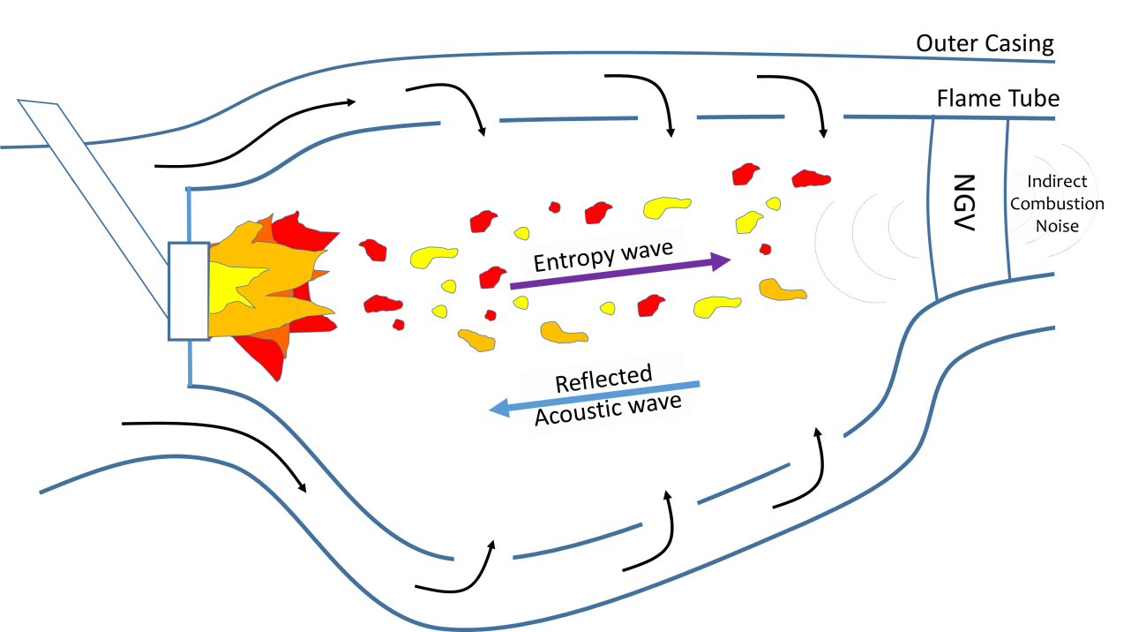
The Prediction of Low Frequency Rumble in Combustion Systems
Danielle Craig 26/06/2017
Low Frequency Rumble is an acoustic instability which occurs in rockets and jet engines capable of producing damage to the hardware of the engine.
Hot spots are emitted due to unsteady heat releases from fuel injectors within the combustion chamber.
These are convected down the combustor and are accelerated creating acoustic waves.
Part of this wave is reflected back into the system, causing further unsteady heat release.
At certain frequencies this can cause an amplification of the acoustic waves creating an instability in the system.

Slide 2
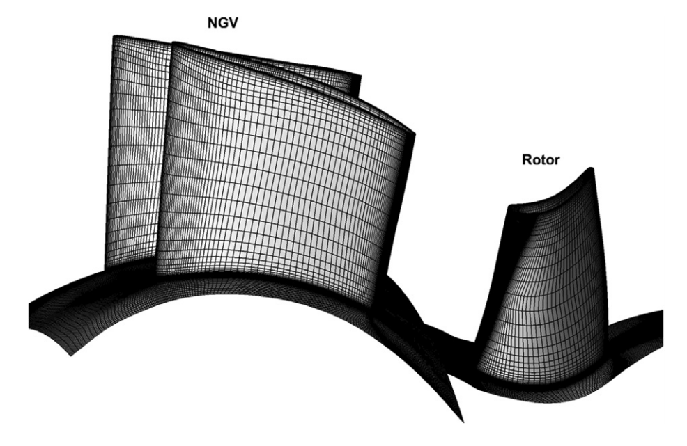
The Prediction of Low Frequency Rumble in Combustion Systems
Danielle Craig 26/06/2017
Low Frequency Rumble is a highly complex phenomena which occurs at extreme temperatures meaning high fidelity experiments are an almost impossible undertaking, therefore Computational Fluid Dynamics is required.
Computational Fluid Dynamics allows the prediction of flow physics by solving sets of partial differential equations.
A mesh is created which is a representation of a geometry made up of a series of nodes.
Calculations take place at these node points.
Billions of calculations are performed for combustion systems and even more are required when capturing acoustics as the mesh needs to be very fine and hence the use of High Performance Computing.
Example Computational Mesh ^{[1]}
[1] - Khanal BB, He LL, Northall JJ, Adami PP. Analysis of Radial Migration of Hot-Streak in Swirling Flow Through High-Pressure Turbine Stage. ASME. J. Turbomach. 2013;135(4):041005-041005-11. doi:10.1115/1.4007505.
Notes:
2000K and

Slide 3
The Prediction of Low Frequency Rumble in Combustion Systems
Danielle Craig 26/06/2017
The Navier Stokes Equations are a set of partial differential equations which describe flow physics usually solved in Computational Fluid Dynamics (CFD) – For combustion extra models are required to calculate the chemistry.
There are three levels of CFD fidelity.
The highest form is known as DNS where every part of the physics is resolved numerically.
The next level down is known as LES this resolves large turbulent structures but uses statistical models for the rest of the turbulent information.
The lowest fidelity simulations are known as RANS, here statistical models are used to model all turbulence within the flow therefore requiring the least computational power.
Reynolds Averaging Navier Stokes (RANS)
Large Eddy Simulations (LES)
Direct Numerical Simulation (DNS)
Notes:
2000K and

Slide 4
The Prediction of Low Frequency Rumble in Combustion Systems
Danielle Craig 26/06/2017
In Computational Fluid Dynamics high speed flows and low speed flows tend to need different calculation methods. To capture Low Frequency Rumble both high and low speed regions need to be observed.
Acoustics within combustion systems require very fine meshes and need compressibility to be taken into account, therefore are very computationally expensive.
Currently at least LES is required to model flame physics with enough accuracy to also capture the acoustics.
With current computational power, calculations can take many months to complete with terabytes of data produced.
Velocity contour
Notes:
2000K and

