Slide 1
Parallel Algebraic Multigrid
Majid Rasouli
University of Utah

Slide 2
Algebraic Multigrid
Multigrid
Algebraic Multigrid
Approximate solution to
a linear system: Au = f
Two phases:
1- Iterative methods
2- Coarse-grid correction

Slide 3
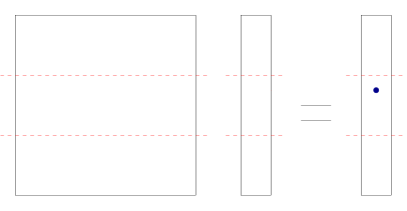
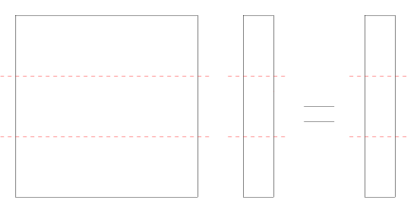
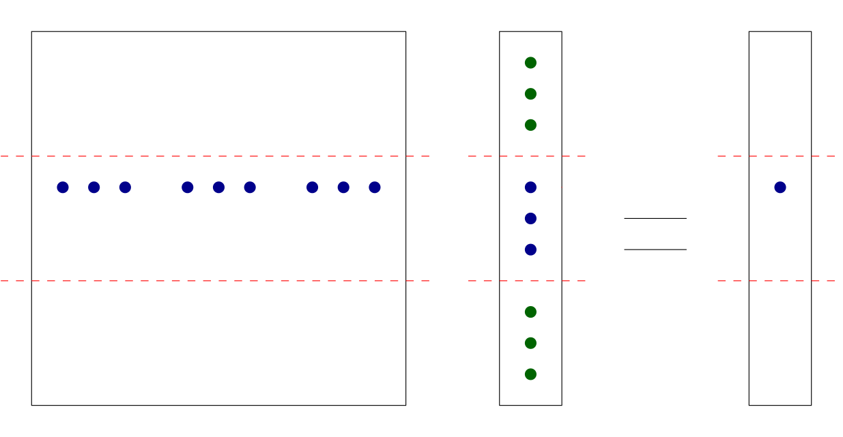
Parallel Matrix-Vector Multiplication
parallel
P1
partition
pass u
P2
A is sparse
P3
A
u
v

Slide 4
Parallel Matrix-Matrix Multiplication
P1
P2
P3
P1
parallel
partition
P2
pass B
P3
A and B
are sparse
A
B
C

