Slide 1
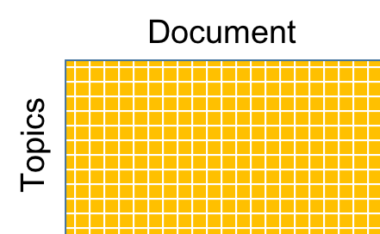
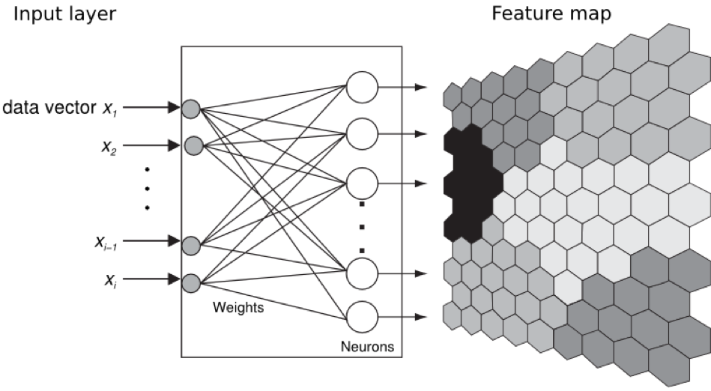
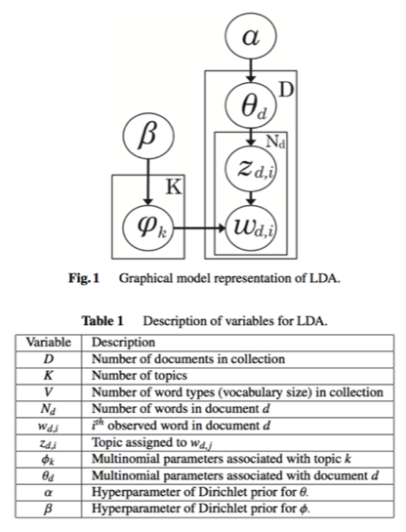
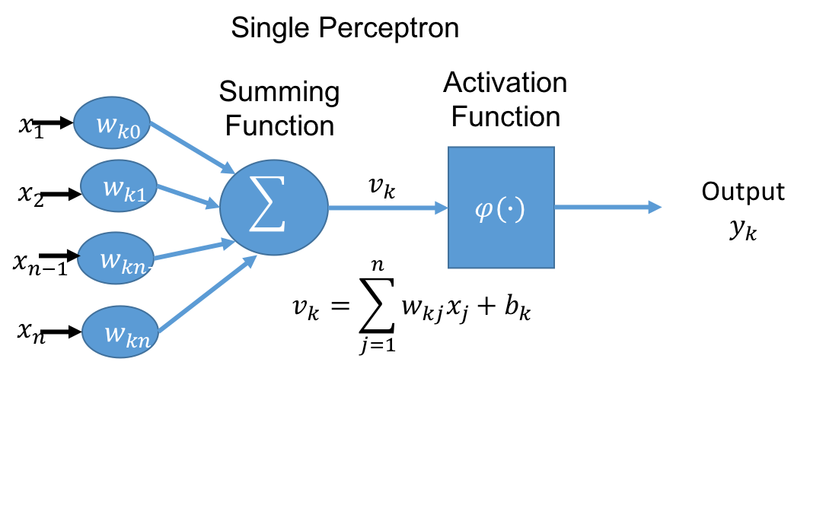
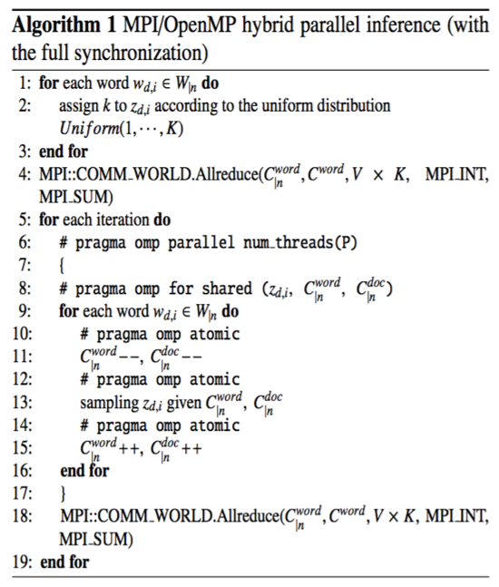
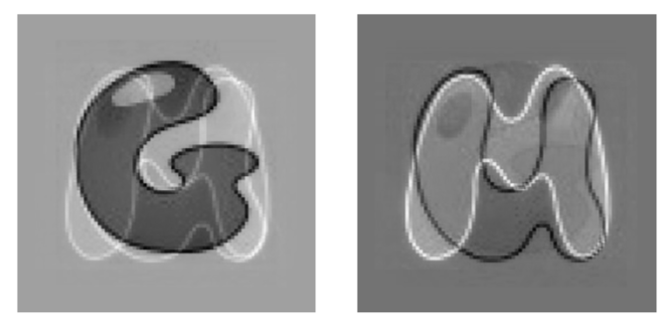
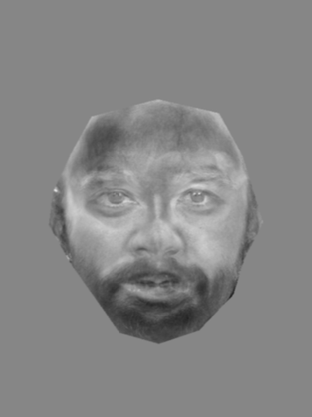
Linking Multi-Domain Data
William Ham
George Mason University
ABSTRACT
MATERIALS & METHODS I
MATERIALS & METHODS II
CONCLUSIONS
Image processing of faces and topic modeling of text are both widely used forms of processing employed in machine learning applications. Facial features can be used to identify faces that look similar or in an ideal case, a specific person, depending on the quality of the image. Topic modeling of text articles is employed across a variety of applications to improve content search from news or research articles, and is also used in a variety of natural language processing applications such as chat bots. The purpose of my research is to identify and validate candidate methods for linking textual articles and images they contain for assessing previously unseen images and/or articles. This requires that I transform both target data types (images and articles) into their respective n-dimensional spaces. I will use both convolutional neural nets (CNNs) and self-organizing maps (SOM) to help me encode the different instances (image, article) and store them for indexing. Data size and computational intensity require HPC for this to be successful. My research also explores identification of a common n-dimensional functional space where vectorized images and text can exist together, enabling classification of new articles and images based on the trained article and image pairs.
Text Processing
Bag of words
(tdf – idf doc-term matrix)
Image processing
Eigen-images
Eigen-faces
MPI + OpenMP
Neural Networks
Self Organizing Map
Created by Tuovo Kohonen in 1980, this neural network is biologically inspired. It leverages that areas in the brain are topologically focused on specific sensor processing. Clustered neighbors have local significance.
The SOM transforms a continuous signal pattern of arbitrary dimension into a 1D or 2D discrete map.
Employing High Performance Computing
MPI + OpenMP
In Progress
Bag of words is a representation of text that describes the occurrence of words within a document. The bag is constructed from selecting which words will represent the document they appear in. Then the documents are scored based on the words they contain using the tf-idf algorithm. One artifact generated in this process is the document term matrix show here;
REFERENCES
Aggarwal, Charu C., and Peixiang Zhao. "Towards graphical models for text processing." Knowledge and Information Systems 36.1 (2012): 1-21.
Blei, David M., Andrew Y. Ng, and Michael I. Jordan. "Latent dirichlet allocation." Journal of machine Learning research 3.Jan (2003): 993-1022.
Rose, Brandon. Document Clustering with Python. N.p., n.d. Web. 4 March 2017.
Chen, Edwin. "Introduction to Latent Dirichlet Allocation." Edwin Chens Blog Atom. N.p., n.d. Web. 16 May 2017.
Hastie, Trevor, Robert Tibshirani, and Jerome H. Friedman. The elements of statistical learning data mining, inference, and prediction. New York, NY: Springer, 2016. Print.
Haykin, Simon S. Neural networks and learning machines. New Dehli: PHI Learning, 2011. Print.
Kohonen, T. (1982). Self-organized formation of topologically correct feature maps. Biological Cybernetics, 43:59-69.
Kohonen T. (1984). Self-Organization and Associative Memory. Springer, Berlin.
Kohonen, T. (2001). Self-Organizing Maps. Third, extended edition. Springer.
Python NLP - NLTK and scikit-learn. N.p., n.d. Web. 04 March 2017.
"Natural Language Toolkit" Natural Language Toolkit — NLTK 3.0 documentation. N.p., n.d. Web. 04 March 2017.
“Neural Networks Research Centre." Neural network research Centre: SOM_PAK and LVQ_PAK. N.p., n.d. Web. 04 March 2017.
“Newspaper: Article Scraping & Curation”, Lucas Ou-Yang, 2013 Web. 04 March 2017.
"Self-organizing Maps" Self-organizing Maps — PyMVPA 2.6.0 documentation. Center for Cognitive Neuroscience, n.d. Web. 16 May 2017.
Wehrens, Ron, and Johannes Kruisselbrink. CRAN - Package kohonen. N.p., n.d. Web. 16 May 2017.
LDA Clustering Background
A generative model that explains why groups (documents) of observations (words) are similar (e.g. each document is a mixture of a small number of topics that is described by a limited set of words)
Words are the only observed variables
Topics & documents are latent variables
Each word has a probability depending on its topic
Each document has a topic depending on its words
Distributions learned using Bayesian inference
Gibbs sampling estimation (doc-topic, word-topic)
OBJECTIVES
Leveraging mature processing techniques in a way that enables inferencing from a combination of different data domains.
Text processing to identify metadata regarding the content of the document
Largely solved with natural language processing and toolkits (word 2 vec, LDA, LSI)
Image processing to find consistent representations for comparison across multiple documents
Largely solved with image processing algorithms (neural nets, eigen faces)
Representing a knowledgebase of text content and related images in the same space or mapping for inference queries.
Identify a space in which both images and text can be represented, distances measured between dissimilar groups, and decisions made for adding to the knowledgebase
Political figures: POTUS, congress persons, foreign dignitaries
Entertainers: actors/ actresses, singers, news anchors
Sports figures: golf, football, baseball, basketball
Once the knowledge based is constructed queries can be answered such as what areas have the most knowledge and details and which have the least. When new data (text or image) comes in, a determination can be that this information is redundant or that it is new and desirable to add to the knowledgebase.
Achieving the knowledge base will require:
Metrics for the space to assess the knowledgebase (distances, density)
Storage requirements for the space
Navigation of the space
Processing requirements (speed, storage) for new information (text, image) to enable meaningful comparison against the knowledge base
Updating the knowledgebase given viral nature of electronic media
Leverage MPI + OpenMP or OpenACC to speed up processing of both documents and images
The LDA processing requires execution of the Gibbs sampling method to estimate the probability distributions for the word and document probabilities. This is a Markov Chain Monte Carlo simulation technique. Samples are taken over many iterations, and the larger the corpus of text documents the longer it takes to reach convergence. The pseudo code for this implementation is on the right.
Additionally, the eigenfaces method will also be appropriate for speedup using MPI + OpenACC since this will employ significant numbers of FFTs and matrix additions of faces.
Similar to Principle Components Analysis (PCA), eigenimages are a weighted linear combination of the training images and the eigenvectors contain the weights.
Example input images and the resulting eigenimage.
By analogy, an eigenface is a weighted linear combination of the training faces employed and the eigenvectors contain the weights. In this example, men with facial hair were used to construct an eigenface of all the male images used that had facial hair.
CONTACT
William Kevin Ham
George Mason University
Department of Computational Science and Informatics
wham2@masonlive.gmu.edu

