Slide 1
Vibrational Properties of Solids: Phonon Lifetimes
Gaurav Kumar
Graduate Research Assistant, Laboratory for Computational Research in Science and Technology
A. James Clark School of Engineering
University of Maryland College Park, USA
PhD Advisor: Dr. Peter W. Chung
ARO Support W911NF-14-1-0330

Slide 2
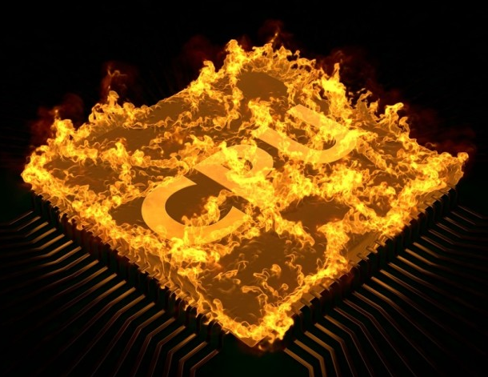
High Performance Atomistic Simulations
Need HPC
Phonons
Heat dissipation
Source: burning cpu by kmls Royalty-free stock illustration ID: 211426045 https://www.shutterstock.com/image-illustration/burning-cpu-211426045?src=RQKvMf0-a0NCONRyZUSb0Q-1-0

Slide 3
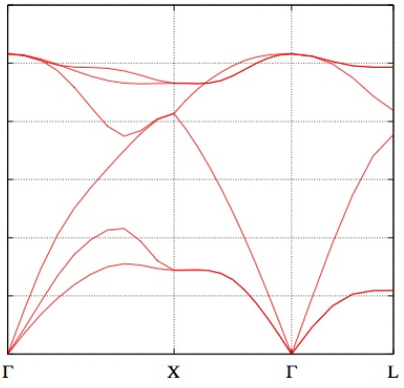
Thermal conductivity $κ=C{ v}_{g}⊗v_{g}τ$
$$Phonon Lifetime τ=\frac{1}{2Γ}$$
$$Specific heat$$
$$C=\frac{dU}{dt}$$
$$\begin{aligned}Phonon Group velocity \\ v_{g}= \frac{∂ω}{∂k}\end{aligned}$$
Gamma $Γ=$ Half width at half maxima of Lorentzian
Fitting Spectral Energy Density
$Φ(κ,ω)$ $=2×Kinetic Energy= \sum_{ν}^{3n}{Coφ }\frac{\frac{Γ_{φ}}{π}}{\text{(}ω_{oφ}−ω)2+Γ_{φ}^{2}}$
$$Internl energy$$
$$U=ℏω\frac{1}{{(e}^{\frac{ℏω}{KT}}−1)}$$
$$Kinetic Energy, \frac{1}{2}\lim_{τ_{o}→∞}{ \frac{1}{τ_{o}}\int_{0}^{τ_{o}}{{\dot{q}}_{φ}\left(t\right) \dot{q_{φ}^{∗}}\left(t\right) dt }}$$
Phonon Normal mode coordinate
$$q_{ϕ}\left(t\right)=\sum_{α,β,l}^{3,n,N}{\sqrt{\frac{m_{β}}{N}}}{ u}_{αβl}\left(t\right){ e}_{φαβ}^{∗} exp⁡(ik.r_{ol})$$
$$k_{y}$$
Frequency
$$y$$
$$u_{αβl}$$
Coordinates
from MD
$${ e}_{φαβ}^{∗}$$
$$Eigenvectors$$
$$from LD$$
$$r_{ol}$$
$$Equilibrium position$$
$$of unit cell$$
$$k_{x}$$
$$x$$
Reciprocal Space
Wave vector
Dispersion
$$r_{ol}$$
$$Equilibrium position vector$$
$$of unit cell$$
Notes:
Each step answers the question “How do I obtain the present step value?”

Slide 4
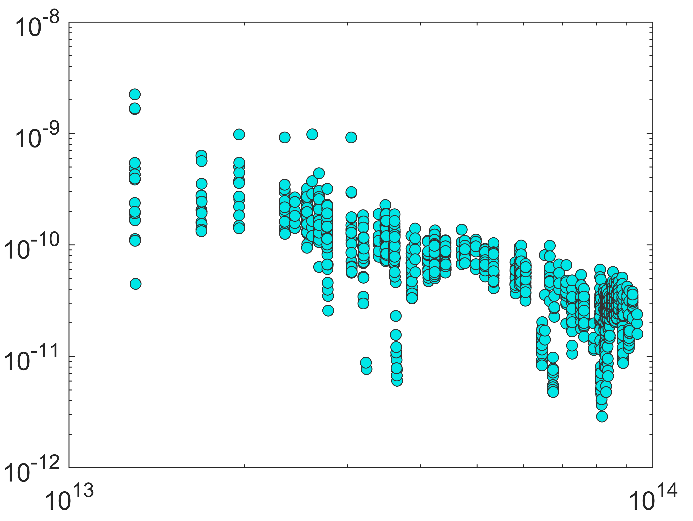
Spectral Energy Density plots for Silicon 6x6x6
Phonon Lifetimes vs Frequency for Silicon 6x6x6
Spectral Energy Density
Relaxation Time (s)
Frequency (rad/s)
Frequency (cm⁻¹)
Notes:
SED for a given phonon mode resembles a Lorentzian function where population of phonons rise, reach maxima at resonance frequency of the mode and then decay
This time difference between excitation and decay of a phonon mode is represented by its relaxation time, and can be calculated as full-width at half-maxima (time difference between fractional phonon population>1/e to <1/e)
The SED data for different phonon modes are fit to Lorentzian curves using least square curve fitting, which requires 4 input parameters.
The goodness of fit has been quantified in terms of rms of residual, and it has been found to be sensitive to the initial value of input parameters
Phonon lifetimes for all modes were plotted against frequency in a loglog plot to observe dependence of lifetimes on mode frequency…

Slide 5
Future Work:
Simulate larger supercells for complex molecular crystals, RDX 10x10x10
Investigate coupling between phonon modes
$$Γ= \left[\begin{matrix}Γ_{φ1φ1} & Γ_{φ2φ1} & ⋯ & Γ_{φ3nφ1} \\ Γ_{φ1φ2} & Γ_{φ2φ2} & ⋯ & Γ_{φ3nφ2} \\ ⋮ & ⋮ & ⋱ & ⋮ \\ Γ_{φ1φ3n} & ⋯ & ⋯ & Γ_{φ3nφ3n}\end{matrix}\right]$$

Slide 6
$κ=\sum_{φ}^{3n}{Cφ vgφ \text{⨂} vgφ τφ}$
$$Phonon modes, M=Κ× V=\left\{φ=\left(k,ν\right)\right| k∈Κ , ν∈V\}$$
$C_{φ}=ℏω\frac{1}{e^{\left(\frac{ℏω}{KT}\right)}−1}$
$$v_{gφ}=\frac{dω}{dk}$$
$$q_{φ}\left(t\right)=\sum_{α,b,l}^{3,n,N}{\sqrt{\frac{m_{b}}{N}}}u_{αbl}\left(t\right){{ e}^{∗}}_{φαb}exp⁡(ik.r_{ol})$$
$$\left.{\dot{q}}_{φ}\left(t\right)=\sum_{α,b,l}^{3,n,N}{\sqrt{\frac{m_{b}}{N}}}{\dot{u}}_{αbl}\left(t\right) {e^{∗}}_{φαb}exp{(}ik.r_{ol}\right)$$
$$Spectral Energy Density, Φ\left(k,ω\right)={\left|\frac{1}{\sqrt{2π}}\int_{−∞}^{∞}{{\dot{q}}_{φ}\exp\left(−iωt\right)dt}\right|}^{2}$$
$Φ(κ,ω)$= $\sum_{ν}^{3n}{Coφ }\frac{\frac{Γ_{φ}}{π}}{\text{(}ω_{oφ}−ω)2+Γ_{φ}^{2}}$
$$Coφ=\sum_{j}{\sum_{j′}{[cos⁡(\text{ω}\left(t_{j}−t_{j^{′}}\right) Ajφ Aj^{′}φ\left({k \atop \text{ν}}\right)}\frac{ω_{oφ}\text{2}+Γ_{φ}^{2}}{\text{8}τ\text{o}Γ_{φ}} }$$
$Lorentzian, Φ=\frac{\sqrt{P_{3}}\left[ P_{1} \frac{P_{2}^{2}+P_{3}}{4π}\right]}{{(P}_{2}−{ω)}^{2}+P_{3}}$

