Slide 1

Simplify Your Science with Workflow Tools
Scott Callaghan
scottcal@usc.edu
2021 IHPCSS
July 28, 2021

Slide 2
Overview
What are scientific workflows?
What problems do workflow tools solve?
Overview of available workflow tools
Real-world seismic hazard application (SCEC CyberShake)
  Computational overview
  Challenges and solutions
Ways to simplify your work
Goal: Help you figure out if this would be useful

Slide 3
Scientific Workflows
Formal way to express a scientific calculation
Multiple tasks with dependencies between them
  No limitations on tasks
Capture task parameters, input, output
Workflow process and data are independent
  Often, run same workflow with different data
  Could take the same workflow and run it on different systems
Actually, you use workflows all the time…

Slide 4
Perhaps your workflow is simple…
stage-in
parallel job
post-process
stage-out

Slide 5
…or maybe a bit more complicated…
Job 1
pre-process
Job 2
visualize
publish
Job 3
Job 4

Slide 6
…or maybe just confusing
edit file names
post-process again if it failed
stage-in
stage-out
parallel job
post-process
stage-in that other file
do you still need this job?
job you always forget
job from past post-doc
email your supervisor

Slide 7
Workflow Components
Task executions with dependencies
  Specify a series of tasks to run
  Outputs from one task may be inputs for another
Task scheduling
  Some tasks may be able to run in parallel with other tasks
File management
  Inputs must be present for tasks to run
Metadata
  Track when a task was run, key parameters
Resource provisioning (getting processors)
  Computational resources are needed to run jobs

Slide 8
What do we need help with?
Task executions with dependencies
  What if something fails in the middle?
  Dependencies may be complex
Task scheduling
  Minimize execution time while preserving dependencies
File management
  Make sure inputs are available for tasks
Metadata
  Automatically capture and track
Matching jobs to processors (across multiple systems?)

Slide 9
Workflow tools can help!
Automate your pipeline
Define your workflow via programming or GUI
Run workflow on local or remote system
Can support all kinds of workflows
Use existing code (no changes)
Provide many kinds of fancy features and capabilities
  Flexible, but can be complex
Will discuss one set of tools (Pegasus) as example, but concepts are shared

Slide 10
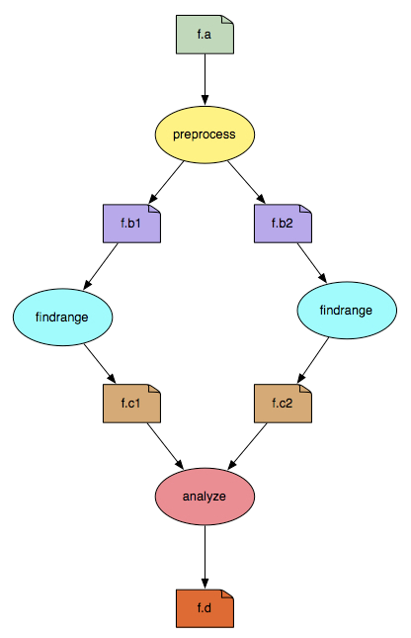
Pegasus-WMS
Developed at USC’s Information Sciences Institute
Used in many science domains, including LIGO project
Workflows are executed from local machine
  Jobs can run on local machine or on distributed resources
You use API to write code describing workflow (“create”)
  Python (recommended), Java, or R
  Define tasks with parent / child relationships
  Describe files and their roles
Pegasus creates XML file of workflow called a “DAX”
Workflow represented by directed acyclic graph

Slide 11
Sample Workflow Creation
input.txt
//Create DAX object
dax = ADAG("test_dax")
//Define my job
myJob = Job(name=“MyGreatJob")
//Input and output files to my job
inputFile = File("input.txt")
outputFile = File("output.txt")
//Arguments to my_job (./my_job input=input.txt output=output.txt)
myJob.addArgument("input=input.txt", "output=output.txt")
//Role of the files for the job
myJob.uses(inputFile, link=Link.INPUT)
myJob.uses(outputFile, link=Link.OUTPUT)
//Add the job to the workflow
dax.addJob(myJob)
//Write to file
fp = open("test.dax", "w")
dax.writeXML(fp)
fp.close()
my_job
output.txt

Slide 12
Getting ready to run
DAX is “abstract workflow” – system-independent
  Logical filenames and executables
  Algorithm description
Use Pegasus to prepare workflow for execution (“plan”)
  Uses catalogs to resolve logical names, compute info
  Pegasus automatically augments workflow
    Staging jobs (if needed) using scp, wget, Globus, Docker Hub, Amazon S3, …
    Registers output files in a catalog to find later
    Wraps jobs in pegasus-kickstart for detailed statistics
  Generates a DAG
    Top-level workflow description (tasks and dependencies)
    Submission file for each job with specifics for the execution system

Slide 13
Pegasus Workflow Path
Create workflow description
(you write this)
Plan
Run
Jobs Execute
DAX API
Scheduler
(HTCondor)
Abstract workflow (DAX)
Logical names, algorithm
job name=“MyGreatJob”
Concrete workflow (DAG)
Physical paths, job scripts
executable=/path/to/directory/my_job

Slide 14
Other tools in stack
HTCondor (University of Wisconsin Madison)
  Pegasus submits workflow to HTCondor (“run”)
  Supervises runtime execution of DAG files
    Maintains job queue
    Monitors dependencies
    Schedules jobs
    Retries failures
    Writes checkpoint
Tools for remote job submission to clusters and clouds
  SSH, BOSCO, CREAMCE, glideins/pilot jobs, …
  Condor uses these tools to match jobs to resources

Slide 15
Full workflow stack
Local machine
Remote machine
What you do:
Create workflow description
Remote scheduler
What the tools do:
HTCondor
Pegasus
SSH,
etc.
local queue
remote queue
DAG

Slide 16
Other Workflow Tools
Regardless of the tool, same basic elements
  Describe your high-level workflow (Pegasus “Create”)
  Prepare your workflow for the execution environment (Pegasus “Plan”)
  Schedule and run your workflow (HTCondor)
  Send jobs to remote resources (SSH, pilot jobs)
  Monitor the execution of the jobs (HTCondor DAGMan)
Brief overview of some other available tools
  All support large-scale workflows

Slide 17
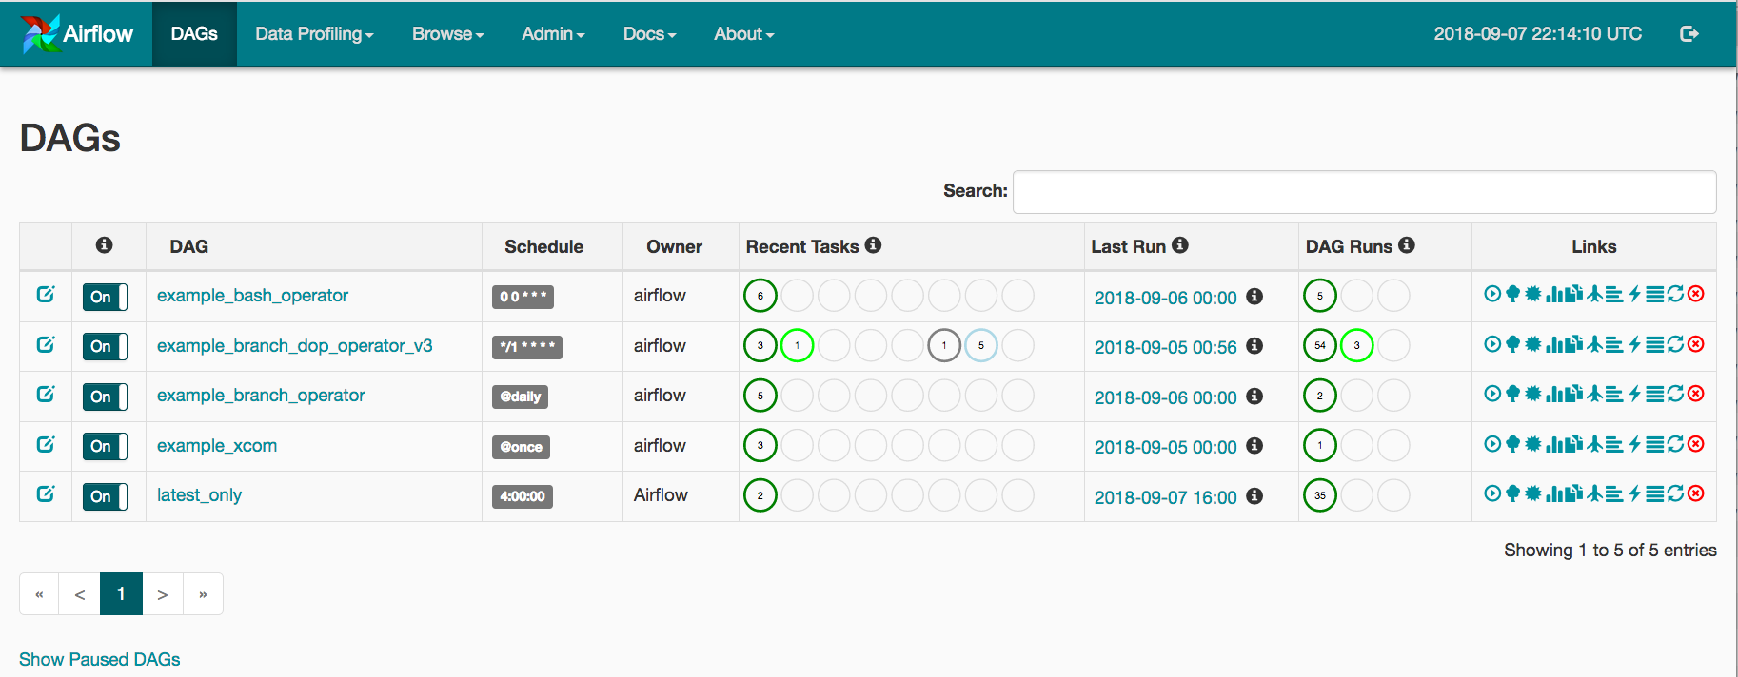
Other Workflow Tools
Parsl (U of Chicago/Argonne NL)
  Parallelize Python by annotating functions or external apps
  Integrated with Jupyter notebooks
  Link outputs and inputs of annotations to describe workflow
  Focus on large data, many tasks
  Airflow (Apache project / Airbnb)
    Workflow defined with Python API
    Description used to write DAGs
    Internal scheduler triggers tasks
    Support for Kubernetes (deploys containers)
    Web UI for getting status
@bash_app
def mysim(stdout=("output/p1.out", "w"),
stderr=("output/p1.err", "w")):
#Call a bash command-line app ‘simulate’
return "app/simulate"
# call the mysim app and wait for the result
mysim().result()
# open the output file and read the result
with open('output/p1.out', 'r') as f:
print(f.read())

Slide 18
Other Workflow Tools
JUBE (Jülich Supercomputing Center)
  Designed for automating benchmarks and testing on multiple systems
  Workflow described via XML files
Makeflow (Notre Dame)
  Makefile-type syntax to specify workflow
    Targets are output files, dependent on input files, with execution string to run
  Can work with Work Queue for management of compute resources (workers)
    Multiple clusters, pilot jobs, dynamic worker pool
Nextflow (Barcelona Centre for Genomic Regulation)
  Uses dataflow paradigm: tasks write/read from channels (not always a file)
  Custom scripting language for defining workflows
Pachyderm (commercial software, free version with limited size/runtime)
  Data-driven: “Git for Data Science”
  Provides data version control and tools for building and running data science workflows
Many more! Ask me about specific use cases

Slide 19
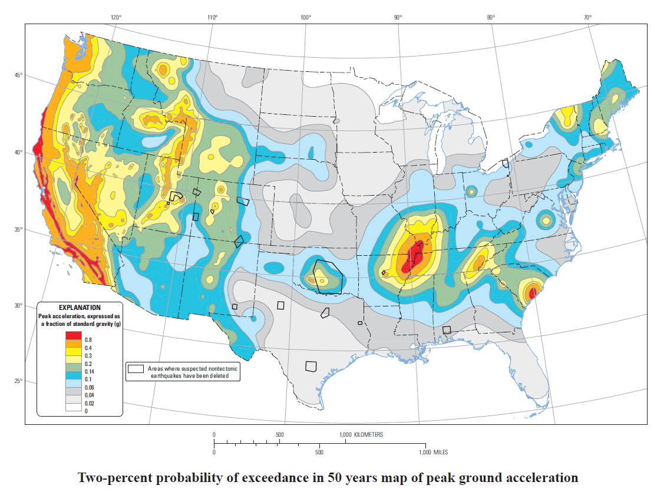
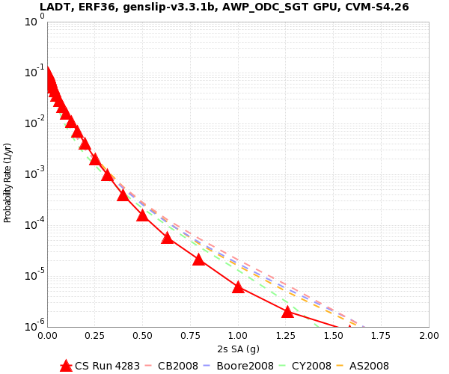
Workflow Application: CyberShake
What will peak earthquake shaking be over the next 50 years?
  Used in building codes, insurance rates, disaster planning
  Answered via Probabilistic Seismic Hazard Analysis (PSHA)
    Get list of all possible earthquakes
    Figure out how much shaking each causes
    Combine shaking levels with probabilities
2% in 50 years
0.4 g

Slide 20
CyberShake Computational Requirements
Determine shaking of ~500,000 earthquakes per site
2 large parallel jobs
  Perform wave propagation
  400 GPUs x 30 min
  1.5 TB total output
500,000 small serial jobs
  Calculate seismograms and shaking measures
  1 core x 4 min
  17 GB total output
Need ~900 sites for hazard map

Slide 21
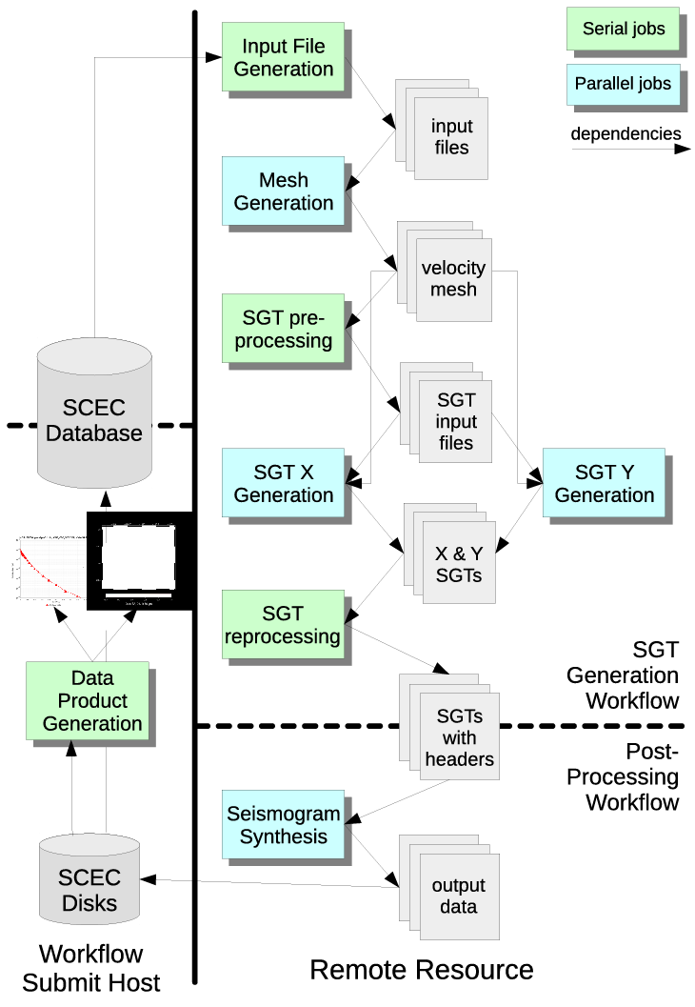
CyberShake Challenges
Automation
  Too much work to run by hand
Data management
  Input files need to be moved to cluster
  Output files transferred back for archiving
Error recovery
  Detect and recover from basic errors automatically
Resource provisioning
  How to execute large numbers of small tasks?
Decided to use scientific workflows
  Selected Pegasus-WMS

Slide 22
Challenge: Resource Provisioning
For large parallel GPU jobs, submit to remote scheduler
  SSH (or other tool) puts jobs in remote queue
  Runs like a normal batch job
  Can specify either CPU or GPU nodes
For small serial jobs, need high throughput
  Putting lots of jobs in the batch queue is ill-advised
    Scheduler isn’t designed for heavy job load
    Scheduler cycle is ~5 minutes
    Policy limits number of job submissions
Solution: Pegasus-mpi-cluster (PMC)

Slide 23
Pegasus-mpi-cluster (PMC)
MPI wrapper around serial or thread-parallel jobs
  Master-worker paradigm
  Preserves dependencies
  HTCondor submits job to multiple nodes, starts PMC
  Specify jobs as usual, Pegasus does wrapping
Uses intelligent scheduling
  Core counts
  Memory requirements
Can combine writes
  Workers write to master, master aggregates to fewer files
Developed for our application

Slide 24
Challenge: Data Management
Millions of data files
  Pegasus provides staging
    Symlinks files if possible, transfers files if needed
    Transfers output back to local archival disk
    Supports running parts of workflows on separate machines
  Cleans up temporary files when no longer needed
  Directory hierarchy to reduce files per directory
We added automated checks to check integrity
  Correct number of files, NaN, zero-value checks, correct size
  Included as new jobs in workflow

Slide 25
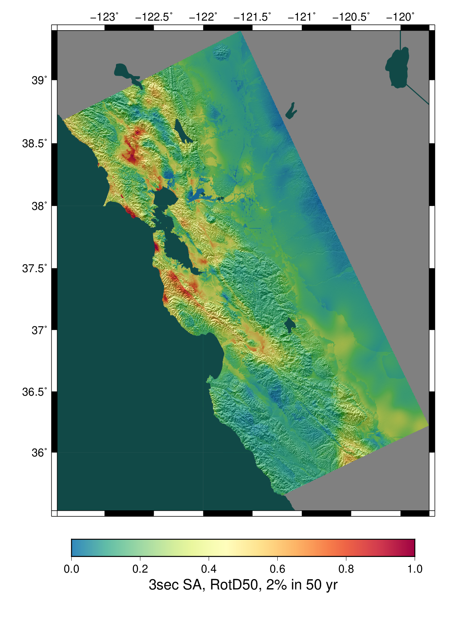
CyberShake Study 18.8
Hazard results for 869 sites
Used OLCF Titan and NCSA Blue Waters
  1/3 of workflows ran jobs on both systems
6.2 million node-hours (120M core-hours)
  Averaged 2,018 nodes (CPUs & GPUs) for 128 days
  Max of 16,219 nodes (~280,000 cores)
Workflow tools scheduled 17,921 jobs
Workflow tools managed 1.2 PB of data
    157 TB of data automatically transferred
    14.4 TB (~12M files) staged back to local disk
Workflow tools scale!

Slide 26
Problems Workflows Solve
Task executions
  Workflow tools will retry and checkpoint if needed
Data management
  Stage-in and stage-out data for jobs automatically
Task scheduling
  Optimal execution on available resources
Metadata
  Automatically track runtime, environment, arguments, inputs
Getting computational resources
  Whether large parallel jobs or high throughput

Slide 27
Should you use workflow tools?
Probably using a workflow already
  Replaces manual hand-offs and polling to monitor status
Provides framework to assemble community codes
  Also useful for training new teammates
Scales from local computer to large clusters
Provide portable algorithm description independent of data
  CyberShake has run on 9 systems since 2007 with same workflow
Does add additional software layers and complexity
  Some development time is required

Slide 28
Final Thoughts
Automation is vital, even without workflow tools
  Eliminate human polling
  Get everything to run automatically if successful
  Be able to recover from common errors
Put ALL processing steps in the workflow
  Include validation, visualization, publishing, notifications
Avoid premature optimization
Consider new compute environments (dream big!)
  Larger clusters, XSEDE/PRACE/RIKEN/SciNet, Amazon EC2
Tool developers want to help you!

Slide 29
Links
SCEC: http://www.scec.org
Pegasus: http://pegasus.isi.edu
Pegasus-mpi-cluster: http://pegasus.isi.edu/wms/docs/latest/cli-pegasus-mpi-cluster.php
HTCondor: http://www.cs.wisc.edu/htcondor/
Parsl: https://parsl-project.org/
Apache Airflow: https://airflow.apache.org/
JUBE: https://www.fz-juelich.de/ias/jsc/EN/Expertise/Support/Software/JUBE/_node.html
Makeflow: http://ccl.cse.nd.edu/software/makeflow/
Work Queue: http://ccl.cse.nd.edu/software/workqueue/
Nextflow: https://www.nextflow.io/
Pachyderm: https://www.pachyderm.com/
CyberShake: http://scec.usc.edu/scecpedia/CyberShake
Notes:
Update links

Slide 30












Questions?

