Slide 1
SINgle Node Optimization
Learn what your code does while the hardware executes the code’s binary representation to tune it
IHPCSS2018, Thomas Röhl, FAU Erlangen-Nuremburg

Slide 2
Agenda for performance engineering sessions
Single node optimization I
  What is performance?
  Introduction to performance engineering
  Hardware performance counter measurements
Single node optimization II
  Hands on using vector triad (DP)
  Hands on using dense matrix-vector-multiplication (DP)
  Hands on using 5pt stencil code (DP)
IHPCSS2018: Single Node Optimization. Thomas Roehl

Slide 3
MOTIVATION
HPC = Computing on the edge

Slide 4
Motivation
Computing on the edge
Execution limited by bottlenecks caused by
  Hardware system limitations
  Software runtime behavior
  User code
Approach in HPC:
  Keep user code slim (glue code & library calls)
  Optimize software runtime and libraries
  Hit hardware bottleneck
IHPCSS2018: Single Node Optimization. Thomas Roehl

Slide 5
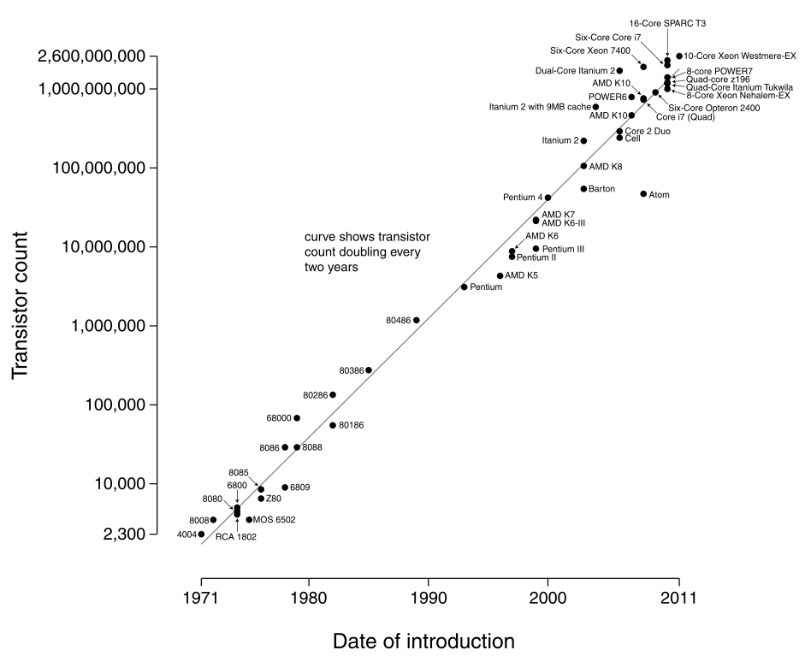
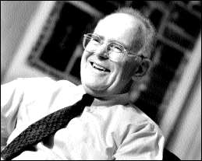
Motivation
A Short look back
1965: G. Moore claimed
#transistors on “microchip” doubles every 12-24 months
IHPCSS2018: Single Node Optimization. Thomas Roehl

Slide 6
Motivation
A Short look back
12 core
Ivy Bridge
But clock speeds saturate
Solution:
  Multiply processing units
  Multiply instruction throughput
24 core
Broadwell
IHPCSS2018: Single Node Optimization. Thomas Roehl

Slide 7
Motivation
A Short look back
Latency as memory technology has matured
Released in 2000
IHPCSS2018: Single Node Optimization. Thomas Roehl

Slide 8
Motivation
Hardware is cheap
Operating a cluster is standard
Good libraries for work & data distribution
So, why optimize at node level?
  It’s there and it’s (almost) for free
  Energy consumption (Exascale and beyond)
  Own aspiration
Bad code always scales!
IHPCSS2018: Single Node Optimization. Thomas Roehl

Slide 9
System architecture
I hope you all have prepared the architecture slides!

Slide 10
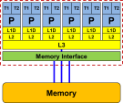
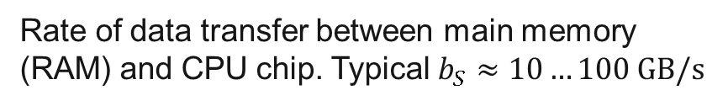
Quiz
What does “clock frequency” mean in computers?
What is “memory bandwidth”?
What is SIMD vectorization?
What is ccNUMA?
The “heartbeat” of the CPU. A clock cycle is the smallest unit of time on a CPU chip. Typically < 1ns → $f≳1 \text{GHz}$
R0
R1
R2
Rate of data transfer between main memory (RAM) and CPU chip. Typical $b_{S}≈10…100 \text{GB}\text{/}\text{s}$
+
A[3]
B[3]
C[3]
A[2]
+
B[2]
C[2]
Single Instruction Multiple Data.
Data-parallel load/store and execution units.
A[1]
+
B[1]
C[1]
A[0]
+
B[0]
C[0]
IHPCSS2018: Single Node Optimization. Thomas Roehl

Slide 11

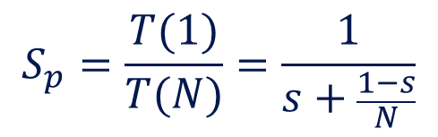


Quiz
What is a register?
What is Amdahl’s Law?
What is a pipelined functional unit?
rax
ymm0
rbx
ymm1
A storage unit in the CPU core that can take one single value (a few values in case of SIMD). Operands for computations reside in registers.
rcx
ymm2
rdx
ymm3
rsi
ymm4
$$T(1)$$
$$S_{p}=\frac{T(1)}{T(N)}=\frac{1}{s+\frac{1−s}{N}}$$
$$T(4)$$
An instruction execution unit on the core that executes an instruction in several simple sub-steps. The stages of the pipeline can act in parallel on several instructions at once.

Slide 12
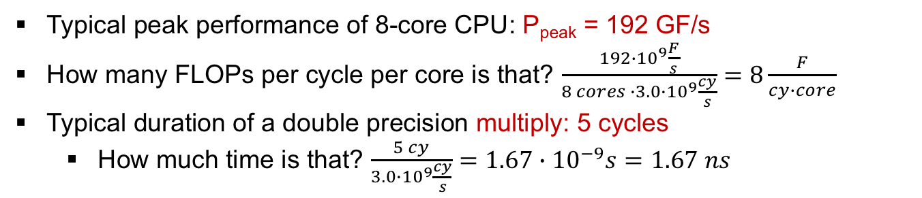
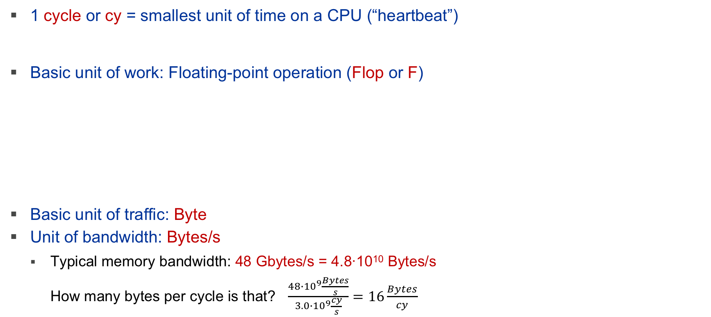
Cycle gymnastics
1 cycle or cy = smallest unit of time on a CPU (“heartbeat”)
Basic unit of work: Floating-point operation (Flop or F)
Basic unit of traffic: Byte
Unit of bandwidth: Bytes/s
  Typical memory bandwidth: 48 Gbytes/s = 4.8∙10¹⁰ Bytes/s
  How many bytes per cycle is that? $\frac{48∙{10}^{9}\frac{Bytes}{s}}{3.0∙{10}^{9}\frac{cy}{s}}=16\frac{Bytes}{cy}$
Clock speed of typical CPU: 3.0 Gcy/s (or GHz)
Typical peak performance of 8-core CPU: P_{peak} = 192 GF/s
How many FLOPs per cycle per core is that? $\frac{192∙{10}^{9}\frac{F}{s}}{8 cores ∙3.0∙{10}^{9}\frac{cy}{s}}=8\frac{F}{cy∙core}$
Typical duration of a double precision multiply: 5 cycles
  How much time is that? $\frac{5 cy}{3.0∙{10}^{9}\frac{cy}{s}}=1.67∙{10}^{−9}s=1.67 ns$
IHPCSS2018: Single Node Optimization. Thomas Roehl

Slide 13
System architecture
Common layout of systems used in HPC
Different levels of sharing (exclusive vs. shared)
Different distances to processing units
  Increasing latency
  Decreasing bandwidth
  Increasing management
  needs
P
…
P
P
…
P
L1D
…
L1D
L1D
…
L1D
GPGPU
L2
…
L2
L2
…
L2
Device Memory
L3
L3
Memory Interface
Memory Interface
GPGPU
Device Memory
Memory
Memory
IHPCSS2018: Single Node Optimization. Thomas Roehl

Slide 14
System architecture
Processing units
What is commonly known as CPU core or HW thread
Load data/instructions, execute instructions on data, write back
Instructions are scheduled on different
ports (=execution unit)
Load/store ops step down in memory
hierarchy until data location is found
Arithmetic ops might have different widths (vectorization)
Load/Store
T1
T2
Branch
P
Arithmetics
L1D
L2
IHPCSS2018: Single Node Optimization. Thomas Roehl

Slide 15
System architecture
Cache hierarchy
Most common one! There are others
Caches keep recently used data (LRU strategy)
High bandwidth and low latency
Organized in cache lines (x86: 64B)
Coherency protocol for management
Shared caches speed up collaborative
work of HW threads
Inclusive vs. exclusive
Different number of ports
T2
T1
T2
T1
T2
T1
T2
T1
T2
T1
T2
T1
P
P
P
P
P
P
L1D
L1D
L1D
L1D
L1D
L1D
L2
L2
L2
L2
L2
L2
L3
Memory Interface
Memory
IHPCSS2018: Single Node Optimization. Thomas Roehl

Slide 16
System architecture
Memory
In ccNUMA architectures each socket has local memory
Access to non-local memory slower (socket interconnect)
Organized in pages (4K, 1M, 1G)
Optimized for streaming access
Commonly max. bandwidth only when
enough requests are in flight
Coherency over all sockets (cc)
T2
T1
T2
T1
T2
T1
T2
T1
T2
T1
T2
T1
P
P
P
P
P
P
L1D
L1D
L1D
L1D
L1D
L1D
L2
L2
L2
L2
L2
L2
L3
Memory Interface
Memory
IHPCSS2018: Single Node Optimization. Thomas Roehl

Slide 17
System architecture
Architecture-specific optimizations
Use widest/fastest arithmetic units if possible
Reuse data as often as possible
  Keep data as close as possible to the execution units
Allocate data in the memory close to the consumers
Avoid sharing cache lines between consumers
Try to organize memory access in streaming fashion
IHPCSS2018: Single Node Optimization. Thomas Roehl

Slide 18
Performance engineering
Let’s understand performance!

Slide 19




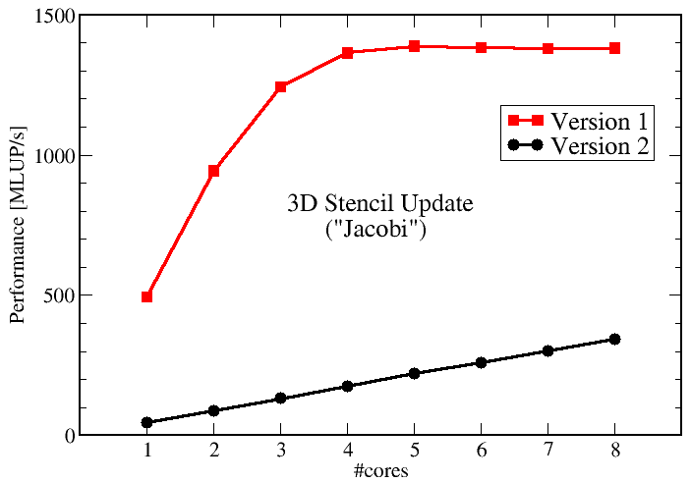






Performance engineering
possible
optimization
white box
input data
CODE
insight:
bottleneck
Y
model OK?
simplified description of system (HW+SW)
N
modeling
predictions
validation
adjust model
→ insight
IHPCSS2018: Single Node Optimization. Thomas Roehl

Slide 20
Performance
What is a good measure/metric?
My vector update code runs at 2,000 MFLOP/s on a 2GHz processor!
Same execution time but…
for(i=0; i<n; i++) {
a[i]= 3.0*c0+c1*c2+c3*c4*a[i]-1.d0*a[i];
}
#FLOPS = 8 * n
#FLOP = 2* n + 5
d0 = 3.0*c0+c1*c2;
d1 = c3*c4-1.d0;
for(i=0; i<n; i++) {
a[i]= d0 + d1*a[i];
}
… but my MFlop/s rate is only ¼!
IHPCSS2018: Single Node Optimization. Thomas Roehl

Slide 21
Performance
What is a good measure/metric?
Performance = WORK / TIME
“Pure” metrics – basic choices for “WORK”
  Iterations: Total number of loop iterations performed
  MFLOP: Millions of Floating Point Operations
  MIPS: Millions of Instructions
  Lattice Site/ Cell / Particle Updates: number of sites/cells/particles to be updated/computed
  Physical simulation time: Physical time (e.g. nanosenconds) a system is propagated
IHPCSS2018: Single Node Optimization. Thomas Roehl

Slide 22
Performance
What is a good measure/metric?
Simplest performance metric (“Bestseller”): 1 / TIME
  Measures time to solution
  Carefully specify the “problem” you solved!
  Best metric thinkable, but not intuitive in all
LINUX / UNIX command time
Problem:
Which TIME?
Always use one dedicated source for time measurements (e.g. one node)
>time ./test.x
>34.650u 0.612s 0:35.28 99.9%
>time ./testwIO.x
>33.802u 0.608s 0:43.64 78.8%
user sys elapsed ratio
cpu time time (u+s)/e
Stay away from
CPU time – it‘s evil!
No I/O!
This is the time (walltime) you wait for the result!
IHPCSS2018: Single Node Optimization. Thomas Roehl

Slide 23
Performance
What is a good measure/metric?
Measuring walltime within code on UNIX (-like) systems with gettimeofday()
  WALLTIME:= Difference of two timestamps!
  Works fine for serial timings – due care for parallel apps is required
  Use runtime specific method (MPI_Wtime(), omp_get_wtime())
#include <sys/time.h>
double timestamp(void){
struct timeval tp;
gettimeofday(&tp, NULL);
return((double)(tp.tv_sec + tp.tv_usec/1000000.0)); }
walltime.h in NPLE/snippets
IHPCSS2018: Single Node Optimization. Thomas Roehl

Slide 24
Performance
How to get performance?
Reduce the gap between hardware and software
  Compilers do the job in most cases
  No huge frameworks with X software layers
  Reuse libraries
Think carefully about the execution while coding
Use tools what help but don’t get into the way
Ask others! Anybody could know the answer.
(of people that know what they do)
IHPCSS2018: Single Node Optimization. Thomas Roehl

Slide 25
Performance
Impact factors
For a given code/problem performance may be influenced by many factors
For reproducibility of
results all performance critical factors need to be reported!
Sensibility and stability analysis!
Statistics - fluctuations between runs
CPU
Clock speed, SMT, #cores, cache size
gnu, Intel, pgi, pathscale
Memory
interface, size, speed
Compiler
Version, Flags
Performance
Atlas, mkl, fftw,…
Vendor / Board
Libraries
IO subsystem
OS
Parameters, Version, Libraries
SuSe, RedHat, Ubuntu,…
BIOS Settings
IHPCSS2018: Single Node Optimization. Thomas Roehl

Slide 26
Performance Measurement
Best Practices
Preparation
  Reliable timing/timer granularity (Minimum time which can be measured?)
  Document code generation (Flags, Compiler Version)
  Document system state (Clock, Turbo mode, Memory, Caches)
  Consider to automate runs with a skript (Shell, python, perl) if it works manually
Doing it
  Get exclusive system
  Fix clock speed
  Control Affinity / Topology– where does my code/threads/processes run exactly?
  Working set size – code input parameters?!
  Is result deterministic and reproducible → Do statistics (Mean, Best, …)
Check: Are the results reasonable?
IHPCSS2018: Single Node Optimization. Thomas Roehl

Slide 27
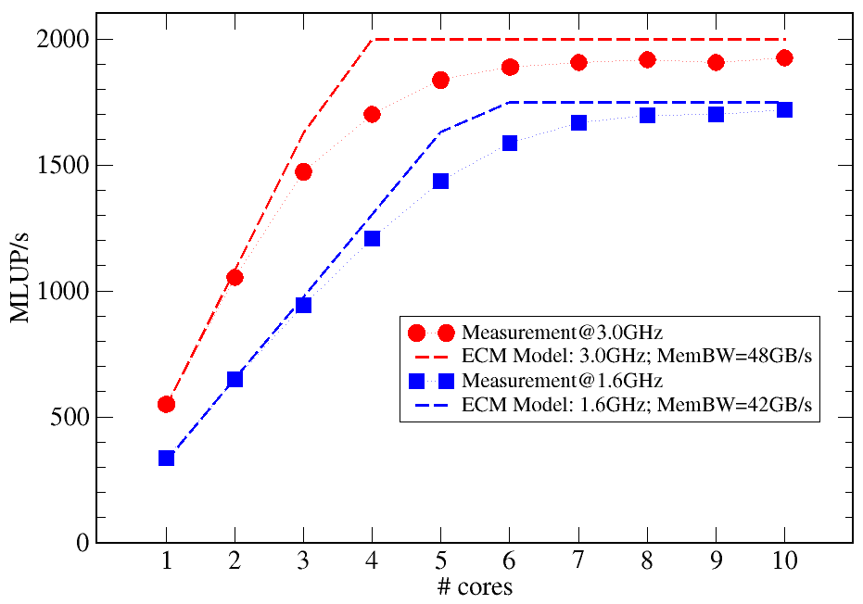
Performance Measurement
Best Practices
Postprocessing
  Documentation
  Try to understand and explain the result
  Plan variations to gain more information
  Many things can be better understood if you plot them (gnuplot, xmgrace)
  Is there a (simple) model which can (qualitatively) explain the performance levels and variations?
do k = 1 , Nk; do j = 1, Nj
do i = 1, Ni
y(i,j,k) = const*
$ ( x(i-1,j,k) + x(i+1,j,k)
$ + x(i,j-1,k) + x(i,j+1,k)
$ + x(i,j,k-1) + x(i,j,k+1) )
enddo
enddo; enddo
Intel(R) Xeon(R) CPU E5-2690 v2 @ 3.00GHz
Memory Bandwidth 48 GB/s
IHPCSS2018: Single Node Optimization. Thomas Roehl

Slide 28
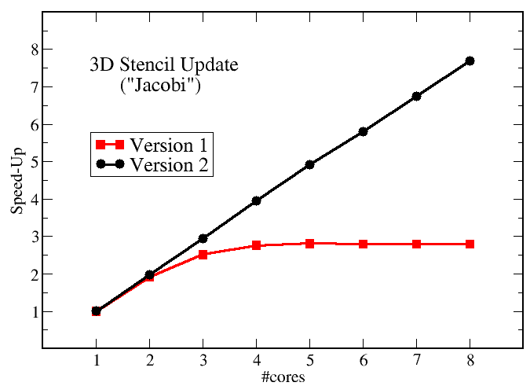
I don’t know where to start
Compilers
!$OMP PARALLEL DO
do k = 1 , Nk
do j = 1 , Nj; do i = 1 , Ni
y(i,j,k)= b*( x(i-1,j,k)
+ x(i+1,j,k)
+ x(i,j-1,k)
+ x(i,j+1,k)
+ x(i,j,k-1)
+ x(i,j,k+1))
enddo; enddo
enddo
!$OMP END PARALLEL DO
–O0
Prepared for
the highly
parallel era!
–O3 -xAVX
Changing only a the compile options makes this code scalable on an 8-core chip (Intel SandyBridge)
IHPCSS2018: Single Node Optimization. Thomas Roehl

Slide 29
I don’t know where to start
Compilers
If you have the source, recompile it for a new machine type
Select architecture flag manually
  Auto selector often chooses not the best option
General optimization levels: -O0, -O1, -O2, -O3
  Enable/disable set of optimization options
  Check compiler’s options to choose best (-xAVX, -mavx)
Different functions may benefit from different options
Put hints in the code (e.g. pragma simd, vector aligned, ..)
Don’t do a parameter search study with machine learning which takes a week!
What is SIMD?
IHPCSS2018: Single Node Optimization. Thomas Roehl

Slide 30
Where to get data from?
Your application is, of course, an important source of data
  Also previous versions / optimization steps
  Measure! Measure! Measure!
Reference values
  Determined with benchmarks (STREAM, MPI ping/pong, …)
  Data sheets of hardware vendors
Microbenchmarks / Proxy Apps
  Code snippet of a hot region to run stand-alone for in-depth analysis
  Code that stresses some specific hardware component
IHPCSS2018: Single Node Optimization. Thomas Roehl

Slide 31
Why do I need reference data?
Simply: To know where to stop
How deep do you want to dig?
Code
Libraries
OS kernel
Hardware
What is FMA?
Intel Haswell:
2x FMA/cy but 1 divide every 28 cycles
Intel Broadwell:
2x FMA/cy but 1 divide every 16 cycles
IHPCSS2018: Single Node Optimization. Thomas Roehl

Slide 32
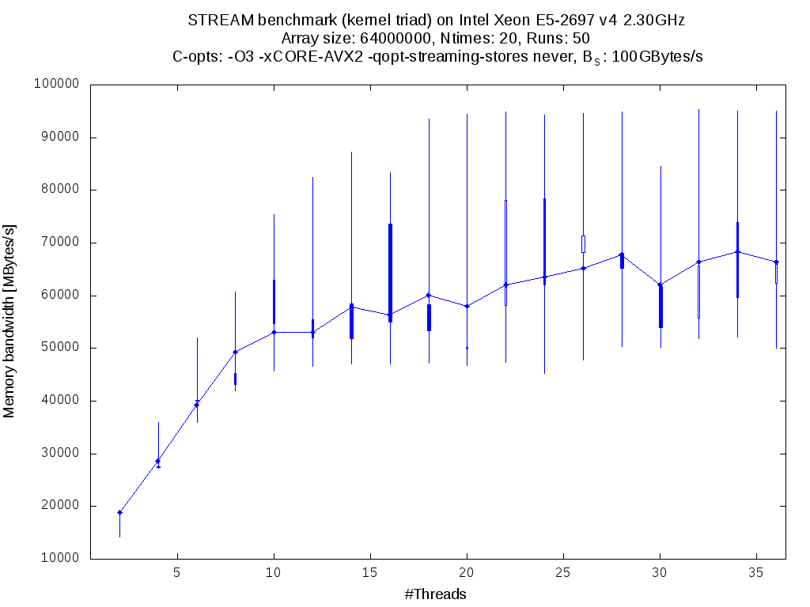
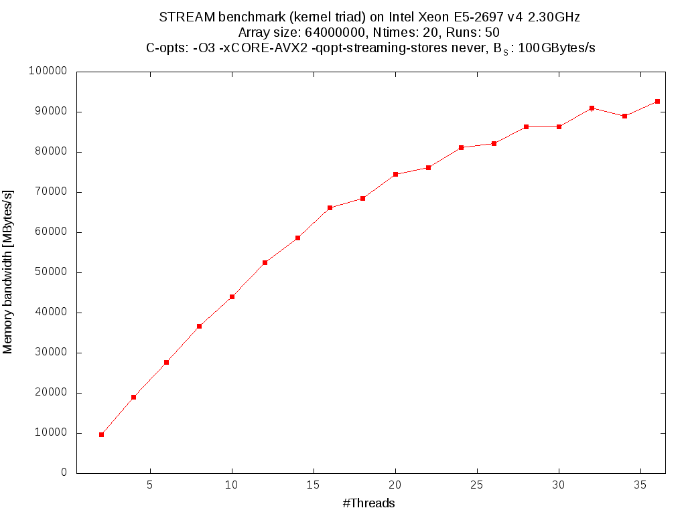
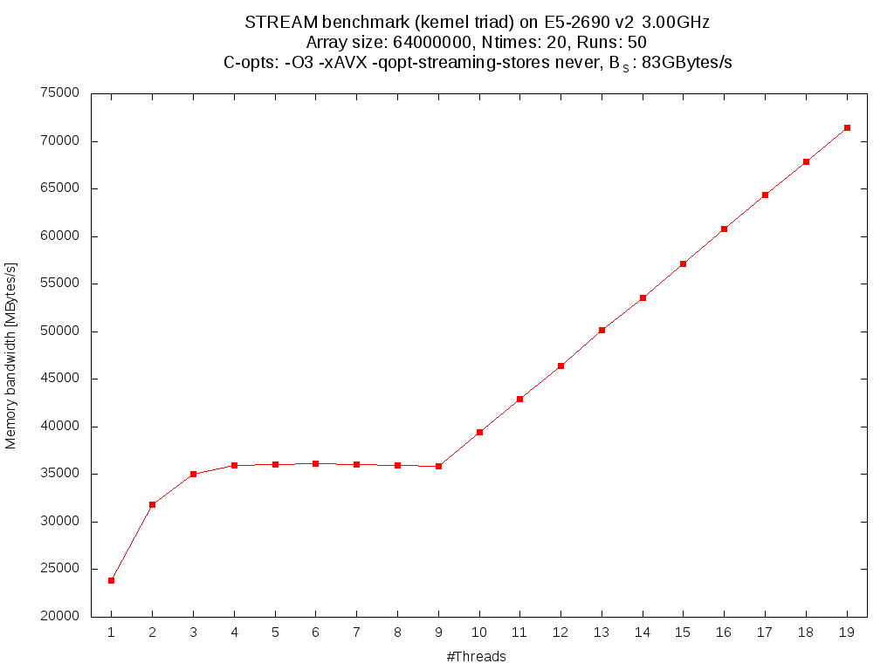
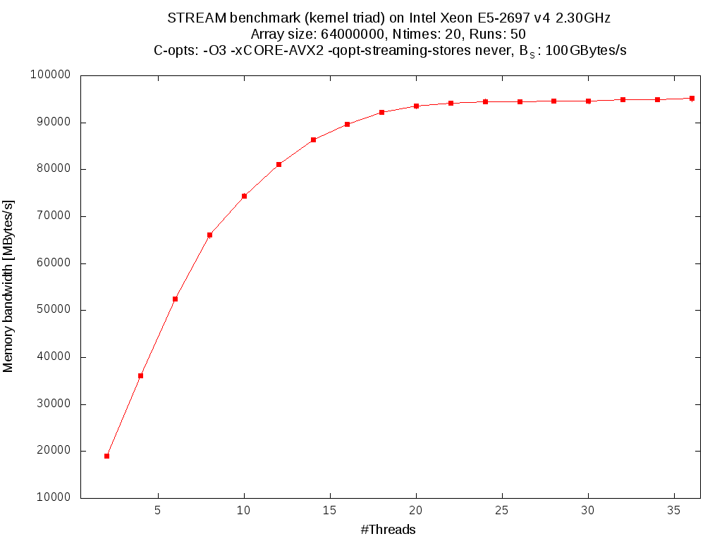
Affinity
Why does my runtime vary?
Enough talking,
Let’s run it
OS task scheduler places tasks (=processes/threads) on cores
OS scheduler moves tasks to different cores from time to time
STREAM: parallel allocation and initialization of data
No CPU affinity
Control your execution environment!
IHPCSS2018: Single Node Optimization. Thomas Roehl

Slide 33
Affinity
Process and thread affinity
Limiting set of possible HW threads per process/thread
There are several reasons for caring about affinity:
  Eliminating performance variation
  Making use of architectural features
  Avoiding resource contention
Many tools/methods for affinity: taskset, sched.h, OpenMP/MPI-specific, numactl, likwid-pin
Choose what fits best! Remember to set thread count!
Define cpuset but no real pinning
Vendor-specific non-portable
Application threads pin themselves
Pin application threads to NUMA domain
IHPCSS2018: Single Node Optimization. Thomas Roehl

Slide 34
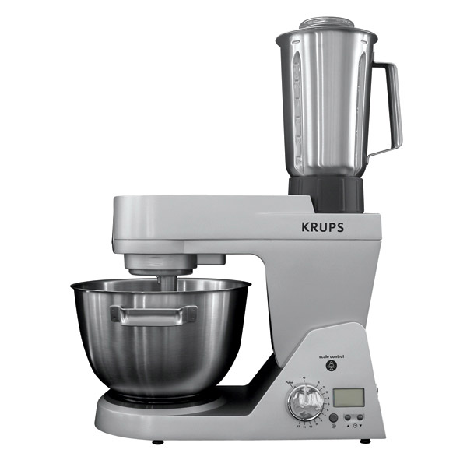


LIKWID
Overview
„Like I knew what I do“
Tool suite for performance-oriented programmers
Developed by HPC group of RRZE since 2009
Goals:
Provide support for architecture at official release date
Offer powerful tools for daily work
IHPCSS2018: Single Node Optimization. Thomas Roehl

Slide 35
LIKWID
Process/thread affinity with likwid-pin
Pinning processes/threads to HW thread(s) is crucial
Pinning of application threads transparent for users
  likwid-pin –c 4 ./serial_app
  likwid-pin –c 4,5 ./threaded_app
  likwid-pin –c S0:1@S1:1 ./threaded_app
  likwid-pin –c S0:0-2 ./threaded_app
  Other selection syntaxes
  exist as well
Physical HW threads first
0
12
1
13
2
14
3
15
4
16
5
17
6
18
7
19
8
20
9
21
10
22
11
23
P
P
P
P
P
P
P
P
P
P
P
P
L1
L1
L1
L1
L1
L1
L1
L1
L1
L1
L1
L1
L2
L2
L2
L2
L2
L2
L2
L2
L2
L2
L2
L2
L3
L3
Memory Interface
Memory Interface
Memory
Memory
IHPCSS2018: Single Node Optimization. Thomas Roehl
Notes:
Runs serial_app on HW thread 4
- Runs threaded_app on HW thread 4 and 5. If threads are started, run first on HW thread 4 and second on HW thread 5
Runs threaded_app on second physical HW thread of sockets 0 and 1
Runs threaded_app on first 3 physical HW threads of socket 0

Slide 36
Process/thread affinity
export OMP_NUM_THREADS=2 taskset –c 4,5 ./app
  = likwid-pin –c 4,5 ./app
OMP_PLACES=cores OMP_PROC_BIND=close OMP_NUM_THREADS=3 ./app
  = likwid-pin –c S0:0-2 ./app
OMP_PLACES=sockets OMP_NUM_THREADS=2 ./app
  = likwid-pin –c S0:1@S1:1 ./app
Choose what fits YOU best!
IHPCSS2018: Single Node Optimization. Thomas Roehl

Slide 37
I don’t know where to start
Common problem in bigger codes
Which function(s) take the largest portion of runtime?
Get timings of callpath for function-level analysis
If parallel: measure serial and parallel execution
  Functions fast in serial might be slow in parallel execution
  Some code paths are only accessed if in serial/parallel
int foo()
{
int a;
a =a + 1;
bar();
a =a + 1;
return a;
}
baz()
inclusive
duration
bar()
exclusive
duration
foo()
IHPCSS2018: Single Node Optimization. Thomas Roehl

Slide 38
I don’t know where to start
Find hot functions
Checks function
execution latency
Only serial analysis
gprof, Intel compiler or xray (clang)
  gcc –pg … && ./a.out && gprof <opts> a.out gmon.out
  Get a first impression where the time is spent
Each sample counts as 0.01 seconds.
% cumulative self self total
time seconds seconds calls ms/call ms/call name
95.70 12.47 12.47 _work_loop_hsw_corei_fma
3.45 12.92 0.45 thread
0.61 13.00 0.08 990522 0.00 0.00 timestamp
0.08 13.03 0.01 2 5.00 5.00 sm_work_hsw_corei_fma_2t
0.00 13.03 0.00 434 0.00 0.00 get_cpu_family
And now?
IHPCSS2018: Single Node Optimization. Thomas Roehl

Slide 39
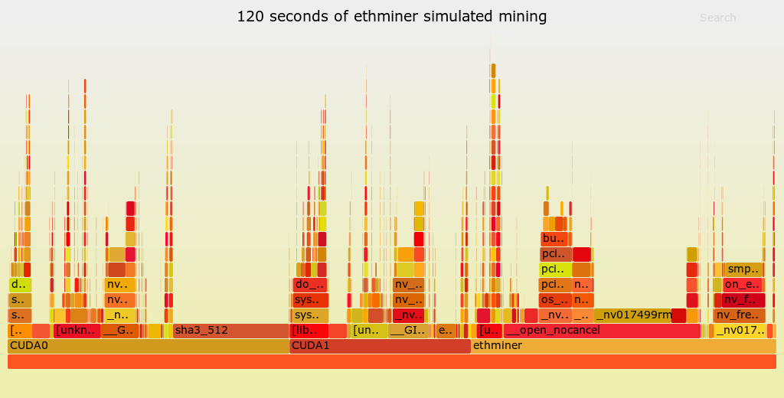
I don’t know where to start
Find hot functions
Use Linux’s perf subsystem for detailed call stack
$ perf record -g ./my-slow-binary
[ perf record: Woken up 1 times to write data ]
[ perf record: Captured and wrote 0.023 MB perf.data (75 samples) ]
$ perf script > out.perf
$ ./stackcollapse-perf.pl out.perf > out.folded
$ ./flamegraph.pl out.folded > perf_samples.svg
Flamegraphs developed by Brendan Gregg (Netflix)
Stack collapse scripts for multiple data sources (perf, dtrace, …)
Problem: No time-based ordering!
Ordering: x-axis lexically , y-axis stack level
IHPCSS2018: Single Node Optimization. Thomas Roehl

Slide 40
Measurement techniques
Sampling & Tracing
Sampling
  Indirect
  External
  Low overhead
Tracing
  Direct
  Internal
  High overhead
Instrumentation
  Direct
  Internal
  High overhead
Profiling
  Direct/Indirect
  Internal/External
  Low overhead due to summary (with respect to context)
Function B
Function B
Function A
Function A
Function A
Function A
Many high-level tools use sampling
LIKWID, PAPI, Caliper, …
Function B
Function A
Function A
IHPCSS2018: Single Node Optimization. Thomas Roehl

Slide 41
Hardware performance counting

Slide 42
What is hardware performance monitoring?
What about software performance monitoring?
People write code and don’t design hardware
Execution behavior is specified by my code
Applications are just compiled code. Compilers are always right
“I know how much data is consumed, it’s my code!”
“I already sum up the number of FLOPs!”
“Of course I overloaded the operators, it’s C++”
not
IHPCSS2018: Single Node Optimization. Thomas Roehl

Slide 43
What is hardware performance monitoring?
What about software performance monitoring?
Pros:
Fine grained control what should be counted
Application insight, you know your code
Measurements always included, no other tool/lib required
Cons:
Own “counters” defer execution of workload code → Overhead
Compilers might add (unwanted) instructions to your code (casts)
Hardware handles code differently than mind model claims
IHPCSS2018: Single Node Optimization. Thomas Roehl

Slide 44
What is hardware performance monitoring?
Overview about HPM
Performance monitoring units (PMUs) at hardware level
Introduced for x86 with Intel Pentium (1994)
Originally used by CPU vendors for hardware validation
No additional CPU work to process hardware events in PMUs
Accessing PMUs requires CPU work → Overhead
Limited number of counters per PMU
IHPCSS2018: Single Node Optimization. Thomas Roehl

Slide 45
What is hardware performance monitoring?
How does it work?
Event X
Execution unit 1
PMU
Config
Counter
Event X
1
Execution unit 2
0
0
Event Y (1)
Event Y (3)
1
0
3
Event Y >= 2
0
>=
2
Execution unit 3
3
Simplyfied!
IHPCSS2018: Single Node Optimization. Thomas Roehl
Notes:
Step 1: Configure event X and event Y to Config 0 and 1
Step 2: Reset Counter registers 0 and 1 to zero
Step 3: Execution unit 1 executes event X
Step 4: Counter 0 incremented by 1
Step 5: Execution unit 3 executes event Y with value 1 -> No increment of Counter 1 because below threshold
Step 6: Execution unit 3 executes event Y with value 3
Step 7: Counter 1 incremented by 3

Slide 46
What is hardware performance monitoring?
Overview about HPM
PMUs are scattered over the whole system
Some PMUs count fixed events, some are configurable
PMUs have different scope:
HW thread, CPU core, shared L2 cache, socket or system
Accessible via MSRs and PCI devices (and other libraries)
Due to validation background: very specific events
IHPCSS2018: Single Node Optimization. Thomas Roehl

Slide 47
What is hardware performance monitoring?
Overview about HPM (Problems)
Each microarchitecture variant has own set of PMUs
  Desktop commonly core-local PMUs & limited uncore PMUs
  Server core-local PMUs & one PMU per uncore unit
Each microarchitecture variant has own set of events
  Events with same name but different meaning
  Events with different names count (superficially) for the same trigger
Access to registers limited (x86: kernel-only, root-only, …)
Use a tool!
IHPCSS2018: Single Node Optimization. Thomas Roehl

Slide 48
Tools for hardware performance monitoring
Kernel-Interface perf_event
  Kernel handles management of PMUs (wrong kernel = no support)
  Counting per OS processes or HW threads
  Feature-rich interface used by many tools: perf, PAPI, …
LIKWID
  Runs in user-space. Uses common kernel interfaces or perf_event
  Counts per HW thread (knowledge about processes)
  Derives metrics out of raw no counter values
IHPCSS2018: Single Node Optimization. Thomas Roehl

Slide 49
LIKWID
System topology
Socket 0: (Intel i7-4770)
+-----------------------------------------+
| +-------+ +-------+ +-------+ +-------+ |
| | 0 4 | | 1 5 | | 2 6 | | 3 7 | |
| +-------+ +-------+ +-------+ +-------+ |
| +-------+ +-------+ +-------+ +-------+ |
| | 32kB | | 32kB | | 32kB | | 32kB | |
| +-------+ +-------+ +-------+ +-------+ |
| +-------+ +-------+ +-------+ +-------+ |
| | 256kB | | 256kB | | 256kB | | 256kB | |
| +-------+ +-------+ +-------+ +-------+ |
| +-------------------------------------+ |
| | 8MB | |
| +-------------------------------------+ |
+-----------------------------------------+
likwid-topology
System information
Thread, cache and NUMA topology
Process affinity
likwid-pin –c <cpustr> ./a.out
Handles common threading solutions
Simple cpu selection syntax
IHPCSS2018: Single Node Optimization. Thomas Roehl

Slide 50
LIKWID
General HPM
Check whether your center supports it
Or check /proc/sys/kernel/perf_event_paranoid <= 1 and
if 1 use --execpid
likwid-perfctr –C <cpustr> -g <events> ./a.out
Programs events on selected cpus and pin application
Predefined evensets: FLOPS_DP, MEM, ENERGY, … (-a)
Multiple measurement backends: raw and perf_event
Modes: whole app, time-based sampling (-t <time>), stethoscope (-S <time>), markerAPI (-m)
IHPCSS2018: Single Node Optimization. Thomas Roehl

Slide 51
LIKWID
HPM with likwid-perfctr
Control application for HPM measurements
Measurement modes:
likwid-perfctr –c/–C <cpusel> -g <eventlist> (opts) ./app
  -c : Measure on cores in cpusel, -C : Measure & pin
  -g : List of event+counter combis or performance group
List of all counters and events: likwid-perfctr –e
Search for some event: likwid-perfctr –E <searchstr>
Start-to-end
Timeline (time-based sampling)
Stethoscope
MarkerAPI (code instrumentation)
IHPCSS2018: Single Node Optimization. Thomas Roehl

Slide 52
LIKWID
HPM with likwid-perfctr
Profiling:
Start counters
Run application
Stop & Evaluate counters
$ likwid-perfctr –C 0,1 –g L2_TRANS_L1D_WB:PMC0 ./app
+-----------------------+---------+--------------+--------------+
| Event | Counter | Core 0 | Core 1 |
+-----------------------+---------+--------------+--------------+
| Runtime (RDTSC) [s] | TSC | 2.573182e+00 | 2.573182e+00 |
| L2_TRANS_L1D_WB | PMC0 | 281176518 | 281240170 |
+-----------------------+---------+--------------+--------------+
Event names (in many cases) not intuitive
Events are architecture-specific
Some sound promising but return bad counts, others are broken
More interest in real metrics like volume of loaded data

Slide 53
LIKWID
HPM with likwid-perfctr
LIKWID defines performance groups
≈ eventlist + derived metrics + documentation
List all groups: likwid-perfctr -a
$ likwid-perfctr -C 0,1 -g L2 ./app
+--------------------------------+-----------+-----------+
| Metric | Core 0 | Core 1 |
+--------------------------------+-----------+-----------+
| Runtime (RDTSC) [s] | 2.6439 | 2.6439 |
| L2D load bandwidth [MBytes/s] | 6744.8121 | 6743.6037 |
| L2D load data volume [GBytes] | 17.8325 | 17.8293 |
+--------------------------------+-----------+-----------+
IHPCSS2018: Single Node Optimization. Thomas Roehl

Slide 54
LIKWID
HPM of functions
Code instrumentation using LIKWID’s MarkerAPI
Compile with –DLIKWID_PERFMON
likwid-perfctr -C 0,1 -g L2 –m ./app
Recommended: Reduces startup overhead
#include <likwid.h>
LIKWID_MARKER_INIT; // in serial region
LIKWID_MARKER_REGISTER(“Compute”); // in parallel region
LIKWID_MARKER_START(“Compute”);
<code>
LIKWID_MARKER_STOP(“Compute”);
LIKWID_MARKER_CLOSE; // in serial region
Multiple regions and nesting allowed
Activate MarkerAPI mode
IHPCSS2018: Single Node Optimization. Thomas Roehl

Slide 55

LIKWID
HPM of functions
If we know that each region executes 2M iterations:
$$\frac{1597.135 GByte}{1E3∗2E6 iterations}≈798\frac{Byte}{iterations}$$
$ likwid-perfctr -C 0,1 -g L2 -m ./app 2000000
Region Compute, Group 1: L2
+-------------------+-----------+-----------+
| Region Info | Core 0 | Core 1 |
+-------------------+-----------+-----------+
| RDTSC Runtime [s] | 77.724980 | 77.725490 |
| call count | 1000 | 1000 |
+-------------------+-----------+-----------+
[…]
+--------------------------------+------------+------------+
| Metric | Core 0 | Core 1 |
+--------------------------------+------------+------------+
| Runtime (RDTSC) [s] | 77.7250 | 77.7255 |
| L2 bandwidth [MBytes/s] | 10275.9891 | 10272.4909 |
| L2 data volume [GBytes] | 798.7010 | 798.4344 |
+--------------------------------+------------+------------+
-> SUM: 15977.135
IHPCSS2018: Single Node Optimization. Thomas Roehl

Slide 56
PAPI
General
perf/perf_event has no instrumentation interface
Performance API developed at University of Tennessee
PAPI offers self-monitoring of applications
papi_avail for all generalized events
papi_native_avail for all events
Only limited set of derived metrics: FLOP/s, IPC, …
No direct control options from outside of application
Used by many tools to access hardware counters
IHPCSS2018: Single Node Optimization. Thomas Roehl

Slide 57
PAPI
General
PAPI offers full C/C++ API for HPM measurements
PAPI offers shorthands for FLOP/s, IPC and others
Header provides PAPI_VER_CURRENT
#include <papi.h>
PAPI_library_init (int version)
PAPI_create_eventset(int* setid)
PAPI_add_event (int setid, int eventid)
PAPI_start(int setid)
PAPI_stop(int setid, long long* values)
PAPI_cleanup_eventset(int setid)
PAPI_destroy_eventset(int* setid)
PAPI_shutdown()
Array needs to be large enough for all added events
Always perform a cleanup before destroy
Memory leak!
IHPCSS2018: Single Node Optimization. Thomas Roehl

Slide 58
A performance model brings together
what you need (application requirements) and
what you get (hardware capabilities)
A series of measurements from benchmarks
is NOT a performance model*
*Bill Gropp, PASC2015
Basics and Theory

Slide 59
Performance Patterns

Slide 60
Performance Patterns
Common groups of performance issues
Pattern |  | Performance behavior | Metric signature, LIKWID performance group(s)
Bandwidth saturation |  | Saturating speedup across cores sharing a data path | Bandwidth meets BW of suitable streaming benchmark (MEM, L3)
ALU saturation |  | Throughput at design limit(s) | Good (low) CPI, integral ratio of cycles to specific instruction count(s) (FLOPS_*, DATA, CLOCK, PORT_USAGE)
Inefficient data access | Excess data volume | Simple bandwidth performance model much too optimistic | Low BW utilization / Low cache hit ratio, frequent CL evicts or replacements (L2, L3, CACHE, DATA, MEM)
 | Latency-bound access
Micro-architectural anomalies |  | Large discrepancy from simple performance model based on LD/ST and arithmetic throughput | Relevant events are very hardware-specific, e.g., memory aliasing stalls, conflict misses, unaligned LD/ST, requeue events
Bottlenecks
Hazards
IHPCSS2018: Single Node Optimization. Thomas Roehl

Slide 61
Performance Patterns
Common groups of performance issues
Pattern | Performance behavior | Metric signature, LIKWID performance group(s)
False sharing of cache lines | Large discrepancy from performance model in parallel case, bad scalability | Frequent (remote) CL evicts (CACHE)
Bad ccNUMA page placement | Bad or no scaling across NUMA domains, performance improves with interleaved page placement | Unbalanced bandwidth on memory interfaces / High remote traffic (MEM, NUMA)
Pipelining issues | In-core throughput far from design limit, performance insensitive to data set size | (Large) integral ratio of cycles to specific instruction count(s), bad (high) CPI (FLOPS_*, DATA, CLOCK)
Control flow issues | See above | High branch rate and branch miss ratio (BRANCH)
Hazards
IHPCSS2018: Single Node Optimization. Thomas Roehl

Slide 62
Performance Patterns
Common groups of performance issues
Pattern |  | Performance behavior | Metric signature, LIKWID performance group(s)
Load imbalance / serial fraction |  | Saturating/sub-linear speedup | Different amount of “work” on the cores (FLOPS_*); Note: instruction count is not reliable due to barriers!
Synchronization overhead |  | Speedup going down as more cores are added / No speedup with small problem sizes / Cores busy but low FP performance | Large non-FP instruction count (growing with number of cores used) / Low CPI (FLOPS_*, CLOCK)
Instruction overhead |  | Low application performance, good scaling across cores, performance insensitive to problem size | Low CPI near theoretical limit / Large non-FP instruction count (constant vs. number of cores) (FLOPS_*, DATA, CLOCK)
Code composition | Expensive instructions | Similar to instruction overhead | Many cycles per instruction (CLOCK) if the problem is large-latency arithmetic
 | Ineffective instructions |  | Scalar instructions dominating in data-parallel loops (FLOPS_*, CLOCK)
IHPCSS2018: Single Node Optimization. Thomas Roehl

Slide 63
Performance Patterns
Todays systems are optimized for instruction throughput
  Amplifies the need to analyze the data paths
Cool, which tool(s)?
  Use pen & paper first!
  Verify model with code measurements &&( || ) tool(s)
  Always remember, a model is a simplification, don’t expect exact results
IHPCSS2018: Single Node Optimization. Thomas Roehl

Slide 64

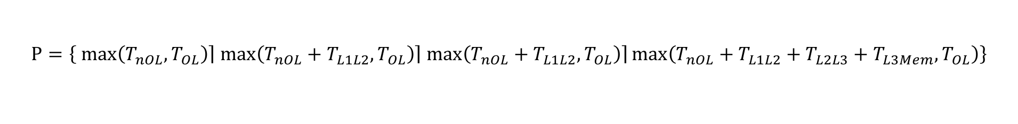
Performance models
Tool for simple C-kernels:
kerncraft
Roofline model:
  Only FLOP/s and memory bandwidth for full system
  Clear distinction between compute-bound and memory-bound
  Sometimes too optimistic
Execution-Cache-Memory model
  FLOP/s, cache traffics and memory bandwidth for parts of the system
  Clear distinction between compute-bound and memory-bound
  Shows bottleneck more clearly but more inputs needed
  $$P=min⁡(P_{max},I∙b_{S})$$
$$P=\left\{ \left.\max\left(T_{nOL},T_{OL}\right)\right\rceil \left.\max\left(T_{nOL}+T_{L1L2},T_{OL}\right)\right\rceil \left.\max\left(T_{nOL}+T_{L1L2},T_{OL}\right)\right\rceil \max\left(T_{nOL}+T_{L1L2}+T_{L2L3}+T_{L3Mem},T_{OL}\right)\right\}$$
IHPCSS2018: Single Node Optimization. Thomas Roehl

Slide 65
Core points for programming from scratch
Highly scalable codes must be designed with scalability in mind!
Reduce algorithmic work (might cause a complete rewrite)
Minimize processor work (fuse loops, …)
Distribute work and data for optimal utilization of parallel resources (shareable data structures, locking, …)
Avoid bottlenecks (load imbalance, false sharing, …)
Use most effective execution units on chip (vectorization, …)
IHPCSS2018: Single Node Optimization. Thomas Roehl

Slide 66

Hands on
Vector Triad (double precision)

Slide 67
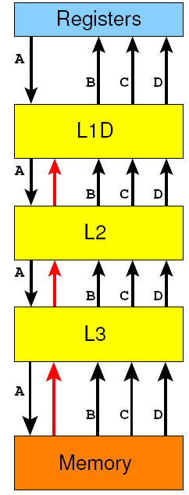
Vector Triad (double precision)
Data transfers on LD/ST basis
do iter=1, niter
do i=1, size
A(i) = B(i) + C(i) * D(i)
enddo
! Prevent loop interchange
if(A(2).lt.0) call dummy(A,B,C,D)
enddo
MFLOPS = (niter * size * 2.d0 )/(runtime *10⁶)
Write-allocate
CL transfer
LD B(i)
LD C(i)
ST A(i)
LD+ST A(i)
LD D(i)
LOAD/STORE CL transfer
2 FLOPs
All data transfers on basis of cache lines
1 cache line = 64 Byte = 8 Words
Vectorization:
Scalar: 8 LD/ST
SSE (128bit): 4 LD/ST
AVX (256bit): 2 LD/ST
AVX512 (512bit): 1LD/ST
for each cache line

Slide 68
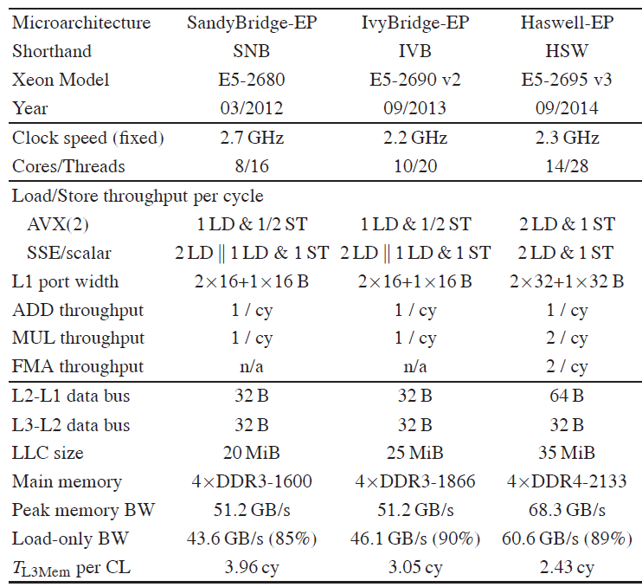
Vector Triad (double precision)
Data traffic analysis
Arithmetic:
2 FMA / cy
Calculate Cycles per CL transfer
Assume streaming (no latency)
2 LD/cy + 1 ST/cy
AXV LD/ST
per cy
64 B/cy (1 cy/CL)
Data per cy
32 B/cy (2 cy/CL)
“No overlap” assumption!
Cluster-on-die
Mode
(BW for 7 cores)
32 B/cy (2 cy/CL)
34.2 GB/s
32 GB/s
4.6 cy/CL

Slide 69
Vector Triad (double precision)
Data traffic analysis
For 1 CL-update from L1 data, i.e. for 8 iterations:
A(i:i+7)=B(i:i+7)+C(i:i+7)*D(i:i+7)
  6 AVX LDs (B(i:i+3), B(i+4:i+7), C(i:i+3), C(i+4:i+7), D(i:i+3), D(i+4:i+7)
  2 AVX STs (A(i:i+3) , A(i+4:i+7)
  Bottleneck: LD instructions → 6 LDs in 3 cy
For 1 CL-update from L2 data, i.e. for 8 iterations:
  8 AVX LDs (A(i:i+3) , A(i+4:i+7, )
  2 AVX STs (A(i:i+3) , A(i+4:i+7)
  5 cy/CL for L1/L2 transfer → (5 cy + 3 cy) / CL-update
This assumes no overlap in data transfers
(i.e. L1 cache is single ported)

Slide 70
Vector Triad (double precision)
Data traffic analysis
Intel Xeon E5-2695 v3 (“Haswell”)
Where does data
come from
Assuming no overlap
throughout
memory hierarchy
Machine
characteristics:
Arithmetic:
2 FMA / cy
Registers
2 LD/cy + 1 ST/cy
Hierarchy | Transfer time to next level | Total transfer time
L1 | 3 cy | 3 cy
L2 | 5 cy | 8 cy
L3 | 10 cy | 18 cy
Memory | 23 cy | 41 cy
L1
64 B/cy (1 cy/CL)
L2
32 B/cy (2 cy/CL)
L3
32 GB/s (4.6 cy/CL)
Mem
Cycles per
CL-update

Slide 71
Vector Triad (double precision)
Data traffic analysis
Intel Xeon E5-2695 v3 (“Haswell”)
From cy/CL-update to MF/s
Performance: {(16 F/CL-update) / (#cy/CL-update)} * ClockSpeed
Clockspeed of Xeon E5-2695 v3: 2.3 GHz = 2300 Mcy/s
Hierarchy | Transfer time to next level | Total transfer time | Performance
L1 | 3 cy | 3 cy | 12266 MF/s
L2 | 5 cy | 8 cy | 4600 MF/s
L3 | 10 cy | 18 cy | 2044 MF/s
Memory | 23 cy | 41 cy | 898 MF/s
Cycles per
CL-update

Slide 72
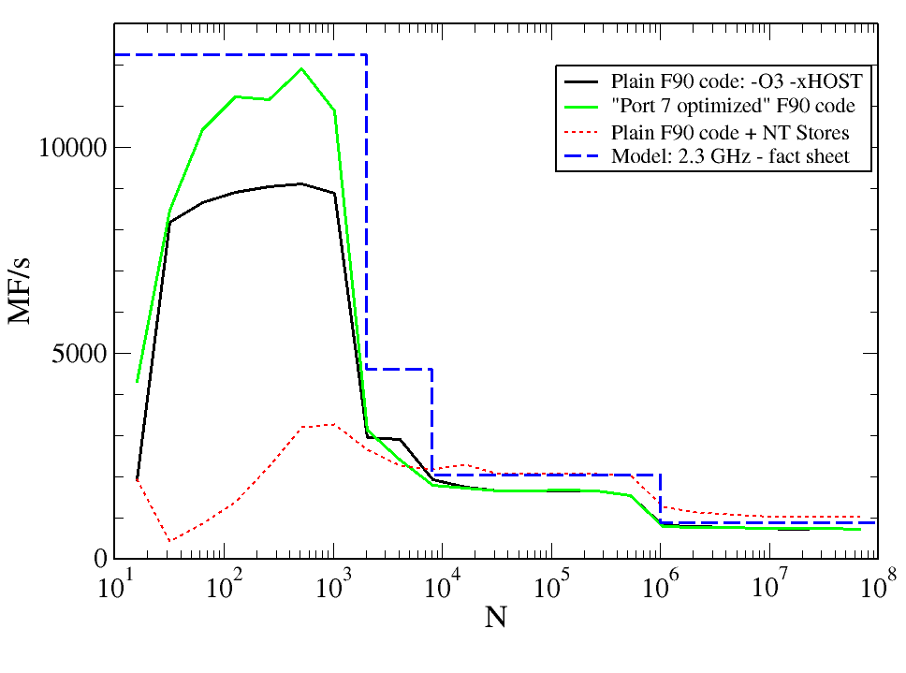
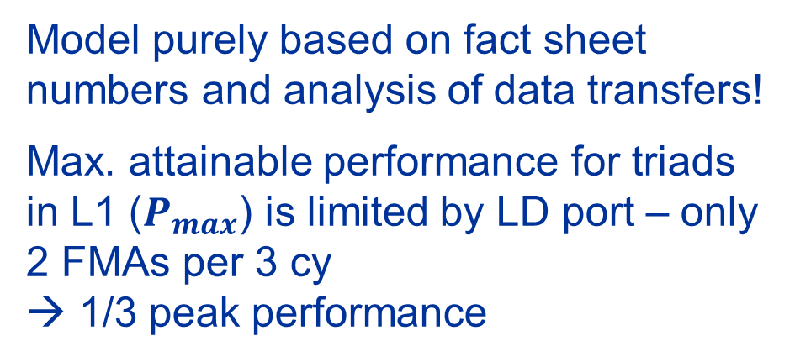
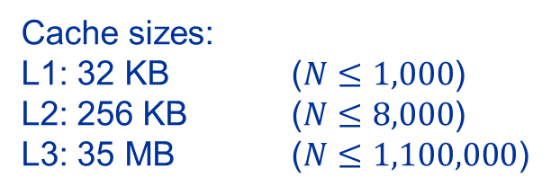
Vector Triad (double precision)
Data traffic analysis
Intel Xeon E5-2695 v3 (“Haswell”)
Cache sizes:
L1: 32 KB ($N≤1,000$)
L2: 256 KB ($N≤8,000$)
L3: 35 MB ($N≤1,100,000$)
Special addressing mode
Good qualitative
agreement
Data set size N*4*8 B
←→ cache sizes
Model purely based on fact sheet numbers and analysis of data transfers!
Max. attainable performance for triads in L1 ($P_{max}$) is limited by LD port – only 2 FMAs per 3 cy
→ 1/3 peak performance
  L2 cache performance 64 B/cy too optimistic
  low level benchmarks:~ 32 B/cy – 48 B/cy
NT-stores decreases inner cache performance
Notes:
Data transfer volume increases due to WRITE ALLOCATE
No overlap assumption in hardware transfer fits well – individual transfer times within memory/cache hierarchy add up!
No overlap assumptions holds qualitatively for Intel processors – may change – does not hold on other architectures

Slide 73
Hands on
Dense Matrix-Vector-Multiplication
(quadratic, double precision)

Slide 74
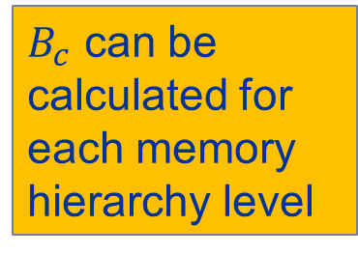
Dense matrix-vector multiplication in DP
do c = 1 , C
tmp=x(c)
do r = 1 , R
y(r)=y(r) + A(r,c)* tmp
enddo
enddo
Right hand side
(RHS) vector
Assume C = R ≈ 10000
  sizeof(A(:,:)) = C * R * 8 Byte
  sizeof(x(:)) = C * 8 Byte
  sizeof(y(:)) = R * 8 Byte
Code balance (inner loop):
What can we do to optimize the code?
Left hand side
(LHS) vector
$$B_{c}=\frac{Data Transfers (Byte)}{Work Metric (flops, CLupdates,…)}=\frac{3 words}{2 flops}=\frac{24B}{2F}$$
$B_{c}$ can be calculated for each memory hierarchy level

Slide 75
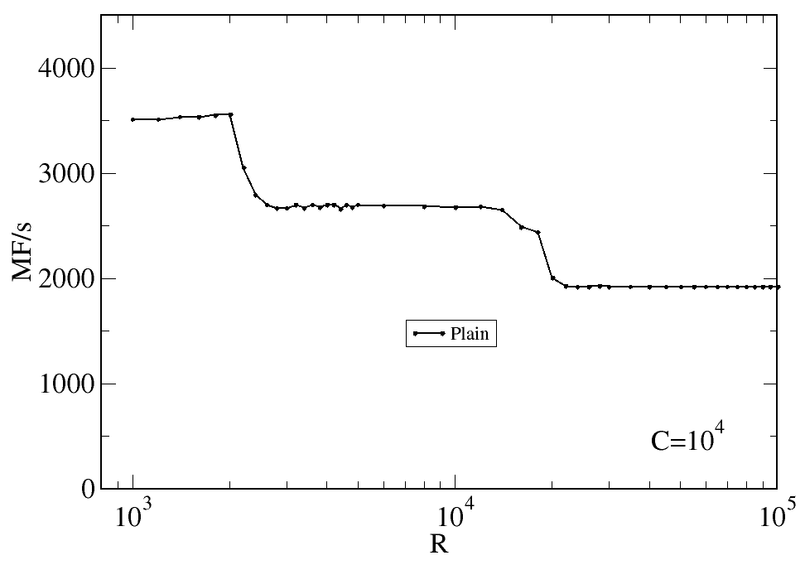
Dense matrix-vector multiplication in DP
Single-core performance vs. column height R
Performance drops as number of rows (inner loop length) increases.
Why this behavior?
Does code balance change?
Intel Xeon E5 2695 v3 (Haswell-EP), 2.3 GHz, CoD mode, Core P_{peak}=18.4 GF/s,
Caches: 32 KB / 256 KB / 35 MB, PageSize: 2 MB; ifort V15.0.1.133; b_{S} = 32 Gbyte/s

Slide 76
Dense matrix-vector multiplication in DP
Data traffic analysis
y(:) frequently updated → likely to stay in cache
A(:,:) no reuse → loaded from memory
x(c) in register during inner loop
do c = 1 , C
tmp=x(c)
do r = 1 , R
y(r)=y(r) + A(r,c)* tmp
enddo
enddo
With increasing R:
y(:) might be too large for innermost cache
→ increased data traffic from lower cache levels
Can we measure this?

Slide 77
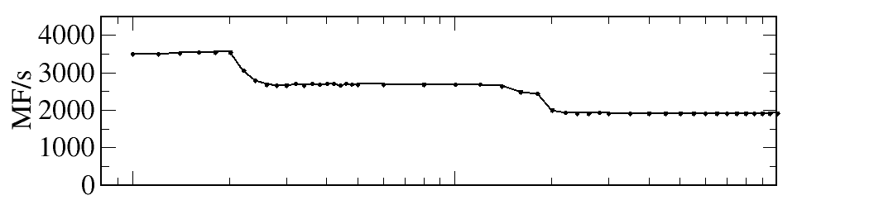
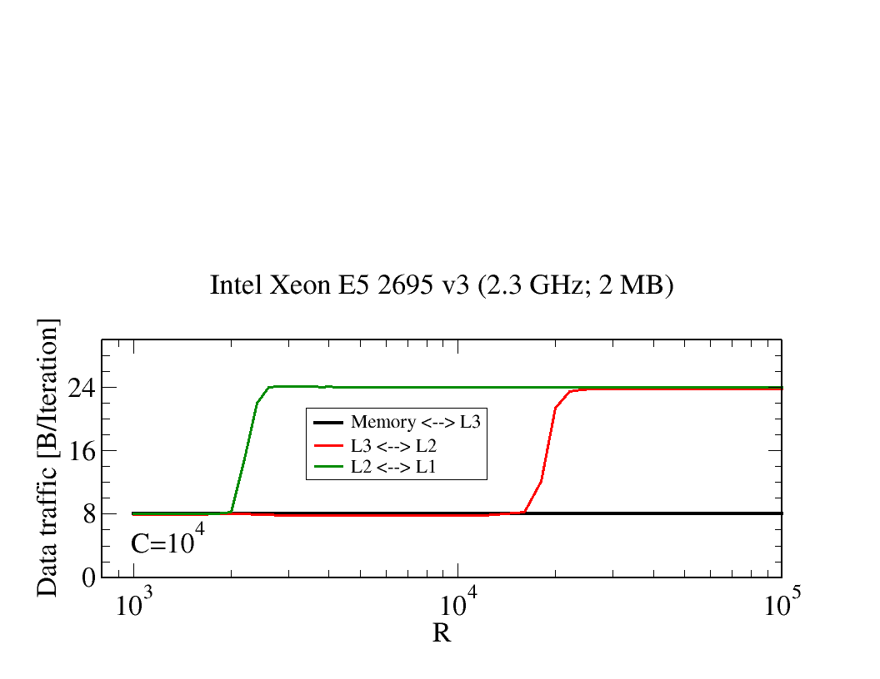




Dense matrix-vector multiplication in DP
Data traffic analysis
size(y(1:R)) = 16 kB
size(y(1:R)) = 160 kB
y Exceeding inner cache size:
→ (8+8) Byte for LD + ST on y
$$B_{C}^{L2}=24\text{B}/2\text{F}$$
$$B_{C}^{L3}=24\text{B}/2\text{F}$$
Intel Xeon E5 2695 v3 (Haswell-EP), 2.3 GHz
Caches: 32 KB / 256 KB / 35 MB,
PageSize: 2 MB; CoD mode,
Core P_{peak}=18.4 GF/s ifort V15.0.1.133;
b_{S} = 32 Gbyte/s
$$B_{C}^{L3}=\text{8}\text{B}/2\text{F}$$
$$B_{C}^{mem}=\text{8}\text{B}/2\text{F}$$

Slide 78
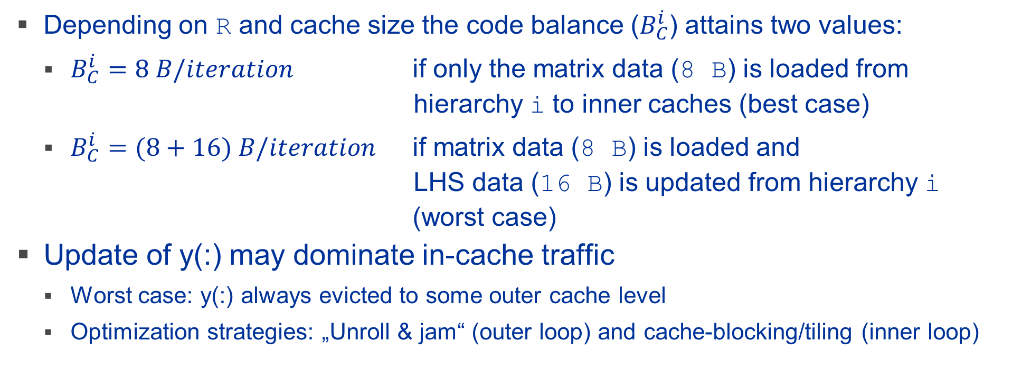
Dense matrix-vector multiplication in DP
Data traffic analysis
Depending on R and cache size the code balance ($B_{C}^{i}$) attains two values:
  $B_{C}^{i}=8 B/iteration$ if only the matrix data (8 B) is loaded from hierarchy i to inner caches (best case)
  $B_{C}^{i}=(8+16) B/iteration$ if matrix data (8 B) is loaded and
  LHS data (16 B) is updated from hierarchy i
  (worst case)
Update of y(:) may dominate in-cache traffic
  Worst case: y(:) always evicted to some outer cache level
  Optimization strategies: „Unroll & jam“ (outer loop) and cache-blocking/tiling (inner loop)

Slide 79
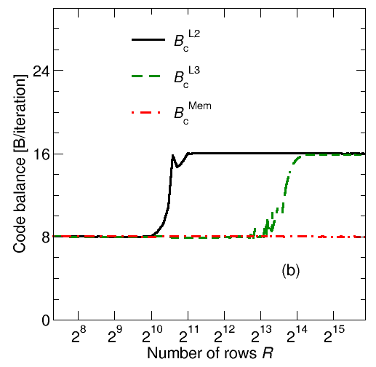
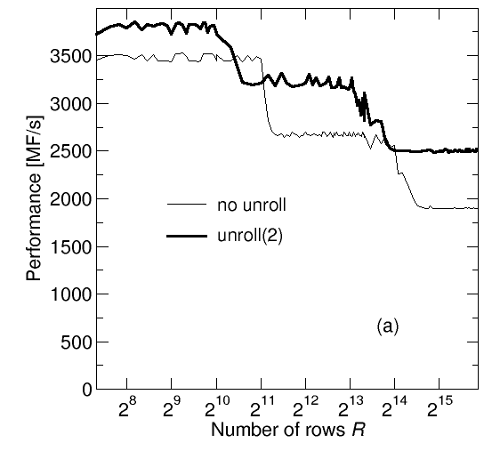

Dense matrix-vector multiplication in DP
Reducion of in-cache traffic “unroll & jam”
y(1:R) Updated
C-1 times
from outer cache
Reduces worst case code balance to $B_{C}^{i}=(8+8) B/iteration$
do c = 1 , C
tmp=x(c)
do r = 1 , R
y(r)=y(r) + A(r,c)* tmp
enddo
enddo
y(1:R) Updated
C/2-1 times
from outer cache
do c = 1 , C , 2
tmp1=x(c)
tmp2=x(c+1)
do r = 1 , R
y(r)=y(r) + A(r,c). * tmp1
y(r)=y(r) + A(r,c+1)* tmp2
enddo
enddo
2-way unroll + jam
Data transfer for y:
16 Byte/2 iterations
ST y(r)
LD y(r)
General for m-way unroll & jam:$B_{C}^{i}=(8+\frac{16}{m}) B/iteration$

Slide 80
Dense matrix-vector multiplication in DP
Reducion of cache traffic by “blocking/tiling”
do c = 1 , C
tmp=x(c)
do r = 1 , R
y(r)=y(r) + A(r,c)* tmp
enddo
enddo
y(:) may not fit into some cache → more traffic for lower level
R
R_{b} free parameter –
adapted to caches size
(commonly size/2)
A(r,c)
do rb = 1 , R , R_{b}
rbS = rb
rbE = min((rb+R_{b}-1), R)
do c = 1 , C
do r = rbS , rbE
y(r)=y(r) + A(r,c)*x(c)
enddo
enddo
enddo
R_{b}
y(rbS:rbE) may fit into some cache if R_{b} is small enough
→ traffic reduction
Careful: loops order!

Slide 81
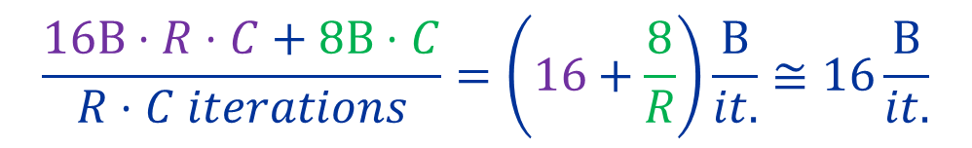

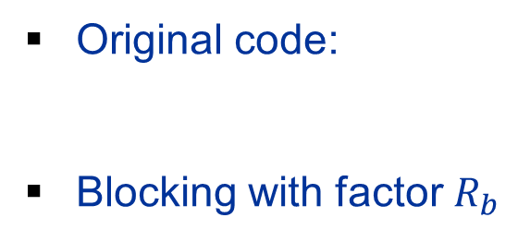
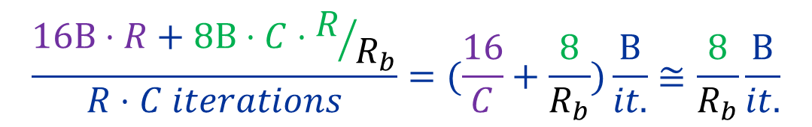
Dense matrix-vector multiplication in DP
Reducion of cache traffic by “blocking/tiling”
Blocking helps keeping LHS y(:) in cache
Price: RHS x(:) loaded $R/{R_{b}}$ times
  → x(:) and y(:) contribute to worst case code balance
  → Do not choose R_{b} too small
Original code:
Blocking with factor $R_{b}$
$$\frac{16\text{B}⋅R⋅C+8\text{B}⋅C}{R⋅C iterations}=\left(16+\frac{8}{R}\right)\frac{\text{B}}{it.}≅16\frac{\text{B}}{it.}$$
$$\frac{16\text{B}⋅R+8\text{B}⋅C⋅R/{R_{b}}}{R⋅C iterations}=(\frac{16}{C}+\frac{8}{R_{b}})\frac{\text{B}}{it.}≅\frac{8}{R_{b}}\frac{\text{B}}{it.}$$

Slide 82
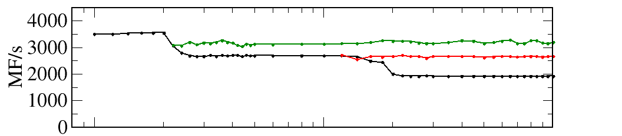
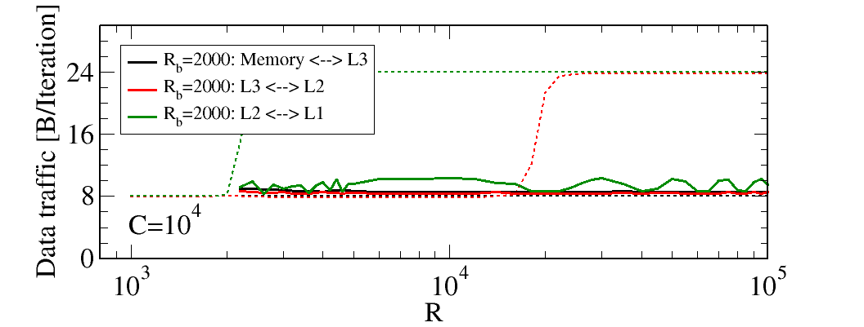
Dense matrix-vector multiplication in DP
Reducion of cache traffic by “blocking/tiling”
“1D blocking” for inner loop
Blocking factor R_{b} ←→ cache level
→ Fully reuse subset of
y(rbS:rbE) from L1/L2
cache
Notes:
Gerhard fragen was die untere Grafik nochmal zeigt. L3 traffic oder memory traffic

Slide 83
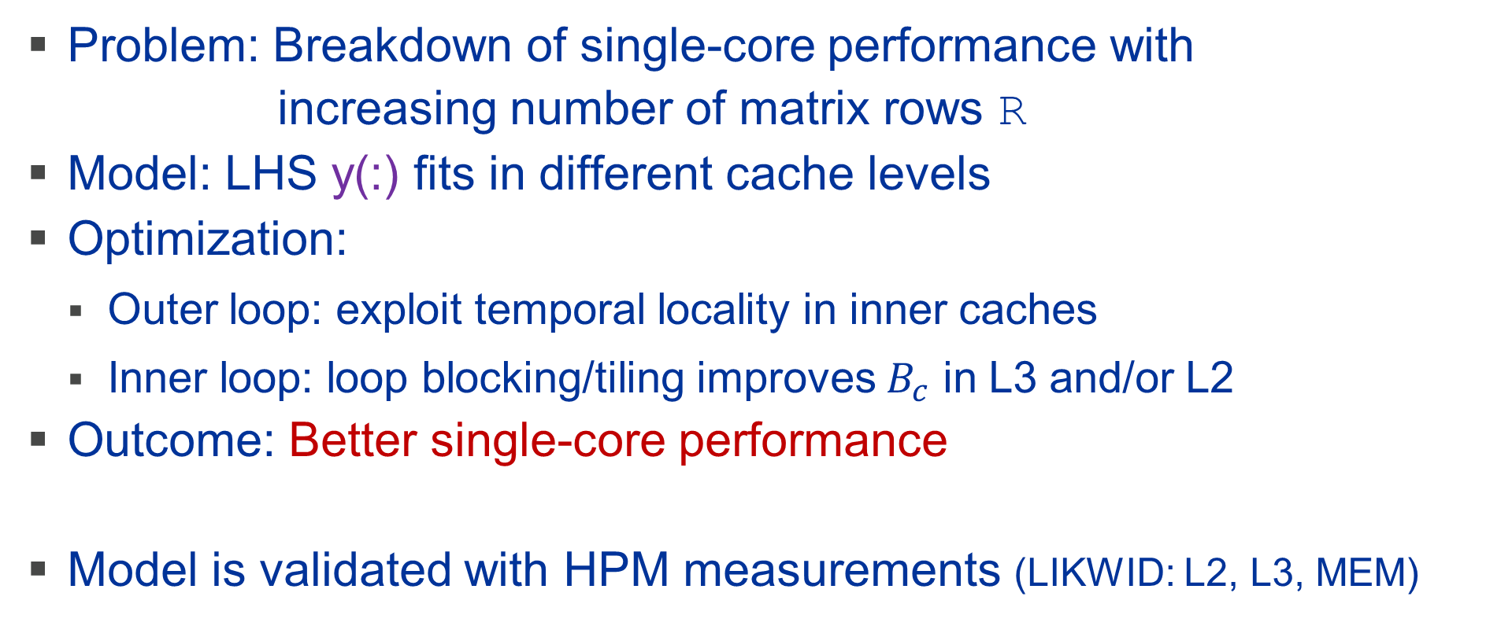
Dense matrix-vector multiplication in DP
Conclusion
Problem: Breakdown of single-core performance with
increasing number of matrix rows R
Model: LHS y(:) fits in different cache levels
Optimization:
  Outer loop: exploit temporal locality in inner caches
  Inner loop: loop blocking/tiling improves $B_{c}$ in L3 and/or L2
Outcome: Better single-core performance
Model is validated with HPM measurements (LIKWID: L2, L3, MEM)

Slide 84
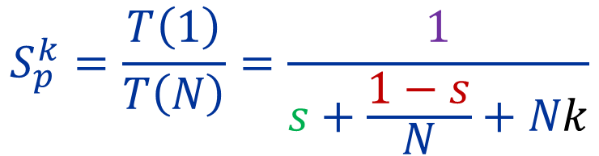
Amdahl’s law (Strong Scaling)
What about communication?
T(1) = s+p = serial compute time (=1)
Communication model: Constant fraction k for each “communication” between each two workers
parallelizable part: p = 1-s
purely serial part s
General formula for speedup: Amdahl's Law
This holds for constant problem size ("strong scaling„)
Extended
Parallel execution time: T(N) = s+p/N
+Nk
$$S_{p}^{k}=\frac{T\left(1\right)}{T\left(N\right)}=\frac{1}{s+\frac{1−s}{N}+Nk}$$
Specific choice of
communication model
(ring shift – bus network)

Slide 85
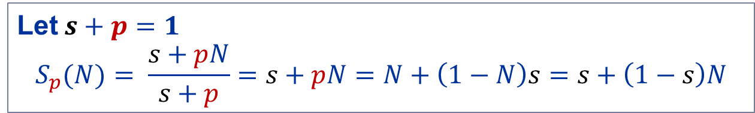
Gustafsen’s law (Weak Scaling)
Increasing problem size often enlarges the parallel fraction p
When scaling a problem to more workers, the amount of work will often be scaled as well
s
p
s
p
s
p/N
s
p/N
Scalability in terms of parallel speedup and parallel efficiency improves when scaling the problem size!
Let$s+p=1$
$$S_{p}(N)= \frac{s+pN}{s+p}=s+pN=N+\left(1−N\right)s=s+\left(1−s\right)N$$
work/time for problem size N with N workers
work/time for problem size 1 with 1 worker
“Performance Speedup” =

Slide 86
Dense matrix-vector multiplication in DP
Parallelization
Let’s assume symmetric matrix
  Avoid unneeded computation by calculating only triangular matrix
  Distribute columns to threads
  Problem?
  Can you name the pattern?
!$omp parallel do private(r)
do c = 1 , C
tmp=x(c)
do r = 1 , c
y(r)=y(r) + A(r,c)* tmp
enddo
enddo
!$omp end parallel do

Slide 87
Dense matrix-vector multiplication in DP
Parallelization
$ likwid-perfctr –C 0,1,2 –g L2 –m ./a.out
--------------------------------------------------------------------------------
CPU type: Intel Core SandyBridge EN/EP processor
CPU clock: 3.09 GHz
--------------------------------------------------------------------------------
========================
Group 1: Region Compute
========================
+-----------------------+---------+--------------+--------------+--------------+
| Event | Counter | Core 0 | Core 1 | Core 2 |
+-----------------------+---------+--------------+--------------+--------------+
| INSTR_RETIRED_ANY | FIXC0 | 2.626800e+08 | 3.187585e+08 | 3.780255e+08 |
| CPU_CLK_UNHALTED_CORE | FIXC1 | 4.972802e+08 | 4.961411e+08 | 4.933711e+08 |
| CPU_CLK_UNHALTED_REF | FIXC2 | 4.972801e+08 | 4.961404e+08 | 4.933714e+08 |
| L1D_REPLACEMENT | PMC0 | 5.490278e+07 | 3.927353e+07 | 2.364295e+07 |
| L1D_M_EVICT | PMC1 | 2.920200e+04 | 2.876600e+04 | 2.861000e+04 |
+-----------------------+---------+--------------+--------------+--------------+
Always use a reasonable metric for “work”!
Number of instructions raise
with CPU number
First CPU loads most data into L1
Same amount of CLs evicted from L1

Slide 88
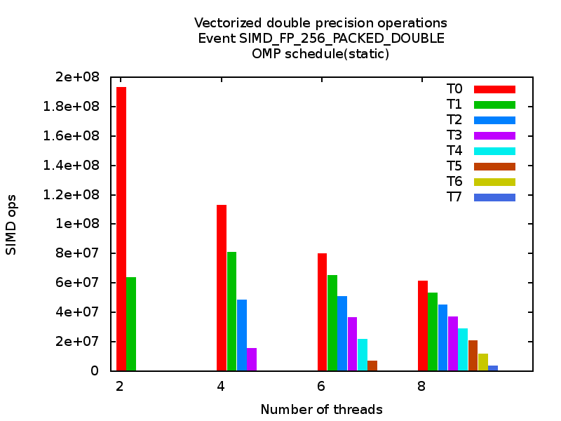
Dense matrix-vector multiplication in DP
Parallelization
Here we look at 256 bit wide
vector operations → AVX
First thread “works” most
=
•
Intel SandyBridge

Slide 89
Dense matrix-vector multiplication in DP
Parallelization
How to balance the workload for every thread?
Over-engineering:
  Different data layout
  Use smaller chunks of work (split rows/columns in multiple chunks?)
Simple: Change OpenMP schedule schedule(kind, chunksize)
  dynamic: actively balance chunks of work
  static: pre-compute chunks of work
  chunksize parameter describes size of chunks
→ Overhead
→ No Overhead

Slide 90
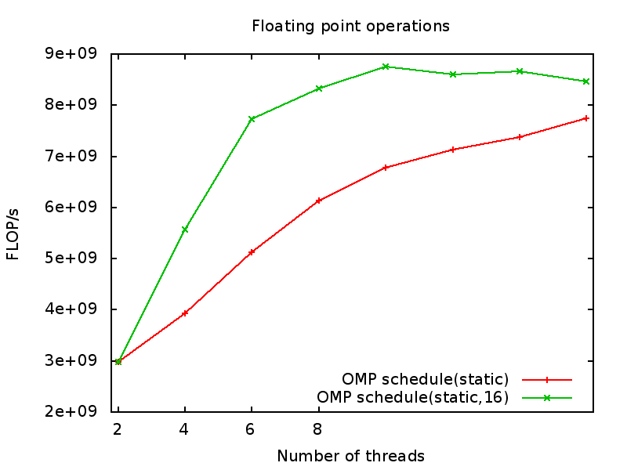
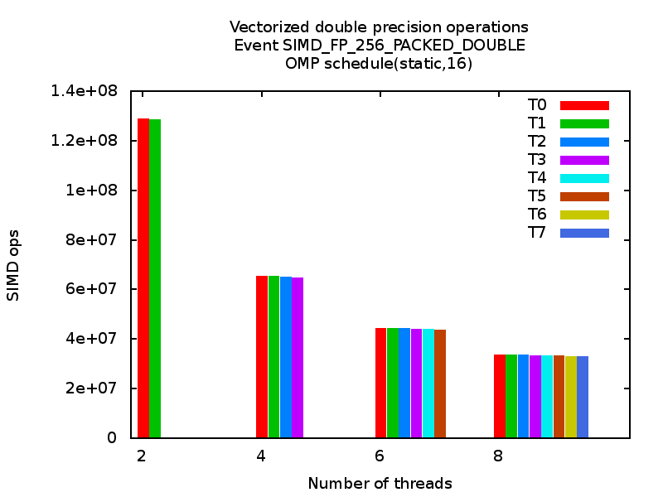
Dense matrix-vector multiplication in DP
Parallelization
Reduce chunk of work to a few rows
Not optimal, but sufficient!
•
=
Saturate memory bandwidth
Intel SandyBridge

Slide 91
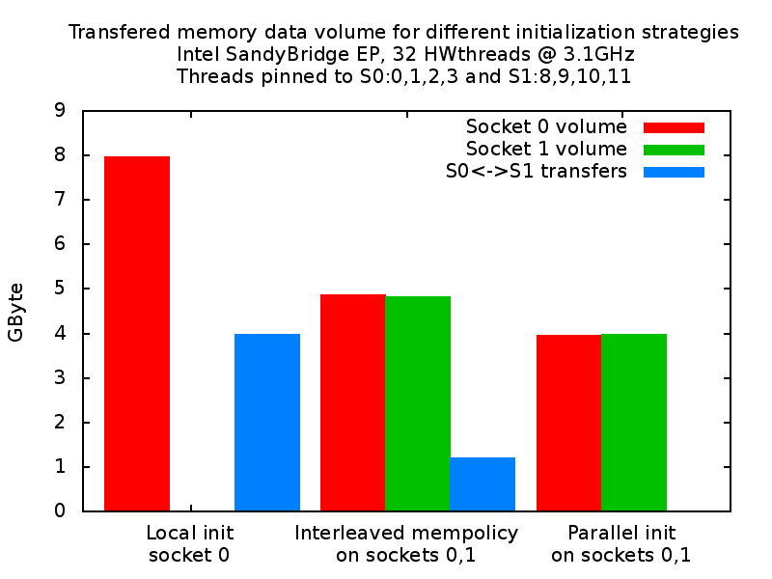
Dense matrix-vector multiplication in DP
Parallelization
malloc() does not locate data
First access defines location
(first touch)
Data locality crucial for high
performance on ccNUMA
systems
Simplification: Use same work sharing for allocation and work!
Not always, but true for GCC and Intel/LLVM OpenMP: Once started
and pinned threads stay there!
numactl –i <nodesel> ./a.out

Slide 92
Hands on
Might be helpful for your coding challenge!
Jacobi 2D 5pt stencil
(double precision)

Slide 93
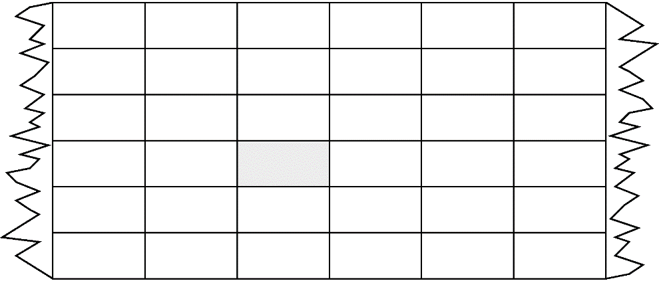
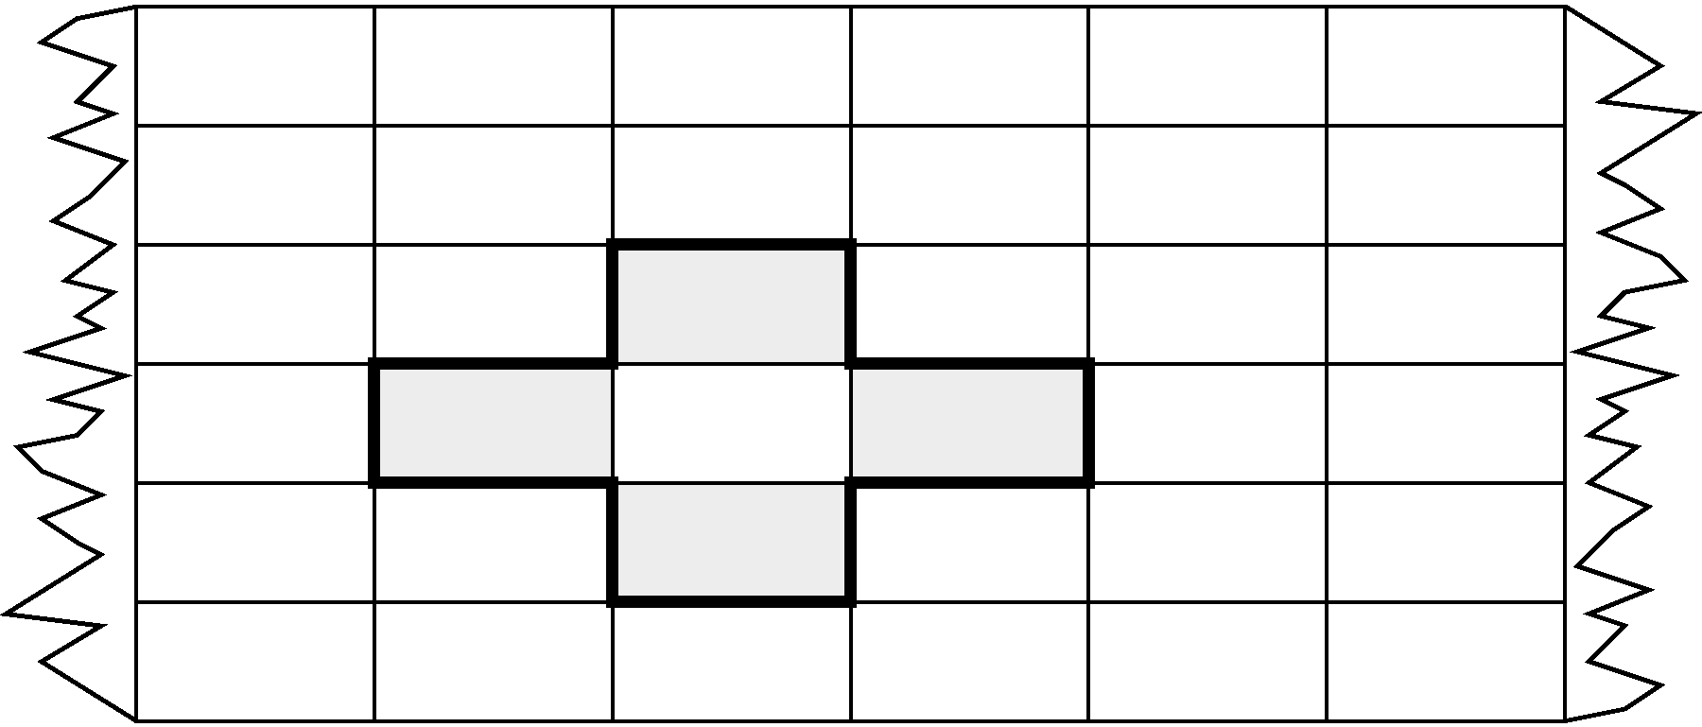
Jacobi 2D 5pt stencil (DP)
Appropriate performance metric:
“Lattice site updates per second” [LUP/s]
(here: Multiply by 4 FLOP/LUP to get FLOP/s rate)
do k=1,kmax
do j=1,jmax
y(j,k) = const * ( x(j-1,k) + x(j+1,k) &
+ x(j,k-1) + x(j,k+1) )
enddo
enddo
sweep
2 arrays
k
y(0:jmax+1,0:kmax+1)
x(0:jmax+1,0:kmax+1)
j

Slide 94
Jacobi 2D 5pt stencil (DP)
Data traffic analysis
Available in cache (used 2 iterations before)
do k=1,kmax
do j=1,jmax
y(j,k) = const * ( x(j-1,k) + x(j+1,k) &
+ x(j,k-1) + x(j,k+1) )
enddo
enddo
LD x(j+1,k)
sweep
LD x(j,k+1)
LD+ST y(j,k)
(incl. write allocate)
LD x(j,k-1)
Naive balance (incl. write allocate):
x( :, :) : 3 LD +
y( :, :) : 1 ST+ 1LD
→ B_{C} = 5 Words / LUP → B_{C} = 40 B / LUP
(assuming double precision)
Reminder “write allocate”:
If a cache line is not present in L1 cache at a store, the CL needs to loaded first into L1.

Slide 95
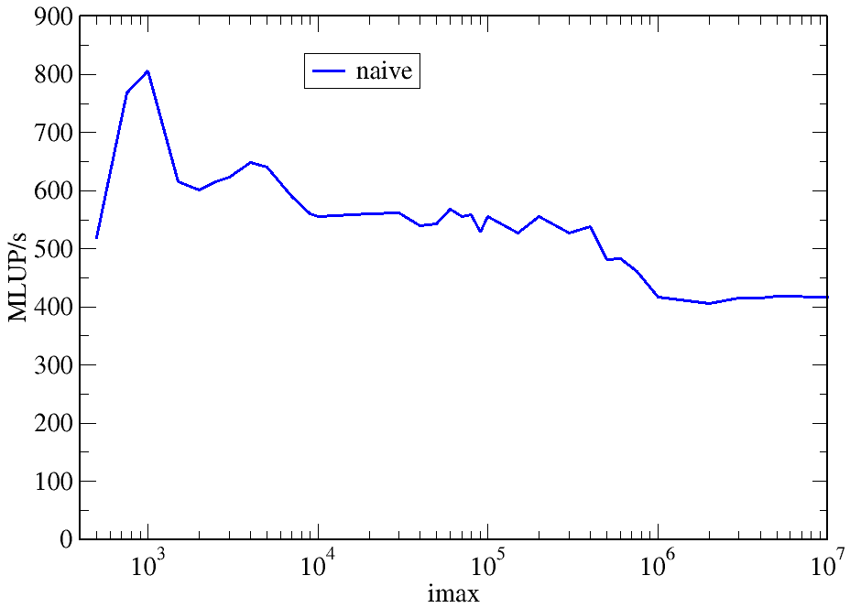
Jacobi 2D 5pt stencil (DP)
Data traffic analysis
Code balance (B_{C} ) measured with LIKWID
L3 Cache
Questions:
How to achieve 24 B/LUP also for large jmax?
How to sustain > 600
MLUP/s for jmax>10⁴ ?
Why 24 B/LUP anyway??
Naïve balance was
40B/LUP!
~24 B / LUP
~40 B / LUP
jmax=kmax
jmax*kmax = const
Intel Xeon E5-2690 v2 @ 3 GHz, ifort V13.1, L1: 32kB, L2: 256kB, L3: 25 MB

Slide 96
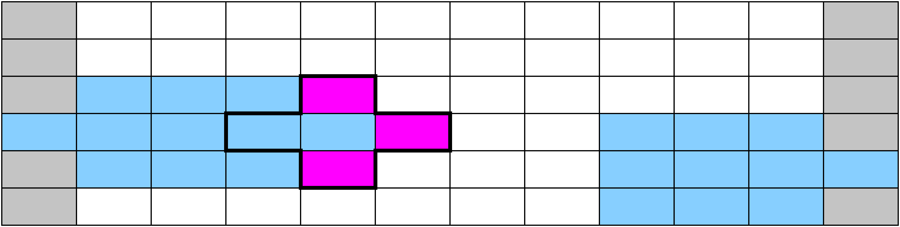
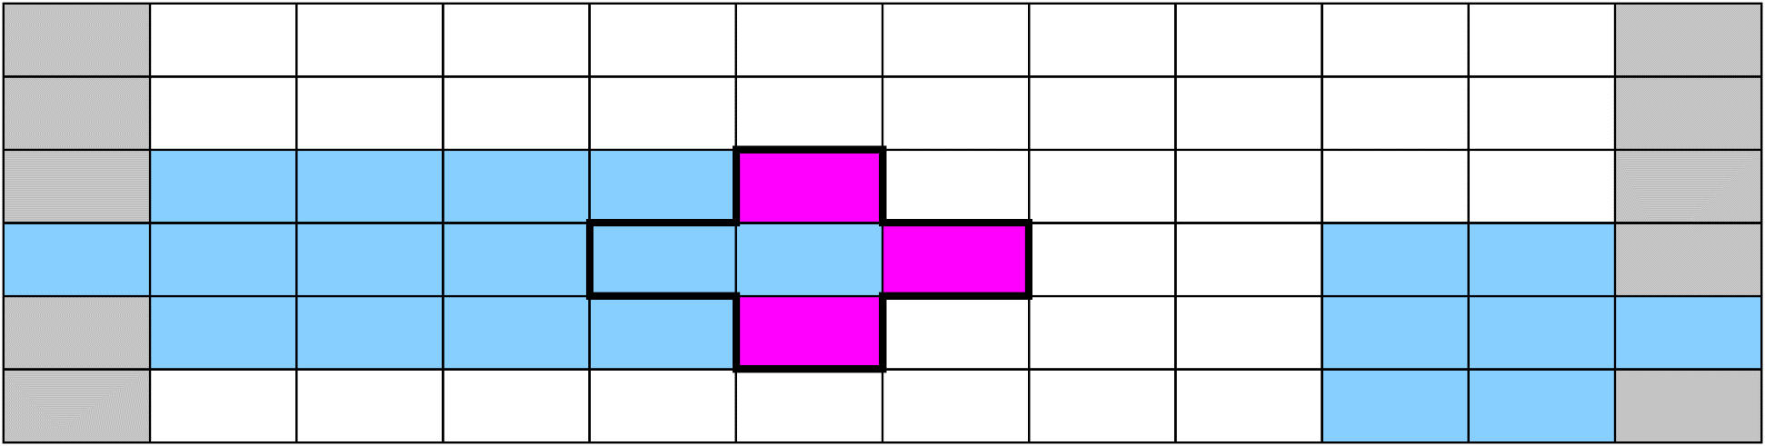
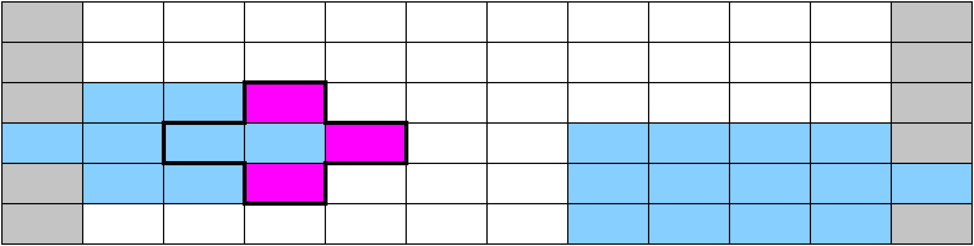

Jacobi 2D 5pt stencil (DP)
Data traffic analysis
cached
memory access
j₀,k₀
j₀+1,k₀
j₀+2,k₀
j₀+3,k₀
k
j
x(0:jmax+1,0:kmax+1)
Worst case: Cache not large enough to hold 3 layers (rows) of grid
(+assume „Least Recently Used“ replacement strategy)

Slide 97

Jacobi 2D 5pt stencil (DP)
Data traffic analysis
Reduce inner (j-) loop dimension successively
k
j
x(0:jmax1+1,0:kmax+1)
Best case: 3 „layers“ of grid fit into the cache!
x(0:jmax2+1,0:kmax+1)

Slide 98
Jacobi 2D 5pt stencil (DP)
Data traffic analysis
x(j₀,k₀+1)
x(j₀,k₀-2)
do k=1,kmax
do j=1,jmax
y(j,k) = const * ( x(j-1,k) + x(j+1,k) &
+ x(j,k-1) + x(j,k+1) )
enddo
enddo
j₀,k₀
3 * jmax * 8B < CacheSize/2
“Layer condition”
3 rows of jmax
double precision
Safety margin (Rule of thumb)
Layer condition:
No impact of outer loop length (kmax)
No strict guideline (cache associativity – data traffic for y() not included)
Needs to be adapted for other stencils, e.g., in 3D, long-range, multi-array,…

Slide 99
Jacobi 2D 5pt stencil (DP)
Data traffic analysis
y: (1 LD + 1 ST) / LUP
x: 1 LD / LUP
do k=1,kmax
do j=1,jmax
y(j,k) = const * ( x(j-1,k) + x(j+1,k) &
+ x(j,k-1) + x(j,k+1) )
enddo
enddo
B_{C} = 24 B / LUP
YES
3 * jmax * 8B < CacheSize/2
“Layer condition” fulfilled?
y: (1 LD + 1 ST) / LUP
do k=1,kmax
do j=1,jmax
y(j,k) = const * ( x(j-1,k) + x(j+1,k) &
+ x(j,k-1) + x(j,k+1) )
enddo
enddo
NO
B_{C} = 40 B / LUP
x: 3 LD / LUP

Slide 100
Jacobi 2D 5pt stencil (DP)
Establish Layer condition for all jmax
Take care, loop over the blocks is most outer loop now
Apply spatial blocking of j-loop
Determine for given CacheSize an appropriate jblock: value:
do jb=1,jmax,jblock ! Assume jmax is multiple of jblock
do k=1,kmax
do j= jb, (jb+jblock-1) ! Length of inner loop: jblock
y(j,k) = const * (x(j-1,k) + x(j+1,k) &
+ x(j,k-1) + x(j,k+1) )
enddo
enddo
enddo
New layer condition (blocking)
3 * jblock * 8B < CacheSize/2
→
jblock < CacheSize / 48 B

Slide 101






Jacobi 2D 5pt stencil (DP)
Data traffic analysis (spatial blocking)
Additional data transfers (overhead) at block boundaries!

Slide 102


Jacobi 5pt stencil (DP)
Blocking for which cache?
Intel Xeon E5-2690 v2 @ 3 GHz, ifort V13.1, L1: 32kB, L2: 256kB, L3: 25 MB
Blocking factor (CS=25MB) too large!
L3 Cache
L2: CS=256 KB
jblock=min(jmax,5333)
L3: CS=25 MB
jblock=min(jmax,533333)
40 B / LUP
Mem
Where does the gap come from?
L1
L2/3
L2/3
24 B / LUP
jmax=kmax
jmax*kmax = const
Main Memory
Code balance (B_{C}) measured
Little overhead at block bounderies
jmax

Slide 103
Jacobi 2D 5pt stencil (DP)
What about 3D 7pt stencil?
2D cut of 3D domain for (new) fixed i-coordinate:
x(i, 0:jmax+1,0:kmax+1)
Think: One cell of j-k plane as a contiguous slab of elements in i-direction: x(0:imax,j,k)
k
i
j

Slide 104
Jacobi 2D 5pt stencil (DP)
What about 3D 7pt stencil?
3*jmax * 8B < CacheSize/2
do k=1,kmax
do j=1,jmax
y(j,k) = const * (x(j-1,k) + x(j+1,k) &
+ x(j,k-1) + x(j,k+1) )
enddo
enddo
B_{C} = 24 B / LUP
“Layer condition” OK →
5 accesses to x() served by cache
do k=1,kmax
do j=1,jmax
do i=1,imax
y(i,j,k) = const * (x(i-1,j,k) + x(i+1,j,k)
+ x(i,j-1,k) + x(i,j+1,k) &
+ x(i,j,k-1) + x(i,j,k+1) )
enddo
enddo
enddo
B_{C} = 24 B / LUP
Same for version with spatial blocking
3*jmax *imax * 8B < CacheSize/2

Slide 105


Jacobi 3D 7pt stencil (DP)
Blocking, layer condition and threading?
do jb=1,jmax,jblock ! Assume jmax is multiple of jblock
do k=1,kmax
do j=jb, (jb+jblock-1) ! Loop length jblock
do i=1,imax
y(i,j,k) = const *(x(i-1,j,k) +x(i+1,j,k) &
+ x(i,j-1,k) +x(i,j+1,k)
+ x(i,j,k-1) +x(i,j,k+1))
enddo
enddo
enddo
enddo
!$OMP PARALLEL DO SCHEDULE(STATIC)
!$OMP END PARALLEL DO
“Layer condition” (j-Blocking))
nthreads*3*jblock*imax*8B < CS/2
jblock < CS/(imax * nthreads * 48B )
Intel Xeon E5-2690 v2 @ 3 GHz, ifort V13.1, L1: 32kB, L2: 256kB, L3: 25 MB
Maximum memory bandwidth $b_{S}=48 GB/s$
Best performance:
$$P=\frac{b_{S}}{B_{C}^{}}=2000 \text{MLUP}\text{/}\text{s}$$

Slide 106


Jacobi 3D 7pt stencil (DP)
What about layer condition and threading?
Intel Xeon E5-2690 v2 @ 3 GHz, ifort V13.1, L1: 32kB, L2: 256kB, L3: 25 MB
Validation: Measured data traffic from main memory [Bytes/LUP]
CS=10 MB, imax=400, jblock < 54
~ 90+ % roofline limit
#blocks changes
CS=25MB, imax=400, jblock < 136:
“Layer Condition” too optimistic
jblock=32,…,64 useful choices
imax = jmax = kmax
jblock < CS/(2*nthreads*3*imax*8B)

Slide 107
Jacobi 3D 7pt stencil (DP)
What about j-loop parallelization?
do k=1,kmax
do j=1,jmax
do i=1,imax
y(i,j,k) = const * (x(i-1,j,k) +x(i+1,j,k) &
+ x(i,j-1,k) + x(i,j+1,k) &
+ x(i,j,k-1) + x(i,j,k+1) )
enddo
enddo
enddo
!$OMP PARALLEL PRIVATE(k)
!$OMP DO SCHEDULE(STATIC)
!$OMP END DO
!$OMP END PARALLEL
All threads work on the same 3 k-layers at the same time
“Layer condition” (j-loop parallel; schedule=static)
3*jmax*imax*8B < CS/2
Layer condition is independent of number of threads (imax<720 for test system)
Parallelization overhead:
jmax*imax implicit barriers,
each ≈ 1500 cycles
jmax = imax = 200, P = 2000 MLUP/s
→ 60000 cycles

Slide 108
Jacobi 3D 7pt stencil (DP)
Other options?
t = 0
t = 1
Temporal blocking
  Compute multiple future iterations for a block in a single iteration
  Reuse data just computed
Semi-Stencil
  Compute only part of stencil and complete computation when required data is really required
?

Slide 109
Jacobi 2D 5pt & 3D 7pt stencil (DP)
Conclusions
Data transfer analysis is key to structured performance modeling and optimization
Avoiding slow data paths == re-establishing the most favorable layer condition
Optimal blocking factor for spatial blocking can be estimated
  Be guided by the cache size & the layer condition
  → does not depend on outer loop!
  Blocking: overhead at block boundaries → Largest cache first choice
  No need for exhaustive scan of “optimization space”

Slide 110
Jacobi 2D 5pt & 3D 7pt stencil (DP)
Conclusions
Performance optimization by re-establishing the layer condition was guided and validated by (roofline-like) model
Modeling and optimizing “Jacobi” stencil is blueprint for many stencil(-like) kernels.

Slide 111
Comments on C++

Slide 112
Comments on C++
C++ codes which suffer from overhead (inlining problems, complex abstractions) need a lot more overall instructions related to the arithmetic instructions
Often (but not always) “good” (i.e. low) CPI → “Instruction overhead” pattern
Low-ish bandwidth
Low # of floating-point instructions vs. other instructions
High-level optimizations complex or impossible → “Excess data volume” pattern
Matrix-matrix multiply with expression template frameworks on a 2.93 GHz Westmere core
 | Total retired instructions [10¹¹] | CPI | Memory Bandwidth [MB/s] | MFlops/s
Classic | 12.5 | 0.44 | 5300 | 1250
Boost uBLAS | 10.1 | 4.6 | 630 | 156
Eigen3 | 2.1 | 0.41 | 371 | 8555
Blaze/DGEMM | 2.0 | 0.32 | 531 | 11260

Slide 113
Profiling with gprof: Example (C++)
Main program:
class D {
double d;
public:
D(double _d=0) : d(_d) {}
D operator+(const D& o) {
D r;
r.d = d+o.d;
return r;
}
operator double() {
return d;
}
};
const int n=10000000;
D a[n],b[n];
D sum;
for(int i=0; i<n; ++i)
a[i] = b[i] = 1.5;
double s = timestamp();
for(int k=0; k<10; ++k) {
for(int i=0; i<n; ++i)
sum = sum + a[i] + b[i];
}
Example with wrapped double class:

Slide 114
Profiling with gprof: Example (C++) profiler output
% cumulative self self total
time seconds seconds calls Ts/call Ts/call name
101.01 0.41 0.41 main
sum = sum + a[i] + b[i];
% cumulative self self total
time seconds seconds calls ns/call ns/call name
46.44 0.59 0.59 200000000 2.93 4.48 D::operator+(D const&)
29.63 0.96 0.37 240000001 1.56 1.56 D::D(double)
24.82 1.27 0.31 main
D sum;
D operator+(const D& o) {
D r;
…}
a[i] = b[i] = 1.5;
icpc -O3 -pg perf.cc
icpc -O3 -fno-inline -pg perf.cc
But where did the time actually go?
  Real problem also with use of libraries (STL!)

Slide 115
Summary
Node-level performance engineering
Increasing complexity of systems
  → Increasing complexity to optimize the code
Systems mainly optimized for instruction throughput
→ Take care about the data side
Keep data in caches (close to the consumer) as long as possible and reuse it as much as possible
Create models that can be verified by testing runs
Limit optimization efforts to a reasonable amount

