Slide 1
Node-level architecture
Single Core Architecture

Slide 2
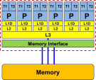
Quiz
What does “clock frequency” mean in computers?
What is “memory bandwidth”?
What is SIMD vectorization?
What is ccNUMA?
The “heartbeat” of the CPU. A clock cycle is the smallest unit of time on a CPU chip. Typically < 1ns → $f≳1 \text{GHz}$
R0
R1
R2
Rate of data transfer between main memory (RAM) and CPU chip. Typical $b_{S}≈10…100 \text{GB}\text{/}\text{s}$
+
A[3]
B[3]
C[3]
A[2]
+
B[2]
C[2]
Single Instruction Multiple Data. Data-parallel load/store and execution units.
A[1]
+
B[1]
C[1]
A[0]
+
B[0]
C[0]

Slide 3
Quiz
What is a register?
What is Amdahl’s Law?
What is a pipelined functional unit?
rax
ymm0
rbx
ymm1
A storage unit in the CPU core that can take one single value (a few values in case of SIMD). Operands for computations reside in registers.
rcx
ymm2
rdx
ymm3
rsi
ymm4
$$T(1)$$
$$S_{p}=\frac{T(1)}{T(N)}=\frac{1}{s+\frac{1−s}{N}}$$
$$T(4)$$
An instruction execution unit on the core that executes an instruction in several simple sub-steps. The stages of the pipeline can act in parallel on several instructions at once.

Slide 4
Cycle gymnastics
1 cycle or cy = smallest unit of time on a CPU (“heartbeat”)
Basic unit of work: Floating-point operation (Flop or F)
Basic unit of traffic: Byte
Unit of bandwidth: Bytes/s
Typical memory bandwidth: 48 Gbytes/s = 4.8∙10¹⁰ Bytes/s
How many bytes per cycle is that? $\frac{48∙{10}^{9}\frac{Bytes}{s}}{3.0∙{10}^{9}\frac{cy}{s}}=16\frac{Bytes}{cy}$
Clock speed of typical CPU: 3.0 Gcy/s (or GHz)
Typical peak performance of 8-core CPU: P_{peak} = 192 GF/s
How many FLOPs per cycle per core is that? $\frac{192∙{10}^{9}\frac{F}{s}}{8 cores ∙3.0∙{10}^{9}\frac{cy}{s}}=8\frac{F}{cy∙core}$
Typical duration of a double precision multiply: 5 cycles
How much time is that? $\frac{5 cy}{3.0∙{10}^{9}\frac{cy}{s}}=1.67∙{10}^{−9}s=1.67 ns$

Slide 5
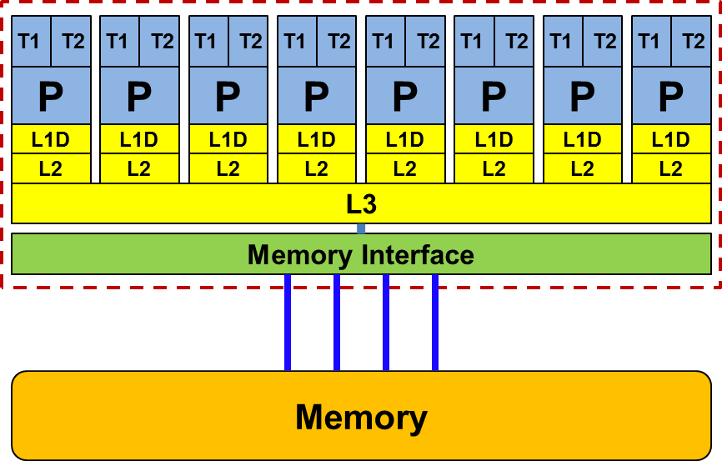
Node-level architecture
Key single processor/core features:
Pipelining Superscalarity SingleInstructionMultipleData

Slide 6
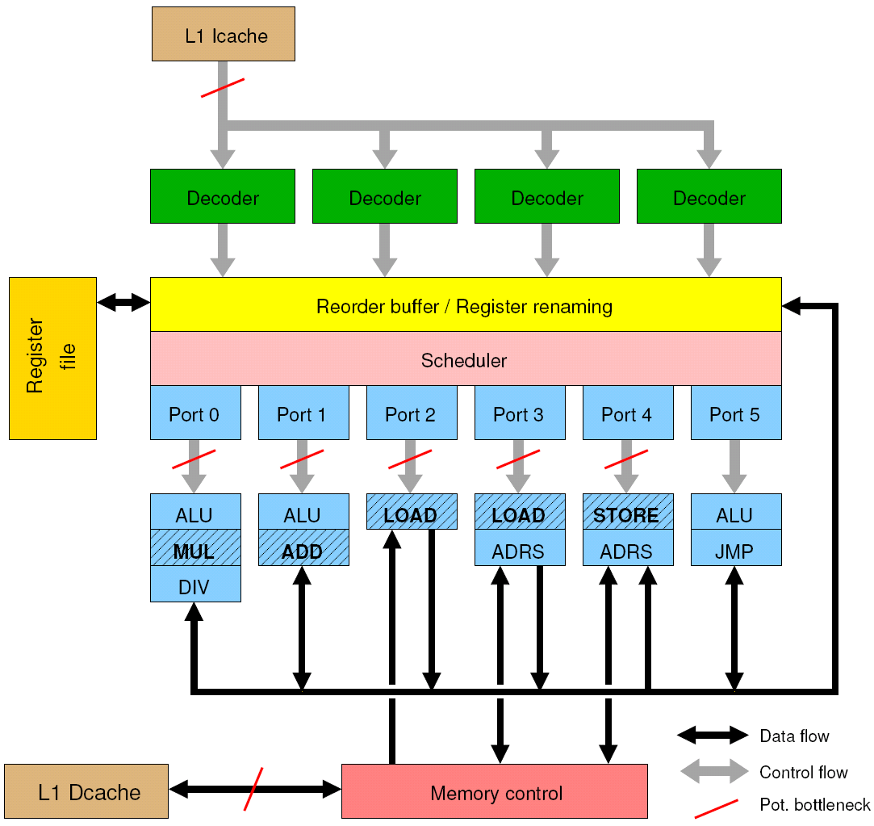
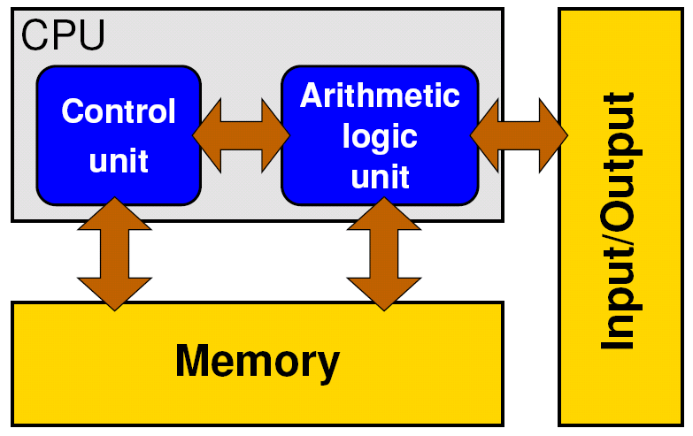
General-purpose cache based microprocessor core
Modern CPU core
Implements “Stored Program Computer” concept (Turing 1936)
Similar designs on all modern systems
(Still) multiple potential bottlenecks
Flexible!
Stored-program computer

Slide 7
Basic resources on a stored program computer Instruction execution and data movement
Instruction execution
This is the primary resource of the processor. All efforts in hardware design are targeted towards increasing the instruction throughput.
Instructions are the concept of “work” as seen by processor designers.
Not all instructions count as “work” as seen by application developers!
Example: Adding two arrays A(:) and B(:)
Processor work: LOAD r1 = A(i) LOAD r2 = B(i) ADD r1 = r1 + r2 STORE A(i) = r1 INCREMENT i BRANCH → top if i<N
do i=1, N A(i) = A(i) + B(i) enddo
User work: N FLOPs (ADDs)

Slide 8
Basic resources on a stored program computer Instruction execution and data movement
Data transfer
Data transfers are a consequence of instruction execution and therefore a secondary resource. Maximum bandwidth is determined by the request rate of executed instructions and technical limitations (bus width, speed).
Example: Adding two arrays A(:) and B(:)
Crucial question: What is the „bottleneck“?
Data transfer? Code execution?
Data transfers: 8 byte: LOAD r1 = A(i) 8 byte: LOAD r2 = B(i) 8 byte: STORE A(i) = r2
Sum: 24 byte
do i=1, N A(i) = A(i) + B(i) enddo

Slide 9
From application to microprocessor
Application
Application: High Level Programming Language (e.g. C / C++ / Fortran) - portable
Compiler translates program to Instruction set (architecture) (IA32, IA64)
Hardware specific execution of Instruction Set Architecture (ISA)
sum=0.0
do i=1, N sum=sum + A(i) enddo …
Compiler
Up to 24 x performance
Instruction Set
Computer
Mem
ALU
I/O
Control Unit

Slide 10
From application to microprocessor
sum=0.d0
do i=1, N sum = sum + A(i) enddo …
Baseline address of A(i)
Compiler
sum in register xmm1
ADDSD: Add 1st argument to 2nd argument and store result in 2nd argument
i in register rdx
Register increment
Compare register content
Jump to label ..B1.62 if loop continues
N in register rax

Slide 11
Node-level architecture
Microprocessors – Pipelining

Slide 12
Pipelining of arithmetic/functional units
Idea:
Split complex instruction into several simple / fast steps (stages)
Each step takes the same amount of time, e.g., a single cycle
Execute different steps on different instructions at the same time (in parallel)
Benefits:
Core can work on 5 independent instructions simultaneously
One instruction finished each cycle after the pipeline is full
Drawback:
Pipeline must be filled; large number of independent instructions required
Requires complex instruction scheduling by hardware (out-of-order execution) or compiler (software pipelining)
Pipelining is widely used in modern computer architectures

Slide 13
Interlude: Possible stages for multiply
Real numbers can be represented as mantissa and exponent in a “normalized” representation, e.g.: s*0.m * 10e with
Sign s={-1,1}
Mantissa m which does not contain 0 in leading digit
Exponent e some positive or negative integer
Multiply two real numbers r1*r2 = r3: s1*0.m1 * 10^{e1} * s2*0.m2 * 10^{e2}
(s1*s2)* (0.m1*0.m2) * 10^{(e1+e2)}
s3 * 0.m3 * 10^{e3}

Slide 14
5-stage Multiplication-Pipeline: A(i)=B(i)*C(i); i=1,...,N
Cycle:
1
2
3
4
5
6
...
N
N+1
N+2
N+3
N+4
Stage
Separate
Mant. / Exp.
B(1)
C(1)
B(2)
C(2)
B(3)
C(3)
B(4)
C(4)
B(5)
C(5)
B(6)
C(6)
...
B(N)
C(N)
Wind-down
Mult.
Mantissa
B(1)
C(1)
B(2)
C(2)
B(3)
C(3)
B(4)
C(4)
B(5)
C(5)
...
B(N-1)
C(N-1)
B(N)
C(N)
Add.
Exponents
B(1)
C(1)
B(2)
C(2)
B(3)
C(3)
B(4)
C(4)
...
B(N-2)
C(N-2)
B(N-1)
C(N-1)
B(N)
C(N)
Normal.
Result
A(1)
A(2)
B(3)
C(3)
...
B(N-3)
C(N-3)
B(N-2)
C(N-2)
B(N-1)
C(N-1)
B(N)
C(N)
Insert Sign
Wind-up
A(1)
A(2)
...
A(N-4)
A(N-3)
A(N-2)
A(N-1)
B(N)
C(N)
First result is available after 5 cycles (=latency of pipeline)!
Empty pipeline stages in Wind-up/-down phase!

Slide 15
Pipelining: Speed-Up and Throughput
Assume m-stage pipe, i.e. pipeline depth is m and fixed clock speed
Speed-up of pipelined ($T_{pipe}$) vs. non-pipelined ($T_{seq}$) execution time $\frac{T_{seq}}{T_{pipe}}= \frac{m∗N}{m+N−1}$
Throughput of fully piplined execution of N instructions, i.e. average instructions completed per cycle:
$$\frac{N}{T_{pipe}}= \frac{N}{N+m−1}$$
Large N limits:
Speed-Up: ${T_{seq}}/{T_{pipe}} ≈m$ for $N≫m$
Throughput: $N/{T_{pipe}} ≈1$ for $N≫m$

Slide 16
Pipelining: Beyond multiplication
Typical number of pipeline stages on modern CPUs:
2-5 for most (important) hardware pipelines: LoaD; STore; MULT; ADD
>>10 for other floating point pipelines: DIVide/SQuareRooT
Many other piplined ALUs, e.g. integer arithmetics
Most “older” x86 processors (AMD, Intel): 1 MULT & 1 ADD floating point unit per processor core → Max. 1 MULT & 1 ADD instruction per cycle

Slide 17
Pipelining: Beyond multiplication
Latest Intel (Haswell+) & AMD (Interlagos+): 1 (AMD) or 2 Floating Point Fused MultiplyAdd (FMA) units
FMA3 instruction: s= s + a*b → 1 Input register (s) is overwritten
FMA4 instruction: s= r + a*b → No input register is modified
→ Max. 2 (1) FMA instruction per cycle for Intel (AMD) processors

Slide 18
Costs of arithmetic instructions Intel SandyBridge
Latency [cycles/instruction] Depth of pipeline, i.e.
cycles to execute a single instruction (worst case)
Instruction | Latency [cy/instruction] | Throughput [instruction/cy]
ADD DP (SP) | 3 (3) | 1 (1)
MULT DP (SP) | 5 (5) | 1 (1)
SQRT DP | 45 | 1/44 = 0.023
SQRT SP | 29 | 1/28 = 0.036
DIV DP | 45 | 1/44 = 0.023
EXP DP | 83 | 1/83 = 0.012
SIN DP | 79 | 1/79 = 0.013
Throughput [instruction/cycle] Cycles per instruction
if pipeline is full (best case: 1 instruction/cycle)
Instructions
Library calls
(glibc 2.12)
Consequence: Avoid expensive instructions in hot spots!

Slide 19
Pipelining: Potential problems Data dependencies
a[3]=a[2]+s
a[4]=a[3]+s
a[2]=a[1]+s
Performance model:
Code: 1 F / 3 cy
Hardware: 3.5 GHz (3.5 Gcy/s)
Expect: 1.17 GF/s
a[1]=a[0]+s
…
for(int i=1; i<n; ++i)
a[i] = a[i-1] + s;
…
1 floating point
operation (1 F)
per iteration
a[3]=a[3]+s
a[5]=a[5]+s
a[4]=a[4]+s
a[2]=a[2]+s
a[1]=a[1]+s
Performance model:
Code: 1 F / 1 cy
Hardware: 3.5 GHz (3.5 Gcy/s)
→Expect: 3.5 GF/s
…
for(int i=1; i<n; ++i)
a[i] = a[i] + s;
…

Slide 20
Pipelining: Potential problems Data dependencies
Sometimes dependencies are not obvious!
What about “reduction operations”?
Data (register) dependency on sum (%xmm1) → 1 F / 3 cy for above code!
sum in register xmm1
A(i) (incl. LD)
sum=0.d0
do i=1, N sum=sum + A(i) enddo …
ADD 1st argument to 2nd argument and store result in 2nd argument
i (loop counter)
N

Slide 21
Pipelining: Potential problems Subroutine/function calls within a loop
→ Inline subroutines! (can be done by compiler….)
do i=1, N call elementprod(A(i),B(i), psum) C(i)=psum enddo … function elementprod( a, b, psum) … psum=a*b
do i=1, N psum=A(i)*B(i) C(i)=psum enddo …

Slide 22
The Instruction pipeline
Besides arithmetic & functional unit, instruction execution itself is pipelined also, e.g.: one instruction performs at least 3 steps:
Fetch Instruction from L1I
Decode instruction
Execute Instruction
Hardware Pipelining on processor (all units can run concurrently):
Time (cycles)
1
Fetch Instruction 1 from L1I
Fetch Instruction 2 from L1I
Decode Instruction 1
Branches can stall this pipeline! (Speculative Execution, Predication)
Each Unit is pipelined itself (cf. Execute=Multiply Pipeline)
2
3
Fetch Instruction 3 from L1I
Decode Instruction 2
Execute Instruction 1
4
Fetch Instruction 4 from L1I
Decode Instruction 3
Execute Instruction 2

Slide 23
The Instruction pipeline: Problem Unpredictable branches to other instructions
1
Fetch Instruction 1 from L1I
2
Decode Instruction 1
Assume: Result determines next instruction!
Time (cycles)
3
Execute Instruction 1
4
Fetch Instruction 2 from L1I
5
Decode Instruction 2
6
Execute Instruction 2
7
Fetch Instruction 3 from L1I
8
Decode Instruction 3

Slide 24
Node-level architecture
Microprocessors – Superscalarity

Slide 25
Superscalar Processors
Superscalar processors provide additional hardware (i.e. transistors) to execute multiple instructions per cycle!
Parallel hardware components / pipelines are available to
fetch / decode / issues multiple instructions per cycle
multiple integer / address calculations per cycle
load (store) multiple operands (results) from (to) cache per cycle
multiple floating point instructions per cycle
Superscalar RISC processors use out-of order (OOO) execution hardware to exploit the parallel hardware (e.g. ARM)

Slide 26
Superscalar Processors Instruction Level Parallelism
Multiple units enable use of Instrucion Level Parallelism (ILP): Instruction stream is “parallelized” on the fly
Issuing m concurrent instructions per cycle: m-way superscalar
Current: 3- to 6-way superscalar with 2 or 4 FP instructions per cycle
Time (cycles)
Fetch Instruction 4 from L1I
Fetch Instruction 3 from L1I
4-way „superscalar“
Fetch Instruction 2 from L1I
Fetch Instruction 1 from L1I
Fetch Instruction 2 from L1I
Decode Instruction 1
Fetch Instruction 2 from L1I
Decode Instruction 1
Fetch Instruction 2 from L1I
Decode Instruction 1
Fetch Instruction 5 from L1I
Decode Instruction 1
Fetch Instruction 3 from L1I
Decode Instruction 2
Execute Instruction 1
Fetch Instruction 3 from L1I
Decode Instruction 2
Execute Instruction 1
Fetch Instruction 3 from L1I
Decode Instruction 2
Execute Instruction 1
Fetch Instruction 9 from L1I
Decode Instruction 5
Execute Instruction 1
Fetch Instruction 4 from L1I
Decode Instruction 3
Execute Instruction 2
Fetch Instruction 4 from L1I
Decode Instruction 3
Execute Instruction 2
Fetch Instruction 4 from L1I
Decode Instruction 3
Execute Instruction 2
Fetch Instruction 13 from L1I
Decode Instruction 9
Execute Instruction 5

Slide 27
Superscalar processors Executing multiple instructions concurrently
Cycle 1 Cycle 2 Cycle 3 Cycle 4 Cycle 5 Cycle 6 Cycle 7 Cycle 8 Cycle 9 Cycle 10 Cycle 11 Cycle 12 Cycle 13 Cycle 14 Cycle 15 Cycle 16 …
load a[1] load a[2] load a[3] load a[4] load a[5] add a[1]=c,a[1] load a[6] add a[2]=c,a[2] load a[7] add a[3]=c,a[3] load a[8] add a[4]=c,a[4] store a[1] load a[9] add a[5]=c,a[5] store a[2] load a[10] add a[6]=c,a[6] store a[3] load a[11] add a[7]=c,a[7] store a[4] load a[12] add a[8]=c,a[8] store a[5] load a[13] add a[9]=c,a[9] store a[6] load a[14] add a[10]=c,a[10] store a[7] load a[15] add a[11]=c,a[11] store a[8] load a[16] add a[12]=c,a[12] store a[10] … … …
LOAD (Latency: 4 cy)
STORE (Latency: 2 cy)
ADD (Latency: 3cy)
…
for(int i=1; i<n; ++i)
a[i] = a[i] + s;
…
“Steady state:”
3 instructions/cy (“3-way superscalar”)
Instructions Per Cycle: IPC=3
Cycles Per Instruction: CPI=0.33
Correct interleaving / reordering the instruction streams:
Out-Of-Order (OOO) execution

Slide 28
Superscalar processors Intel x86 processors – qualitative view
Execution ports map
decoded instructiona
to execution units
Max. of 4 instr./cycle can
be decoded → CPI ≥ 0.25
3 LD/ST units
FP MULT & FP ADD can run in parallel
2 memory instr.
Concurrently
(AGU)
Intel SandyBridge/IvyBridge

Slide 29
Superscalar processors Intel x86 processors – qualitative view
Port 0
Port 1
Port 2
Port 3
Port 4
Port 5
Port 6
Port 7
Max. attainable performance
($r0$,$r1$,$r2$ registers)
ALU
ALU
LOAD
LOAD
STORE
ALU
ALU
AGU
FMA
FMA
AGU
AGU
FSHUF
JUMP
FMUL
JUMP
$1/2$ Peak Performance $A\left(i\right)= r1 + r2 ∗ B(i)$ 1 ST + 1 FMA + 1 LD → 1 cy
$1/4$ Peak Performance $A(i) = r1 ∗B(i)$ 1 ST + 1 LD + 1 MULT → 1 cy
$1/3$ Peak Performance $A(i) = A(i)+B(i)∗C(i)$ 1 ST + 1 FMA + 3 LD → 1.5 cy
Per cycle (cy) a maximum of
2 LOAD (LD) AND 1 STORE (ST) instruction
2 floating point instructions (Port0/1): Any combination of FMA, MULT, ADD
4 instructions in total
Peak performance: 2 FMA / cy
$½$ Peak Performance: (1 MULT + 1 ADD) / cy
Intel Haswell/Broadwell

Slide 30
Superscalar processors Summary
Exploits Instruction Level Parallelism
Obstacles:
Instruction / Loop carried dependencies
Latencies
Enabling Techniques
Software Pipelining & Loop unrolling (see later) (Compile Time)
Out-of-order Execution (Runtime)
Simultaneous Multithreading (Runtime)
See later

Slide 31
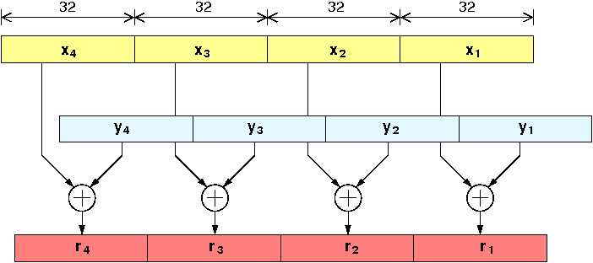
Node-level architecture
Microprocessors – Single Instruction Multiple Data (SIMD)-processing

Slide 32
SIMD-processing Basics
Single Instruction Multiple Data (SIMD) instructions allow the concurrent execution of the same operation on “wide” registers.
x86_64 SIMD instruction sets:
SIMD-execution ←→ vector execution
If compiler has vectorized loop ←→ SIMD instructions are used
SIMD version | Register width | Double precision values | Single precision values
Scalar | 64 Bit / 32 Bit | 1 | 1
SSE | 128 Bit | 2 | 4
AVX/AVX2 | 256 Bit | 4 | 8
AVX512 | 512 Bit | 8 | 16

Slide 33
SIMD-processing Basics
Scalar execution: R2← ADD [R0,R1]
SIMD execution: R2← V64ADD [R0,R1]
R0
R0
R1
R2
R1
R2
A[3]
+
B[3]
C[3]
A[2]
+
B[2]
C[2]
256 Bit
A[1]
+
B[1]
C[1]
64 Bit
A[0]
+
B[0]
C[0]
A[0]
+
B[0]
C[0]
If 128 Bit SIMD instructions (SSE) are executed only half of the registers width is used
33

Slide 34
SIMD-processing Basics
“Pointer aliasing” may prevent compiler from vectorization
If “pointer aliasing” is not used, tell it to the compiler
Intel: –fno-alias GCC: -fargument-noalias
void scale_shift(double *A, double *B, double *C, int n) {
for(int i=0; i<n; ++i)
C[i] = A[i] + B[i] + C[i-1];
}
#pragma simd enforces vectorization (Intel > 12.0)
Intel compiler will vectorize starting with –O2. →To enable specific SIMD extensions use the –x option:
-xSSE2 vectorize for SSE2 capable machines
-xAVX on Sandy/Ivy Bridge processors
-xCORE-AVX2 on Haswell/Broadwell
-xCORE-AVX512 on Skylake (certain models)
-xMIC-AVX512 on Xeon Phi Knights Landing
-xHOST use SIMD extensions of machine you compile on
No SIMD-processing for loops with data dependencies
Prerequesites:
Countable loop
Innermost loop
Single entry and single exit
No function calls & straight line code

Slide 35
SIMD-processing Data layout: structure of arrays
A[]
B[]
C[]
D[]
xmm0
xmm1
float *A,*B,*C,*D,*R;
xmm2
xmm3
+ / √
+ / √
+ / √
+ / √
R[]

Slide 36
SIMD-processing Data layout: array of structures
S[]
struct stype {
float A,B,C,D,R;
};
struct stype *S;
xmm0
xmm1
+
√
/
Things to watch out for:
LOADs, STOREs, arithmetic all need to be SIMD-parallel
“Horizontal” operations across slots of a register are slow (no good support in instruction sets)
A (limited) number of parallel data streams are not a problem

Slide 37
SIMD-processing Basic rules
Rules for vectorizable loops
Inner loop
Countable (loop length can be determined at loop entry)
Single entry and single exit
Straight line code (no conditionals)
No (unresolvable) read-after-write data dependencies
No function calls (exception intrinsic math functions)
Better performance with:
Simple inner loops with unit stride (contiguous data access)
SIMD-compatible data layout
Minimize indirect addressing
Align data structures to SIMD width boundary
In C use the restrict keyword and/or const qualifiers and/or compiler options to rule out array/pointer aliasing

Slide 38
Expensive instructions With SIMD
Intel SandyBridge
SIMD (256-Bit AVX)
Instruction | Latency [cy/instruction] | Throughput [instruction/cy] | Operation Throughput [operations/cy]
ADD DP (SP) | 3 (3) | 1 (1) | 4 (8)
MULT DP (SP) | 5 (5) | 1 (1) | 4 (8)
SQRT DP | 45 | 1/44 = 0.023 | 1/11 = 0.091
SQRT SP | 29 | 1/28 = 0.036 | 1/7 = 0.143
DIV DP | 45 | 1/44 = 0.023 | 1/11 = 0.091
EXP DP | 83 | 1/83 = 0.012 | 1/12.5 = 0.080
SIN DP | 79 | 1/79 = 0.013 | 1/17.5 = 0.057
Intel SVML
Consequence: Avoid expensive instructions like the plague!
glibc 2.12

Slide 39
SIMD-processing Summary
Exploits Data Parallelism
Obstacles:
Loop carried dependencies
Non-vectorizable parts (e.g. non-consecutive data access)
Enabling Techniques
Avoid / resolve data dependencies
(Inner) Loop Unrolling + SIMD instructions (Compile Time)
Data layout / alignment for better performance

Slide 40
Single core peak performance Putting it all together
Floating point (FP) peak performance of modern cores depends on
Pipelining → 1 FP instruction per cycle per execution unit
Superscalarity → Multiple FP instructions per cycle
SIMD vectorization → Multiple FP operations per instructione
FMA factor → FMA instructions or MULT/ADD only
Clock speed → cycles / s

Slide 41
Single core peak performance Putting it all together
Maximum floating point (FP) performance:
$P_{core}= n_{super}^{FP}∙n_{FMA}∙n_{SIMD}∙f$
Typical representatives | $$n_{super}^{FP}$$ [inst./cy] | $$n_{FMA}$$ | $n_{SIMD}$ [F/inst.] |  | Code | $f$ [GHz] | $$P_{core}$$ [GF/s]
Nehalem | 2 | 1 | 2 | Q1/2009 | X5570 | 2.93 | 11.7
Westmere | 2 | 1 | 2 | Q1/2010 | X5650 | 2.66 | 10.6
Sandy Bridge | 2 | 1 | 4 | Q1/2012 | E5-2680 | 2.7 | 21.6
Ivy Bridge | 2 | 1 | 4 | Q3/2013 | E5-2660 v2 | 2.2 | 17.6
Haswell | 2 | 2 | 4 | Q3/2014 | E5-2695 v3 | 2.3 | 36.8
Broadwell | 2 | 2 | 4 | Q1/2016 | E5-2699 v4 | 2.2 | 35.2
IBM POWER8 | 2 | 2 | 2 | Q2/2014 | S822LC | 2.93 | 23.4
Super-
scalarity
FMA
factor
SIMD
factor
Clock
Speed

