Slide 1
Node-level architecture
Memory hierarchy

Slide 2
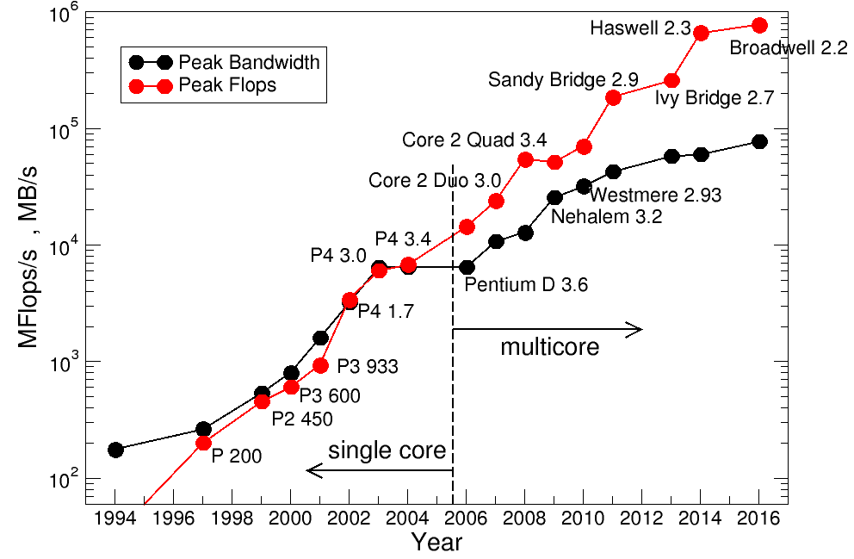
Von Neumann bottleneck reloaded
DRAM gap
Approx.
10 F/B
Main memory access speed not sufficient to keep CPU busy…
→ Introduce fast on-chip caches, holding copies of recently used data items

Slide 3
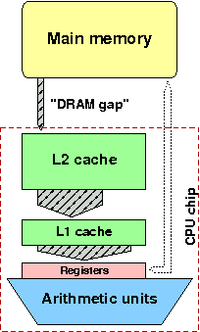
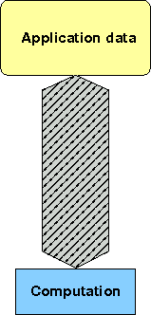
Schematic view of modern memory hierarchy & cache logic
CPU/Arithmetic unit issues a LOAD request to transfer a data item to a register
Cache logic automatically checks all cache levels if data item is already in cache.
If data item is in cache (“cache hit”) it is loaded to register.
If data item is in no cache level (“cache miss”) data item is loaded from main memory and a copy is held in cache.

Slide 4
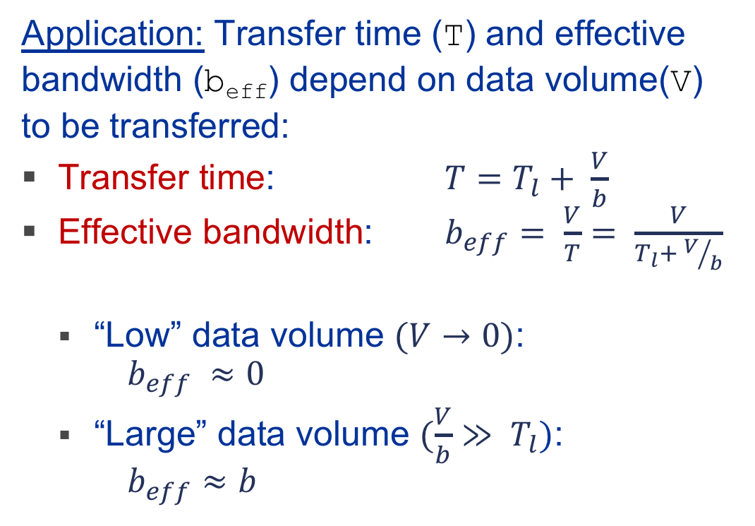
Memory hierarchies
Effective Bandwidths
Hardware: Quantities to characterize the quality of a memory hierarchy:
Latency (T_{l}): Set up time for data transfer from source (e.g. main memory or caches) to destination (e.g. registers).
Bandwidth (b): Maximum amount of data per second which can be transferred between source (e.g. main memory or caches) and destination (e.g. registers).
Application: Transfer time (T) and effective bandwidth (b_{eff}) depend on data volume(V) to be transferred:
Transfer time: $T=T_{l}+ \frac{V}{b}$
Effective bandwidth: $b_{eff}= \frac{V}{T}= \frac{V}{T_{l}+ V/b}$
  “Low” data volume $(V→0)$: $b_{eff} ≈0$
  “Large” data volume $(\frac{V}{b}≫ T_{l})$: $b_{eff}≈b$

Slide 5
Node-level architecture
Caches – Basics

Slide 6
Memory hierarchies
The latency problem
Main memory latency and bandwidth for modern multicore CPUs: T_{l} = 64 ns & b = 64 GB/s
Data access is organized in cache lines (CL) – always a full CL is transferred
Multiple CLs can be loaded concurrently
  Multiple data requests by application code
  Automatic hardware prefetching
V | T_{l} | V/b | T | b_{eff}
8 B | 64 ns | 0.125 ns | 64.125 ns | 0.13 GB/s
128 B | 64 ns | 2 ns | 66 ns | 1.9 GB/s
4096 B | 64 ns | 64 ns | 128 ns | 32 GB/s
V=64B or V=128B on modern architectures

Slide 7

Memory hierarchies
Cache lines
If one data item is loaded from main memory (“cache miss”),
whole cache line it belongs to is loaded
Cache lines are contiguous in main memory, i.e. “neighboring“ items can then be used from cache
Iteration
t
Cache miss : T_{l}
$$V/b$$
1
LD
Use data
2
LD
Use data
3
LD
Use data
do i=1,n
s = s + a(i)*a(i)
enddo
4
Cache line size:
4 words
LD
Use data
5
LD
6
Use data
7
LD
Use data
8
LD
Use

Slide 8

Memory hierarchies
(Automatic) Prefetching
Prefetching data to hide memory latencies of CL transfers
Iteration
t
Cache miss : T_{l}
$$V/b$$
1
LD
Use data
2
LD
Use data
3
LD
Use data
4
LD
Use data
do i=1,n
s = s + a(i)*a(i)
enddo
5
LD
Use data
6
LD
Use data
7
LD
Use
Data transfer is started before cache miss
→ Prefetching
8
LD
Use data
LD
Use data
LD
Use

Slide 9
Memory Hierarchies
Prefetching – Hide memory latency
Prefetch (PFT) instructions (limited use on modern architectures): Transfer one cache line from memory to cache and then issue LD to registers
Most architectures (Intel/AMD x86, IBM Power) use
hardware-based automatic prefetch mechanisms
  HW detects regular, consecutive memory access patterns (streams) and prefetches at will
  Intel x86: Adjacent cache line prefetch loads 2 (64-byte) cache lines on L3 miss → Effectively doubles line length on loads (typical. enabled in BIOS)
  Intel x86: Hardware prefetcher: Prefetches complete page (4 KB) if 2 successive CLs in this page are accessed
For regular data access main memory latency is not an issue!
May generate excessive data transfers for irregular access pattern

Slide 10
Node-level architecture
Data access ←→ locality

Slide 11
Memory Hierarchies
Cache line ←→ Spatial locality
Cache line features
  Cache line use is optimal for contiguous access (“stride 1”) → STREAMING
  Non-consecutive access reduces performance
  Access with wrong stride (e.g. cache line size) can lead to disastrous performance breakdown
“Spatial locality”: Ensure accesses to “neighboring” data items
GOOD (“Streaming”)
BAD (“Strided”)
do i=1,n
s = s + a(i)*a(i)
enddo
do i=1,n,2
s = s + a(i)*a(i)
enddo

Slide 12
Memory Hierarchies
Spatial locality & data layout
How to traverse multidimensional arrays?!
Example: Initialize matrix A with A(i,j) = i*j
What is the storage order of multidimensional-data structure?
It depends, e.g. 2-dimensional 3x3 array A of doubles
FORTRAN: column by column („column major order“)
C/C++: row by row („row major order“)
0 B Memory layout 71 B
A(1,1) | A(2,1) | A(3,1) | A(1,2) | A(2,2) | A(3,2) | A(1,3) | A(2,3) | A(3,3)
0 B Memory layout 71 B
A[0][0] | A[0][1] | A[0][2] | A[1][0] | A[1][1] | A[1][2] | A[2][0] | A[2][1] | A[2][2]

Slide 13
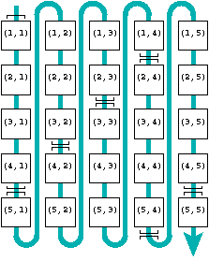
Memory Hierarchies
Spatial locality & data layout
Default layout for FORTRAN: column by column (column major order)
do i=1,n
do j=1,n
a(j,i)=i*j
enddo
enddo
do j=1,n
do i=1,n
a(j,i)=i*j
enddo
enddo
Continuous access!
Stride n access!
FORTRAN:
Inner loop must access innermost/left array index
Data arrangement is “transpose” of the “usual” matrix layout

Slide 14
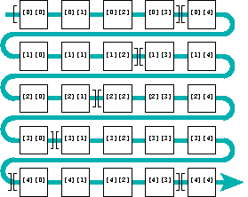
Memory Hierarchies
Spatial locality & data layout
Default layout for C/C++: row by row (row major order)
for(i=0; i<N; ++i) {
for(j=0; j<N; ++j) {
a[i][j] = i*j;
}
}
for(j=0; j<N; ++j) {
for(i=0; i<N; ++i) {
a[i][j] = i*j;
}
}
Continuous access!
Stride N access!
C/C++:
Inner loop must access outermost/rightmost array index

Slide 15
Memory hierarchies
Temporal locality
Temporal locality: If data is already in cache - reuse it from there!
Example: Dense matrix vector multiplication
(assume that cache is large enough to hold y(1:R) )
x(c) stays
in register
A(r,c)
do c = 1 , C
tmp=x(c)
do r = 1 , R
y(r)=y(r) + A(r,c)* tmp
enddo
enddo
A(,):continuous access
→ Spatial locality
y(1:R) is loaded C times
→ Temporal locality for C-1 accesses

Slide 16
Node-level architecture
Cache management

Slide 17
Memory Hierarchies
Cache Mapping
L1 Cache (~10³ Byte)
L2 Cache (~10⁶ Byte)
Pairing of memory addresses with cache locations
Where is the CL to given memory addressed
placed in the cache?
Simplest strategy: Directly Mapped caches,
e.g. if cache size is 1 MB choose “lowest” 20 bits of memory address
Mapping substantially impacts the flexibility of replacement strategies → Reduces the potential set of evict/replace locations
May incur additional data transfer (→ cache thrashing) !
CL 0
CL 1
CL 2
Memory (~10⁹ Byte)
CL 3
…
…
  Memory address 32 Bit:
  011100100000 11110100111110 001111
…
…
…
…
…
…

Slide 18
Memory Hierarchies
Cache Mapping – Associative Caches
Set-associative cache:
  m-way associative cache of size m x n: each memory location i can be mapped to the m cache locations (“ways”) j*n+mod(i,n), j=0..m-1
  E.g.: 2-way set associative cache of size 256 KBytes:
  Number of sets: 256 KB/ 64 Byte /2 = 2048
  Memory address (32 Bit): 011100100000111 10100111110 001111
Modern processors: 4-way to 48-way associative caches
“Way”
1 |  |  |  |  | ... | 128 KB
128KB+1 |  |  | ←CacheLine→ |  |  | 256 KB
Address within cache line
“Set”

Slide 19
Memory hierarchies
Cache Mapping – Cache Thrashing
If many memory locations are used that are mapped to the same set, cache reuse can be very limited even with m-way associative caches
Warning: Using powers of 2 in the leading array dimensions of multi-dimensional arrays should be avoided! (Cache Thrashing)
If cache / m-ways are full and new data comes in from main memory, data in cache (full cache line) must be invalidated or written back to main memory
Ensure spatial and temporal data locality for data access!
  011100100000111 10100111110 001111
A(1,1)
  011100100001000 10100111110 001111
double precision A(16384,16384)
A(1,2)
  011100100001001 10100111110 001111
A(1,3)

Slide 20
Memory hierarchies
Data transfers
Caches help with getting instructions and data to the CPU “fast”
How does data travel from memory to the CPU and back?
  Remember: Caches are organized in cache lines
  Only complete cache lines are transferred between
  memory hierarchy levels (except registers)
  Cache MISS: Load or store instruction does not find the
  data in a cache level → CL transfer required
Example: Array copy A(:)=C(:)
2-level (“Inclusive cache”) cache hierarchy:
L1 Load MISS → L2 Load MISS → CL loaded to L2
→ CL loaded to L1 → data loaded to register
LD C(1)
CPU registers
MISS
ST A(1)
MISS
LD C(2..N_{cl})
ST A(2..N_{cl})
HIT
Cache
CL
CL
write
allocate
evict
(delayed)
Memory
CL
CL
3 CL transfers
C(:)
A(:)

Slide 21
Memory management
Caches management details
Inclusive:
Cache line copy in all levels
Reduced effective size in outer cache levels
Cheap eviction for unmodified cache lines
Higher latency: cache lines have to load through hierarchy
→ Intel processors
Exclusive:
Only one cache line copy in cache hierarchy
Full aggregate effective cache size
Eviction is expensive (copy back)
Lower latency: Data can be directly loaded in L1 cache
→ AMD processors and Intel Skylake L3
“Write back”: A modified cache line is evicted to the next (lower) cache/memory
level before it is overwritten by new data
“Write through”: When a cache line is updated then the cache line copy in the next
(lower) cache/memory level is updated as well

Slide 22
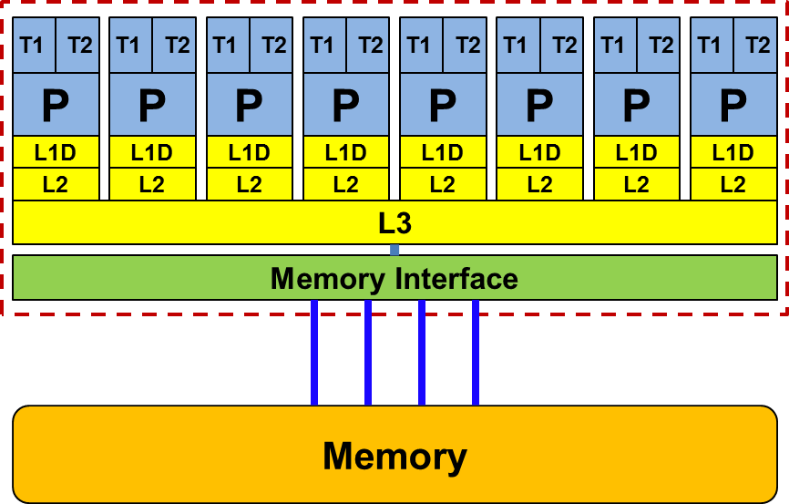
Memory Hierarchies
Typical cache configuration
 |  | Intel Xeon E5-2680 Sandy Bridge
# FP registers |  | 16
# GP registers |  | 16
L1 D | Size | 32 KB
 | Associativity | 8-way
 | local per core
L2 | Size | 256 KB
 | Associativity | 8-way
 | local per core
L3 | Size | 20 MB (shared)
 | Associativity | 20-way
 | shared across all cores
SIMD
registers
Same for more recent Intel architectures:
Ivy Bridge, Haswell and Broadwell
Depends on core count, CPU variant, CoD mode

Slide 23
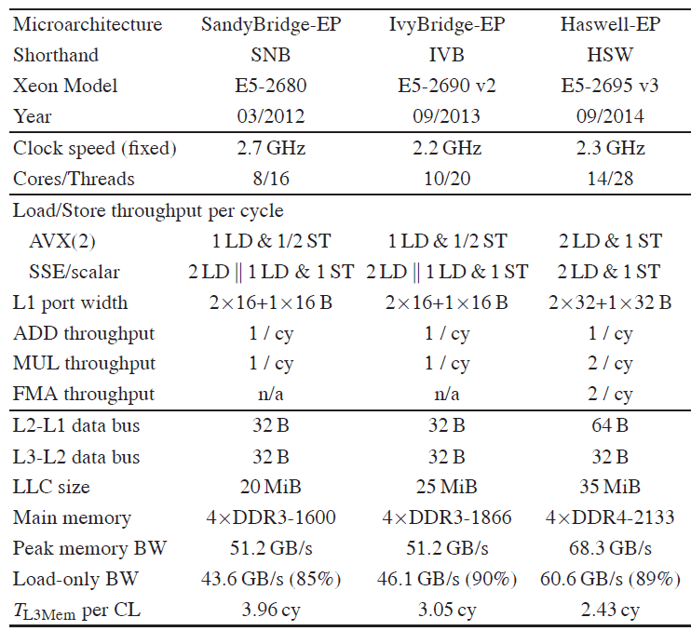
Memory Hierarchies
Intel Xeon E5 multicore processors
…
FP instructions throughput per core
Max. data transfer per cycle between caches
Peak main memory bandwidth

Slide 24
Node-level architecture
Cache coherence

Slide 25
Memory hierarchies
Cache Coherence
Data in cache is only a copy of data in memory
  Multiple copies of same data on multiprocessor systems
  Cache coherence protocol/hardware ensure consistent data view
  Without cache coherence, shared cache lines can become clobbered:
P1
P2
P1
P2
C1
C2
Load A1
Write A1=0
Load A2
Write A2=0
A1, A2
A1, A2
Write-back to memory leads to incoherent data
Bus
A1, A2
A1, A2
A1, A2
Memory
A1, A2
C1 & C2 entry can not be merged to:
A1, A2

Slide 26
Memory hierarchies
Cache Coherence
Cache coherence protocol must keep track of cache line (CL) status
P1
P2
Load A1
Write A1=0:
Load A2
Write A2=0:
P1
P2
1. Request exclusive
access to CL
C1
C2
2. Invalidate CL in C2
A1, A2
A1, A2
A1, A2
A1, A2
A1, A2
3. Modify A1 in C1
1. Request exclusive
CL access
Bus
2. CL write back + Invalidate
Memory
A1, A2
A1, A2
C2 is exclusive owner of CL
3. Load CL to C2
4. Modify A2 in C2

Slide 27
Memory hierarchies
Cache Coherence
Cache coherence can cause substantial overhead
  may reduce available bandwidth
Different implementations
  Snoop: On modifying a CL, a CPU must broadcast its address to the whole system
  Directory, “snoop filter”: Chipset (“network”) keeps track of CLs’ location and state and
  filters coherence traffic
Directory-based can reduce pain of additional coherence traffic
Caution:
Multiple processors should never write frequently to the same cache line (“false sharing”)!

Slide 28
Node-level architecture
Basic compute node architecture
Shared Memory Nodes: UMA and ccNUMA

Slide 29
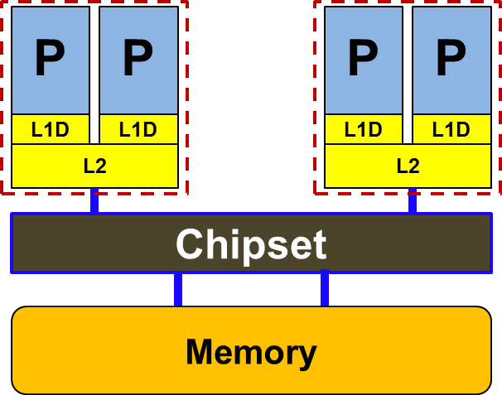
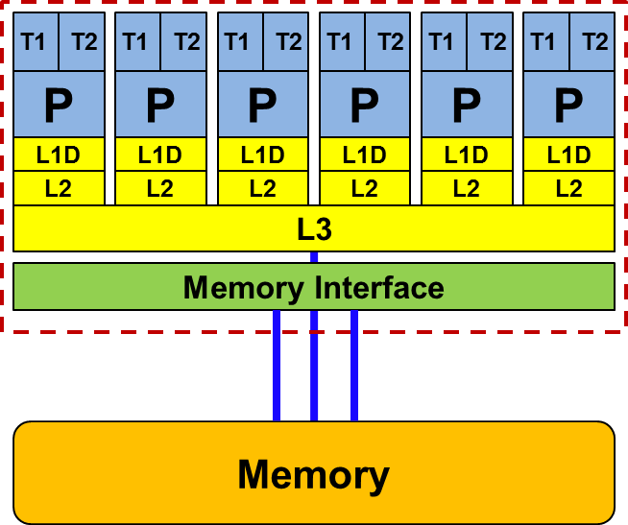
Basic compute node architecture
UMA / ccNUMA
Shared memory: Shared address space for all processors and cache contents are kept coherent automatically
Cache-coherent Non-Uniform
Memory Architecture (ccNUMA):
Uniform Memory Architecture (UMA):
Outdated!
Single “flat” memory: Data access times for a given data item are constant
Limited scalability in terms of main memory bandwidth
Physically distributed memory, i.e. multiple memory controllers
“Local” & “Remote” data
Good scalability / hard to program

Slide 30
Basic compute node architecture ccNUMA
Hardware/software layers (HT/QPI): Shared address space and ensure data coherency
Separate memory controllers –
scalable performance
Single shared address space – ease of use
Where does the data end up?????
A(1: 1000000000)
"Golden Rule" of ccNUMA:
A memory page gets mapped into the local memory of
the processor that first touches it (i.e. writes to it)!

Slide 31
Basic compute node architecture ccNUMA – Golden Rule
Dense matrix vector multiplication (dMVM)
void dmvm(int n, int m, double *lhs, double *rhs, double *mat){
#pragma omp parallel for private(offset,c)schedule(static) {
for(r=0; r<n; ++r) {
offset=m*r;
for(c=0; c<m; ++c)
lhs[r] += mat[c + offset]*rhs[c];
}
}
→ OpenMP parallelization?!

Slide 32
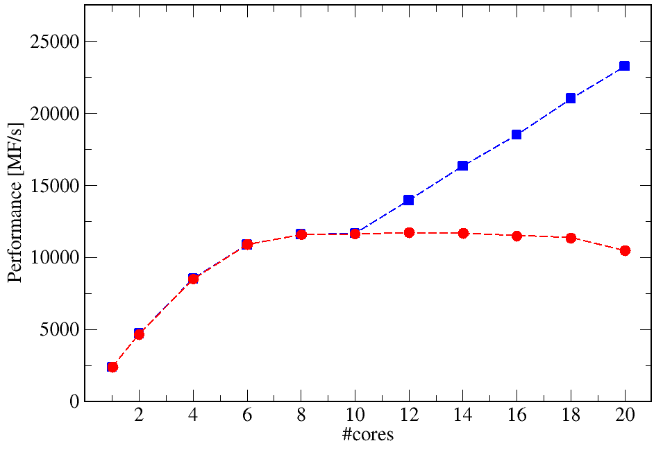
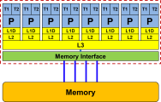
Basic compute node architecture ccNUMA – Golden Rule
#pragma omp parallel for schedule(static) private(c) {
for(r=0; r<n; ++r)
for(c=0; c<m; ++c) mat[c + m*r] = …; } }
10 cores
10 cores
Parallelization
of matrix data initialization
dMVM
Matrix data initialization: serial

Slide 33
Basic compute node architecture ccNUMA – Summary
Golden rule for NUMA-aware shared memory programming!
Touch means write (not allocate)←→ “First touch policy”
Placement is done on page basis, i.e. chunks of 4 KB or 2 MB (see OS)
Writing a single byte is sufficient to map the full page
Thread – core affinity over execution time required → Pinning
Check if memory is “clean” – OS may keep (IO) buffers
→ “remove” them if necessary
Linux Tools: numactl, likwid-topology, likwid-pin

