Slide 1
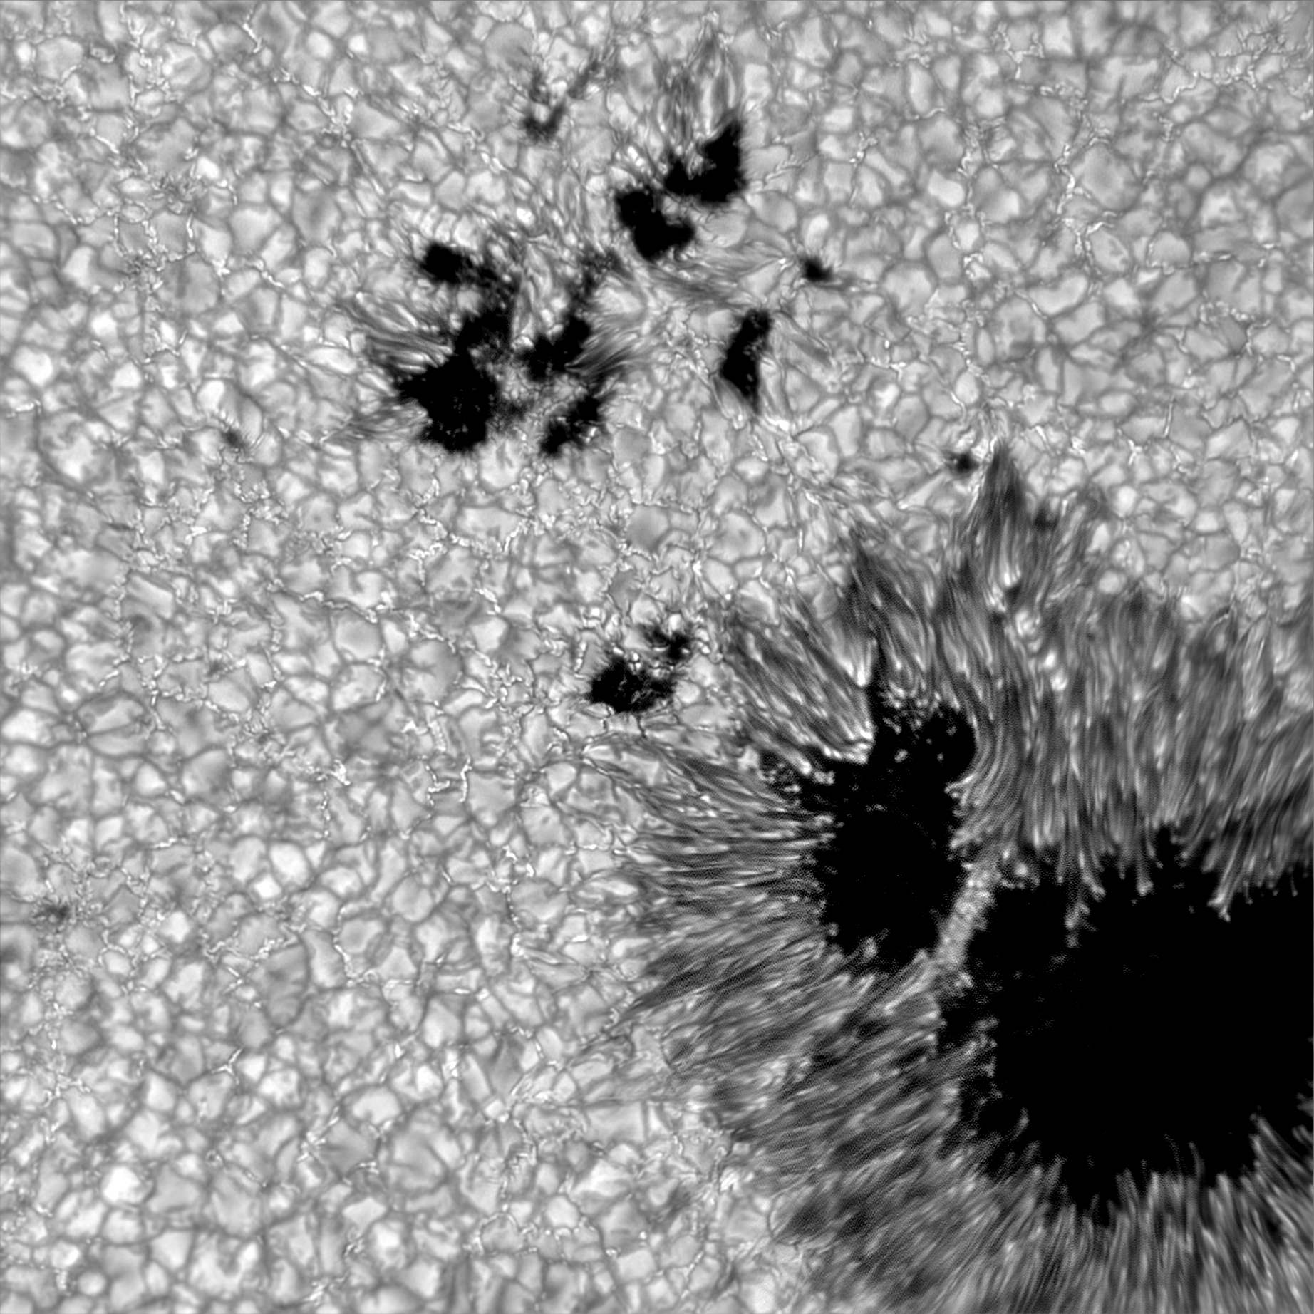
The Impact of Small-Scale Magnetism on Solar Variability
Abstract:
Spectral solar irradiance (SSI), the radiant energy flux per wavelength of the Sun received at Earth, is an important driver of chemical reactions in the Earth’s atmosphere. Accurate measurements of SSI are therefore necessary as an input for global climate models. While models and observations of the spectrally-integrated total solar irradiance (TSI) variations agree within ∼ 95%, they can disagree on the sign and magnitude of the SSI variations. In this work, we examine the contribution of currently-unresolved small-scale magnetic structures to SSI variations in the photosphere. We examine the emergent spectra of two atmospheres with differing imposed-field conditions — one with a small-scale dynamo and the other with a predominantly vertical magnetic field — with similar mean field strengths at wavelengths spanning from visible to infrared. Comparing the radiative output at various viewing angles of pixels of equal vertical magnetic field strength between the two simulations, we find that the small-scale dynamo simulations produce higher radiative output than those in the predominantly vertical field simulation. This implies that the radiative output of a small magnetic structure depends on the magnetic morphology of the environment in which it is embedded, which is currently not included in SSI models.
Courtney Peck^{1,3}
Advisor: Dr. Mark Rast^{2,3}
In collaboration with Dr. Serena Criscuoli⁴, Dr. Friedrich Wöger⁴, and Dr. Jose Marino⁴
Department of Physics¹, Department of Astrophysical and Planetary Sciences², Laboratory for Atmospheric and Space Physics³: University of Colorado, Boulder
National Solar Observatory⁴, Boulder CO

Slide 2
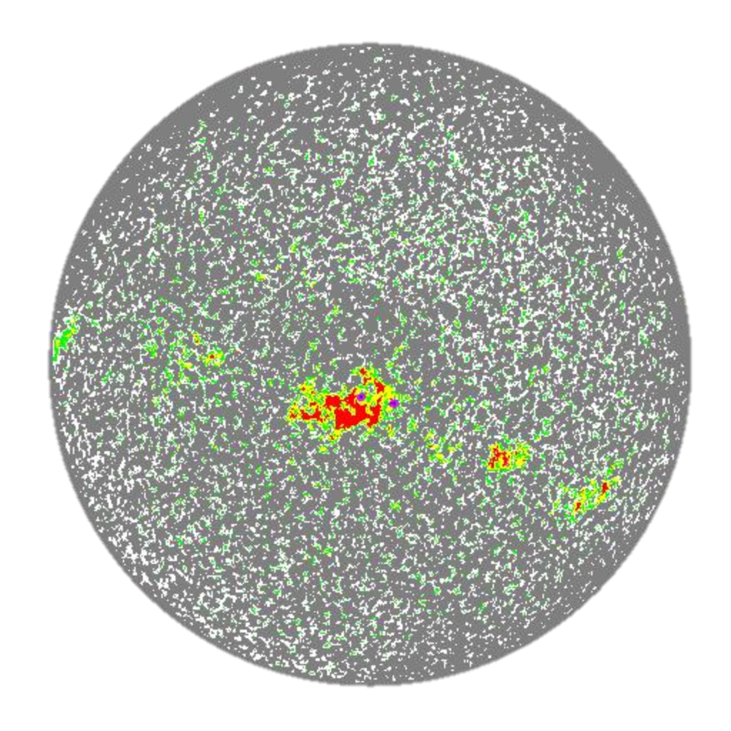
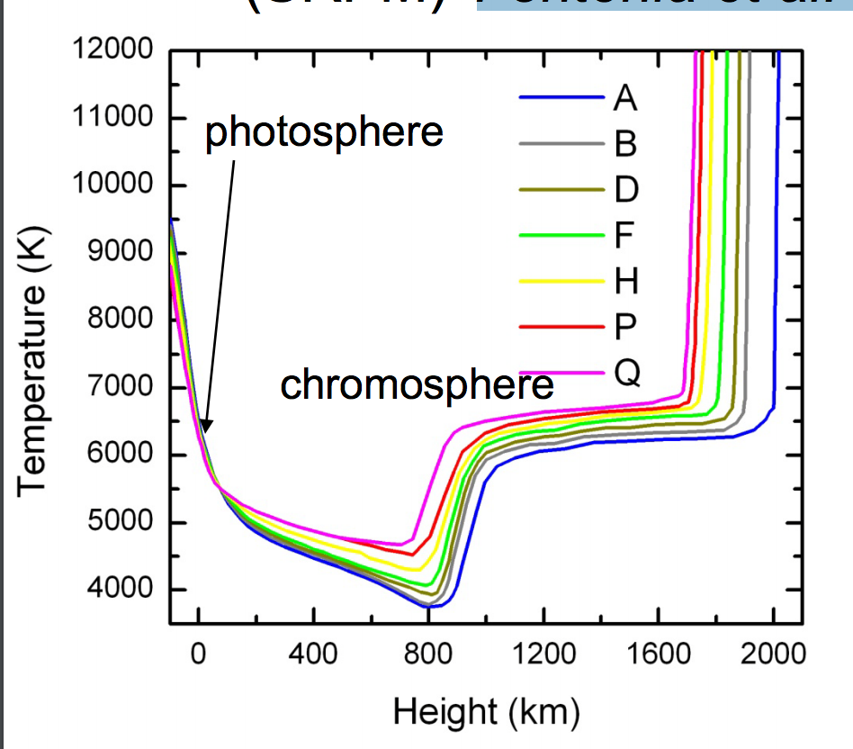
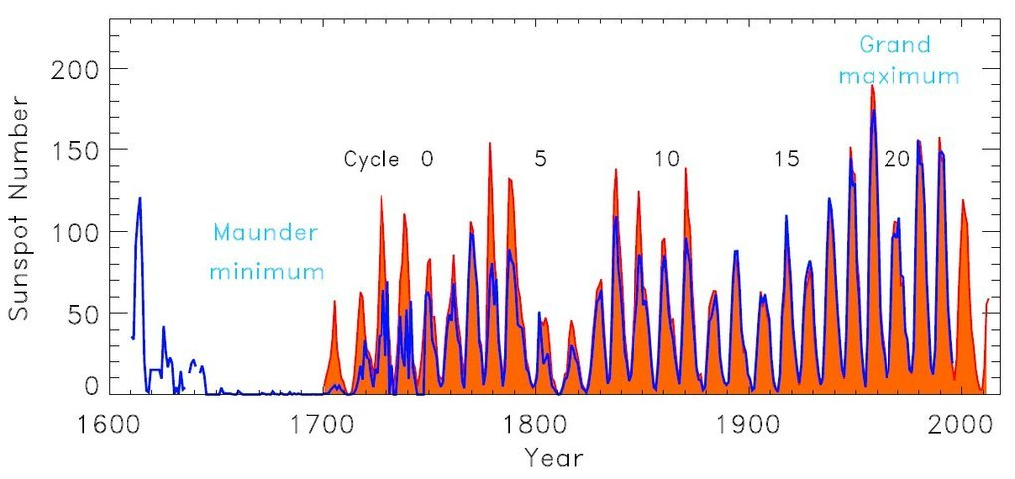
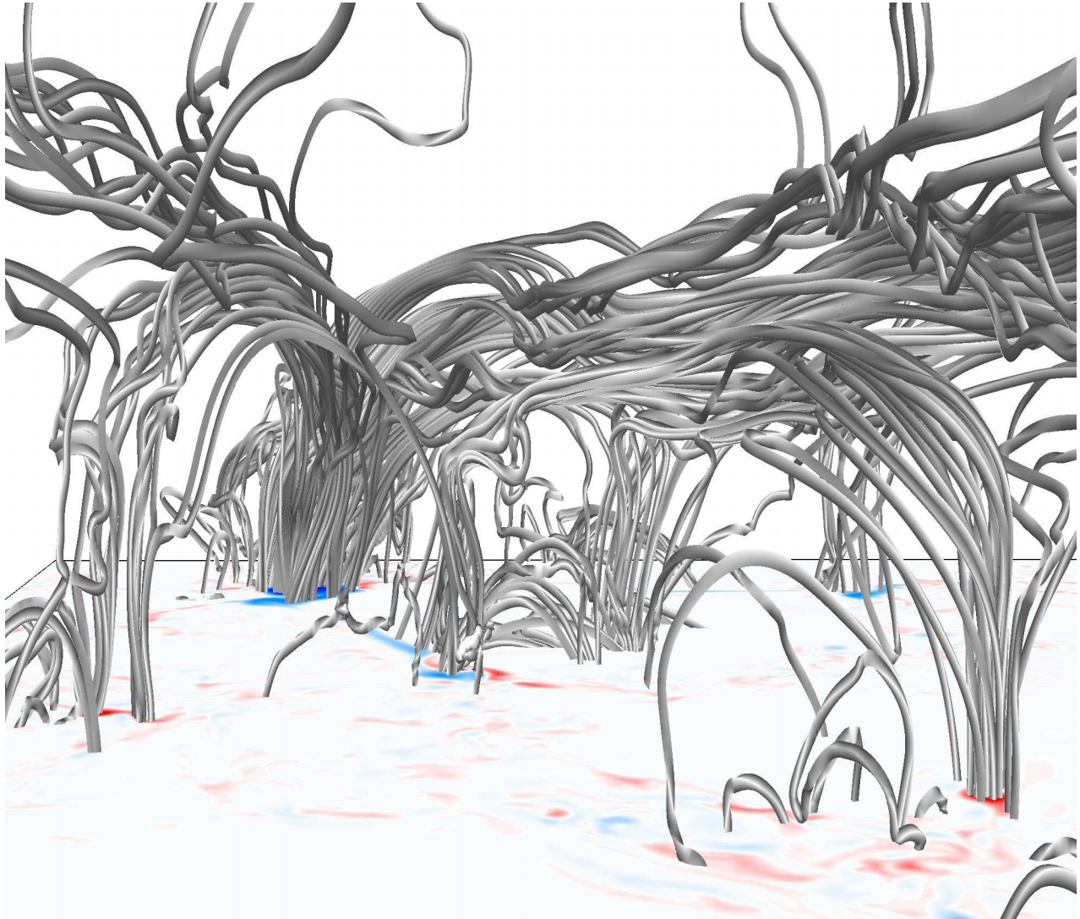
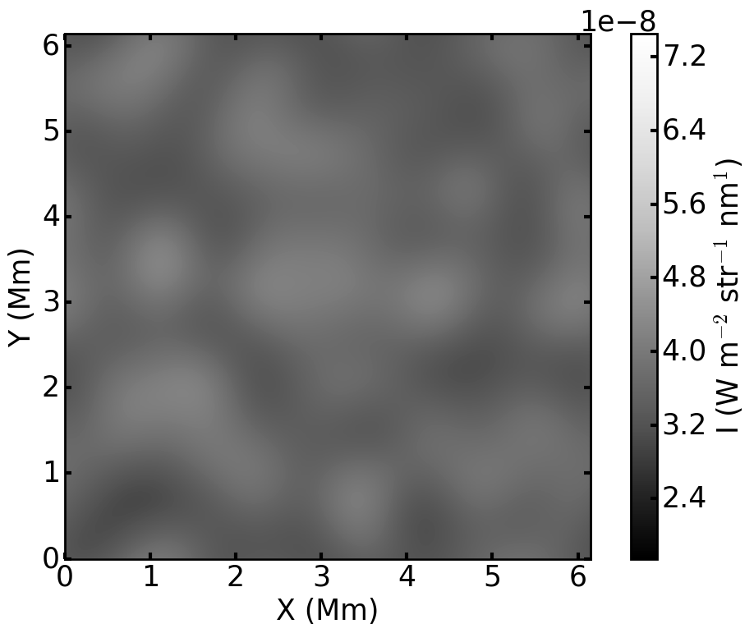
Irradiance models identify structures based on full-disk images and employ 1D average model atmospheres
Average atmospheres do not represent the average radiative output
Uitenbroek & Criscuoli (2011)
Covers ~90% of disk and contributes significantly to total magnetic surface flux
Fontenla et al. (2011)
The radiative output of the most abundant solar structures likely depends on local magnetic environment, which is currently unresolved
Presence of small-scale dynamo may impact quiet-sun radiative output
+ free parameter(s)
Full-disk images can not resolve under-lying substructure of quiet-sun
(e.g., Lites et al., 2008; Buehler et al., 2013)
Kitiashvili et al (2013)
Yeo et al. (2014)
Ermolli et al. (2013)
Notes:
Magnetic fields change the mean stratification

Slide 3
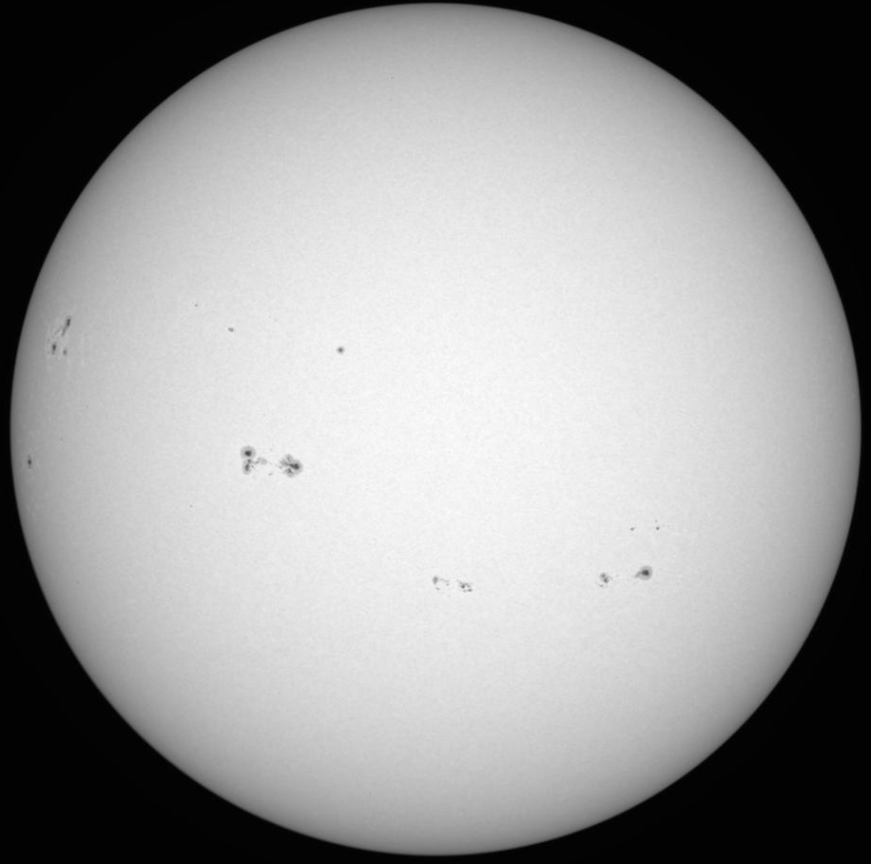
Synthesize the radiative output of 3D MHD simulations with HPC
768 pix
768 pix
Solve radiative transfer equation as function of viewing angle
180 pix
3D MHD sim.
P, T, v, ρ, B
Solved using finite difference
3 atmospheres, 768X768X180 pixels, 10 viewing angles, 17+ frequencies (ν)
Large computational problem
Doesn’t fully solve radiative transfer
6X6 Mm
λ = 500 nm
Also shown for continuum wavelengths between 400 and 2300 nm
Notes:
Finite differences

Slide 4
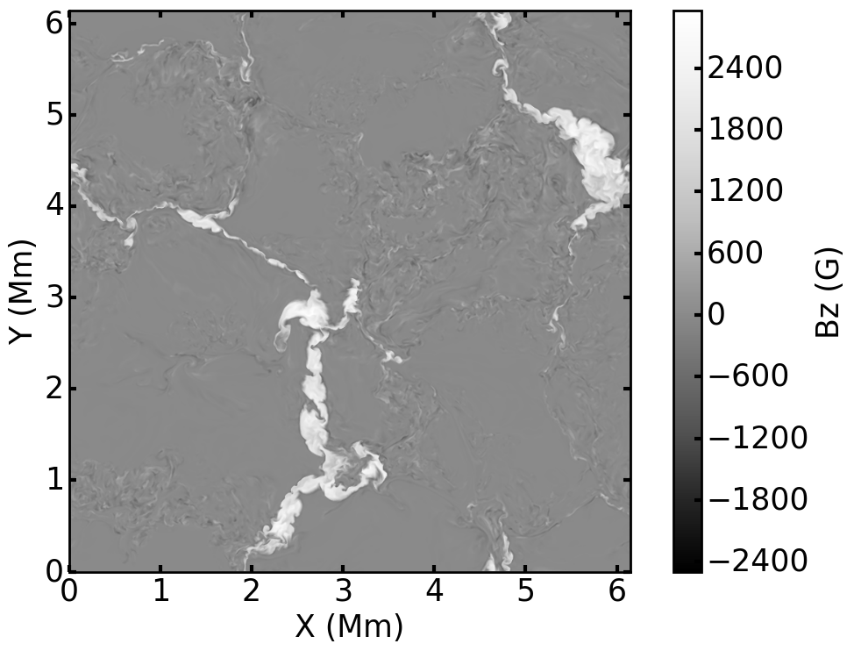
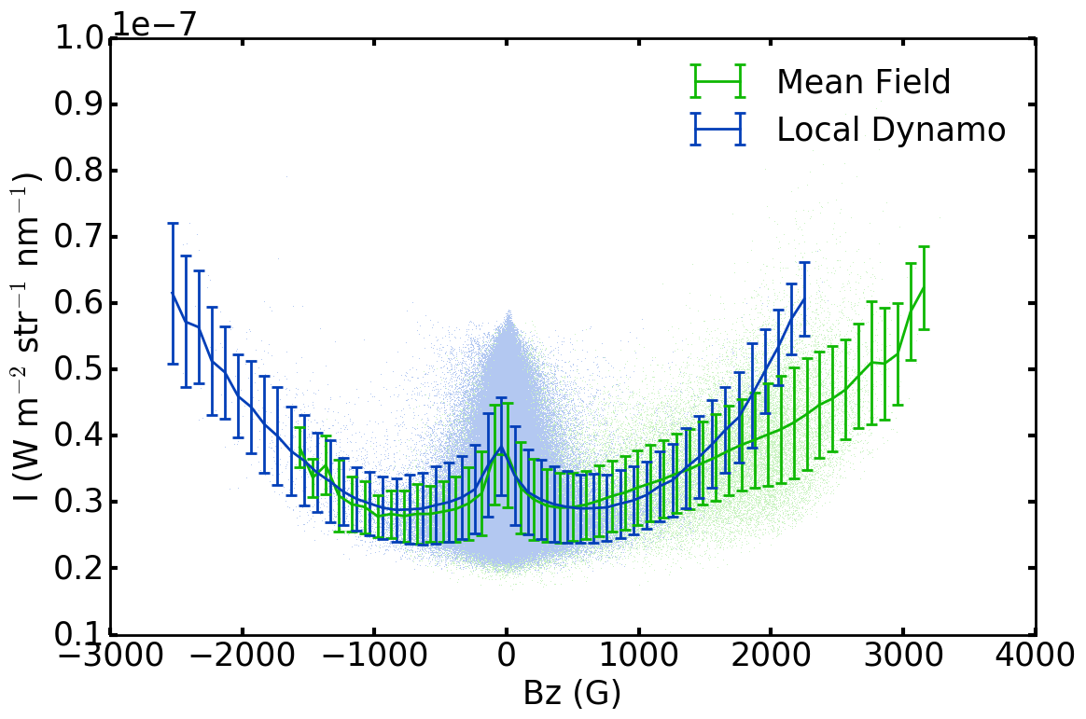
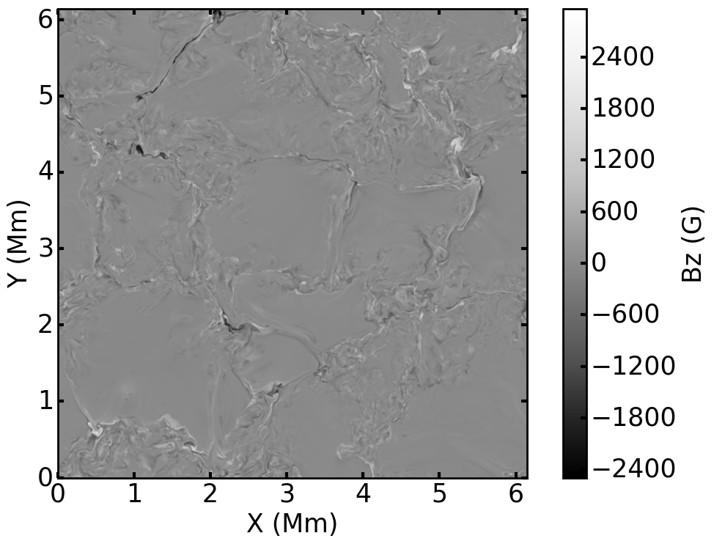
For identical field strength pixels, the radiative output differs between the two magnetic environments
Two simulations of small scale magnetism
Predominantly vertical magnetic field
Predominantly transverse magnetic field
Equivalent total unsigned magnetic flux
Compare their radiative output to infer potential net effect on spectral irradiance
λ = 500 nm
We aim to demonstrate the source of the radiative differences to better understand the solar irradiance variability
Radiative output at large magnetic field depends explicitly on the magnetic environment it is embedded
Also shown for continuum wavelengths between 400 and 2300 nm
Brief on future work

