Slide 1


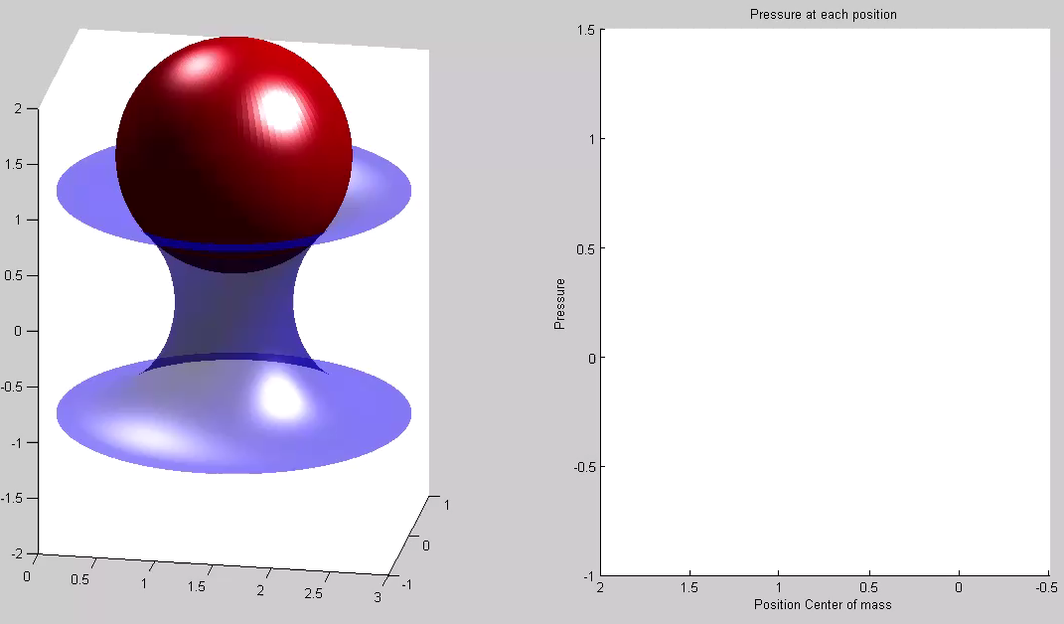
IHPCSS17 Poster Session Aly Badran C-2
The porous media's effect on the permeation of elastic (soft) particles
Eduard Benet, Aly Badran, John Pellegrino, Franck Vernerey
Abstract:
To further the ability to design membranes for separation/fractionation of deformable particles (such as, cells, liposomes and vesicles), we have developed a 2-d multiscale computational approach to study how the pressure drops and bulk flow within the depth of a porous "membrane" influences the mobility of an immiscible droplet through that structure. We calculated how the combination of several model 2-d porous network domain geometries (pore size and distribution), and a soft particle's deformation-related property (surface tension), influences the particles' velocity relative to the bulk fluid flux (aka sieving) in model porous domains made up of circular obstacles. The focus in this paper is on the scaling relationship between the particle's properties, the geometry of the system, and the overall droplet's sieving through a periodic domain. In this work we present first the case of a droplet permeating through an individual pore to determine its critical pressure. Then, the base case of a single pore and droplet is extended to include arrays of obstacles (creating a porous network domain) with different droplet volume fraction. These cases can provide a set of scaling rules to guide membrane design for droplet separation purposes.
E. Benet, A. Badran, J. Pellegrino and F. Vernerey. The porous media's effect on the permeation of elastic (soft) particles, Journal of Membrane Science, Volume 535, August 2017, Pages 10-19

Slide 2
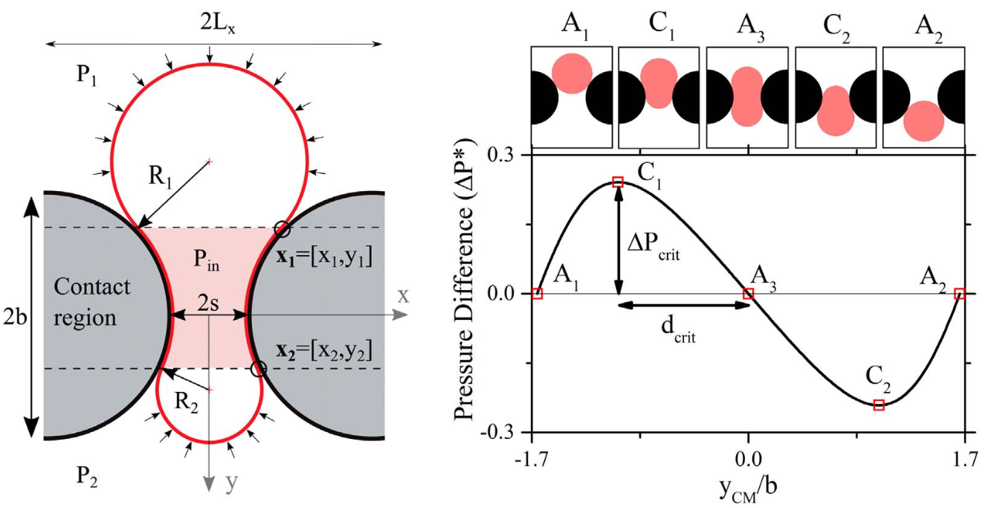
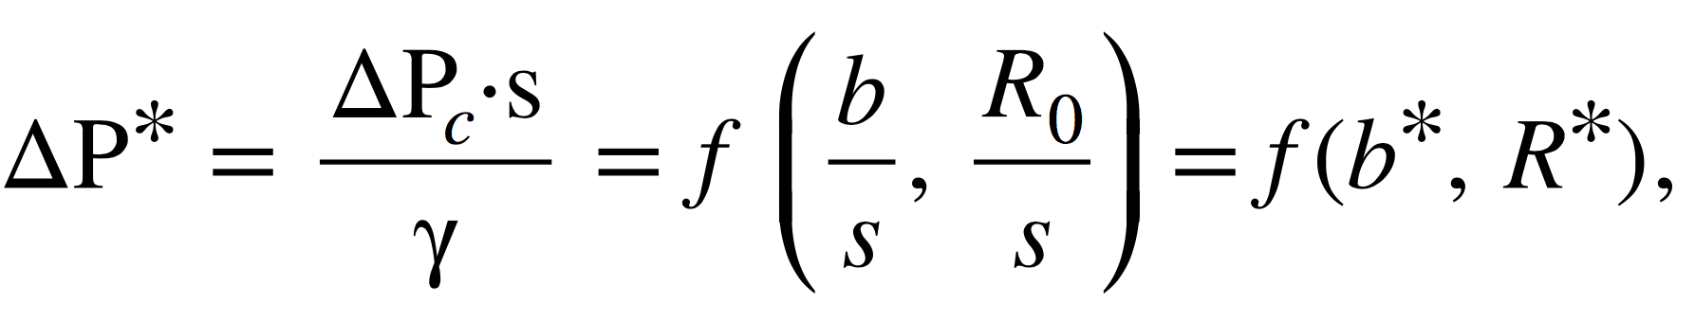

Objectives:
Develop a multiscale model to characterize and predict the effect of particle deformability on their permeation through filtration membranes under the various extant operating conditions.
Provide a continuum mechanics modeling tool (with experimental validation) that predicts the movement and deformation of immiscible soft particles through membranes.
Determine how to improve current models of filtration to target both size and deformability for soft vesicles such as oil droplets, cells and liposomes.
Parametric study (single pore):
To understand the vesicle permeation through a porous network we first need to understand how it permeates through a single pore.
We performed a parametric study to investigate what parameters affect the critical pressure drop of a fluid vesicle (e.g. an oil droplet) through a circular pore.
Critical Pressure Drop:
Where $γ$ is the surface tension and $f$ is a function determined by the computational tool

Slide 3
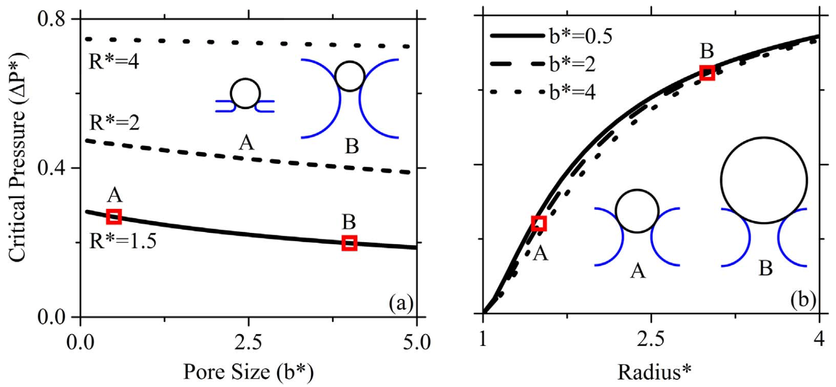
Parametric Study Results:
Conclusions:
Larger pores imply larger pressure drops
Larger vesicles need larger pressure drops
The increase in the critical pressure becomes more non-linear with the increase on the vesicle size.
Those cases do not give any information on the time needed for a vesicle to cross the domain, such as the one depicted on the right.
Pore geometry affects the deformation mode of the vesicle and therefore the critical pressure of the problem

Slide 4
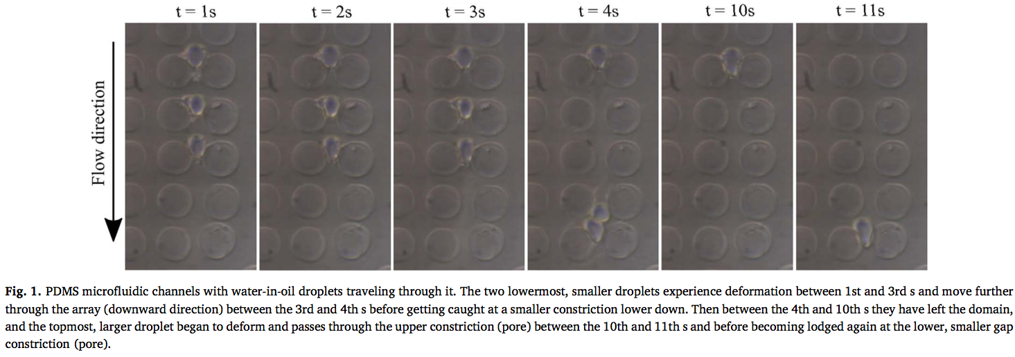
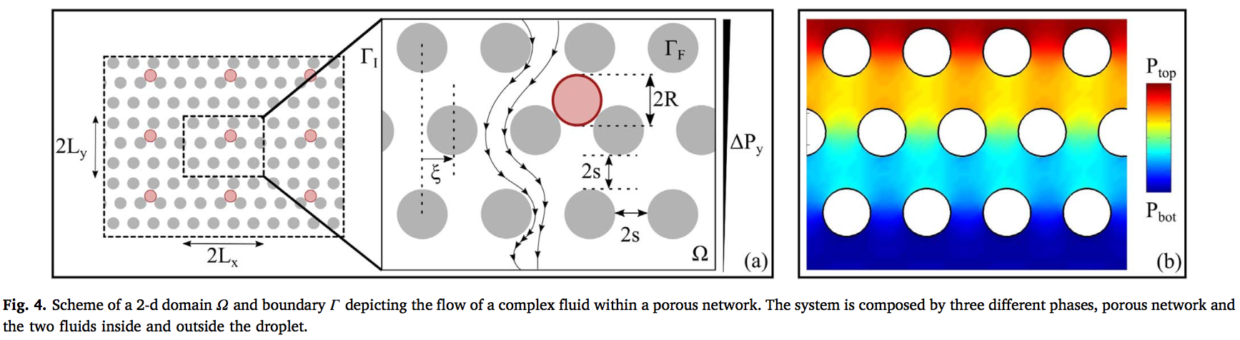
Experimental Validation:
Porous Network:

Slide 5
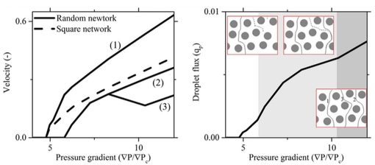
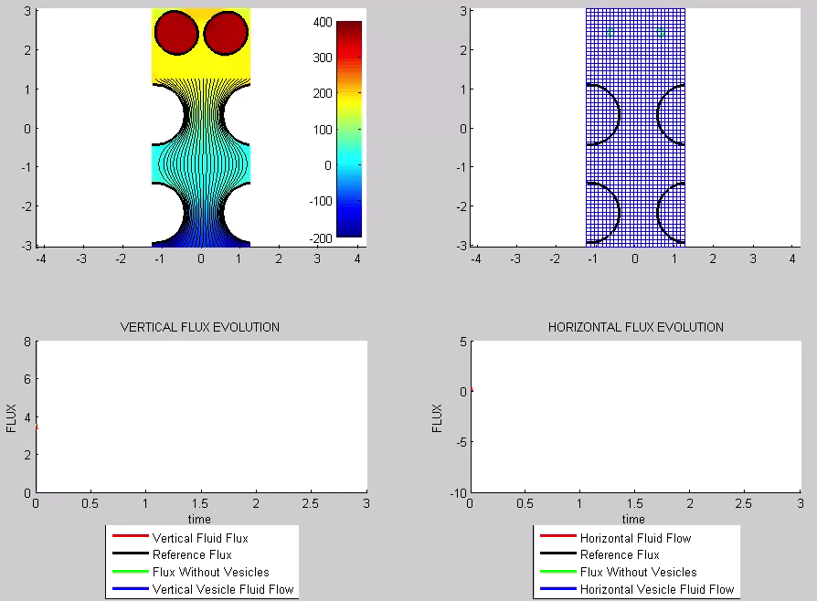
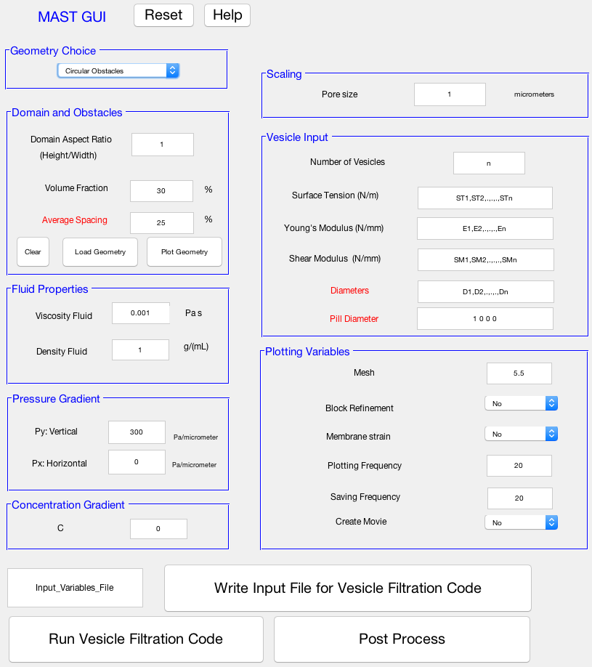
Porous Network Results:
Industry Graphical User Interface Demo

