Slide 1


Core-Collapse Nucleosynthesis
ANDREWS , S., ^{1, 2} FRYER , C., ^{3, 2, 4} EVEN , W., ^{3, 2, 5} JONES , S., ^{3, 2} PIGNATARI , M., ⁶ AND HEGER , A. ^{7, 8}
¹ T-Division, Los Alamos National Laboratory, Los Alamos, NM, 87545
² Center for Theoretical Astrophysics, Los Alamos National Laboratory, Los Alamos, NM, 87545
³ CCS-Division, Los Alamos National Laboratory, Los Alamos, NM, 87545
⁴ Department of Physics and Astronomy, The University of New Mexico, Albuquerque, NM 87131
⁵ Southern Utah University, Cedar City, UT 84720
⁶ E. A. Milne Center for Astrophysics, Department of Physics and Mathematics, University of Hull, HU6 7RX
⁷ Monash Centre for Astrophysics, School of Physics and Astronomy, Monash University, Victoria, 3800
⁸ School of Physics and Astronomy, University of Minnesota, Minneapolis, MN 55455c

Slide 2
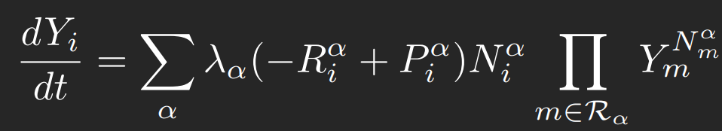
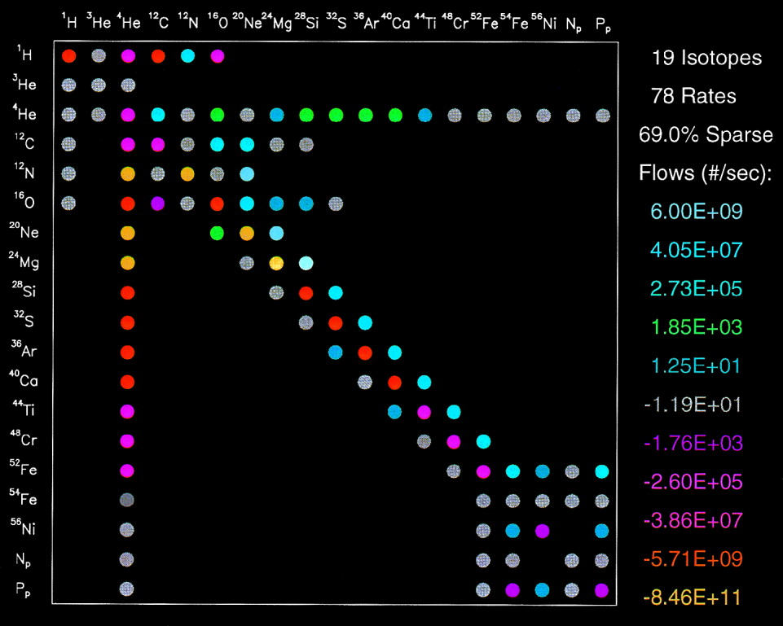
Nuclear Reaction Networks
Solve systems of coupled non-linear differential equations
Sparse matrix linear algebra
Post-processing a suite of spherically symmetric hydrodynamic core-collapse trajectories in a highly customizable network of 5000+ isotopes
Timmes, F. 1999

Slide 3
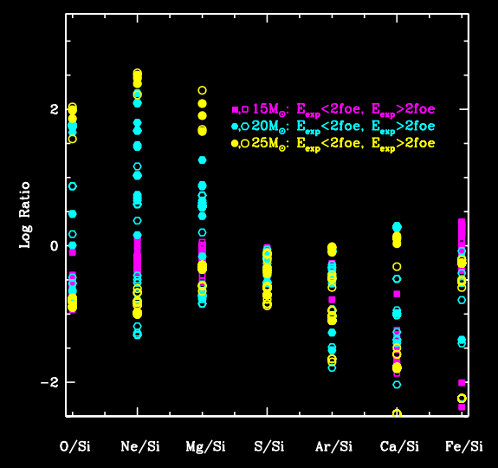
What Do We Care About?
CCSN
⁴⁴Ti
⁵⁶Ni
⁶⁰Fe
R-process (?)
Radio-isotopes for the next generation of gamma-ray telescopes
Fryer, C. et al. 2017

Slide 4
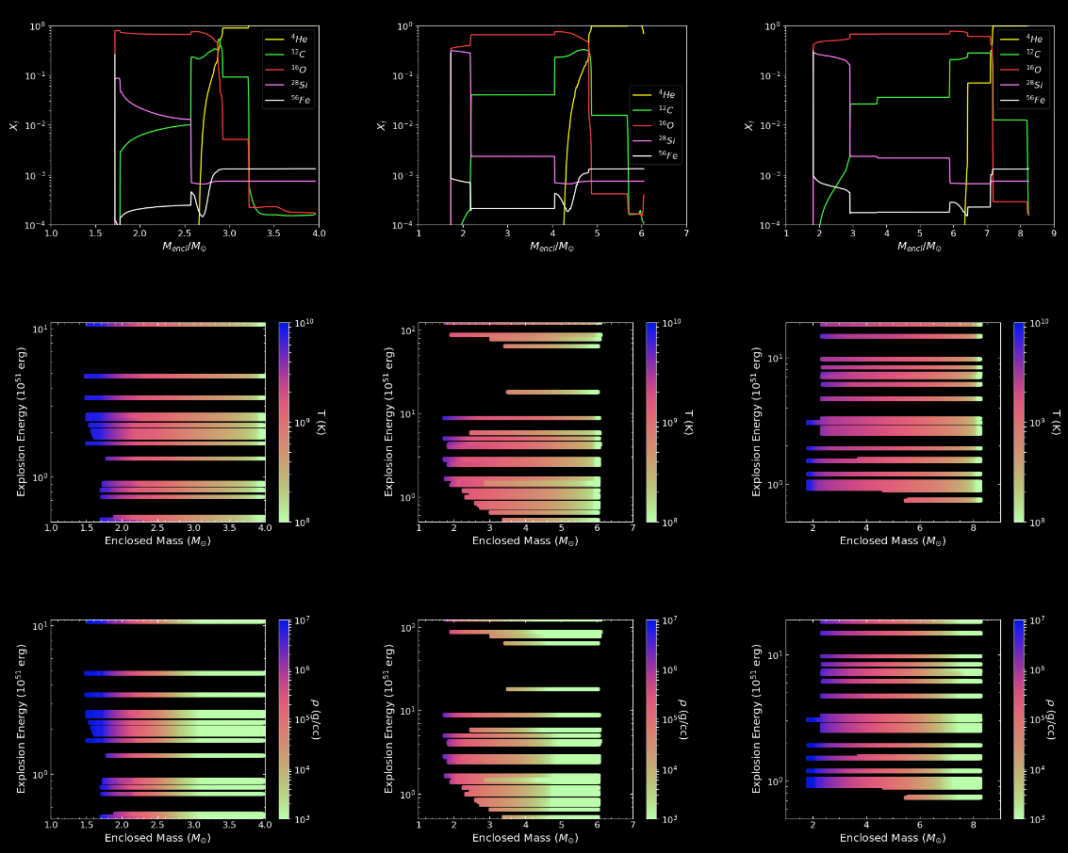
Explosion Profiles

Slide 5
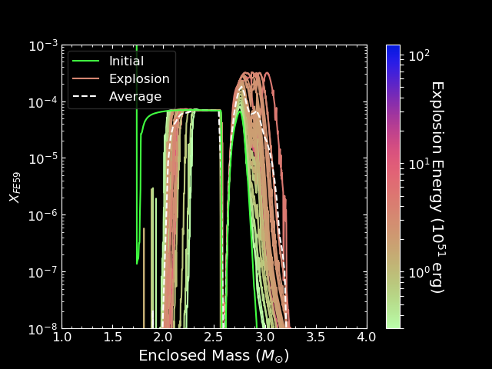
Sample Results

