Slide 1
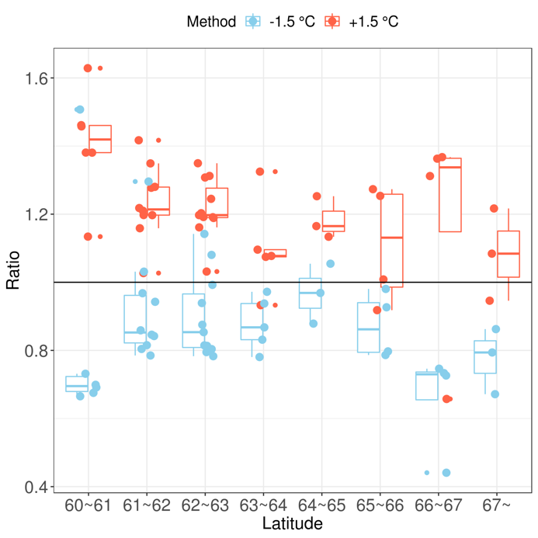
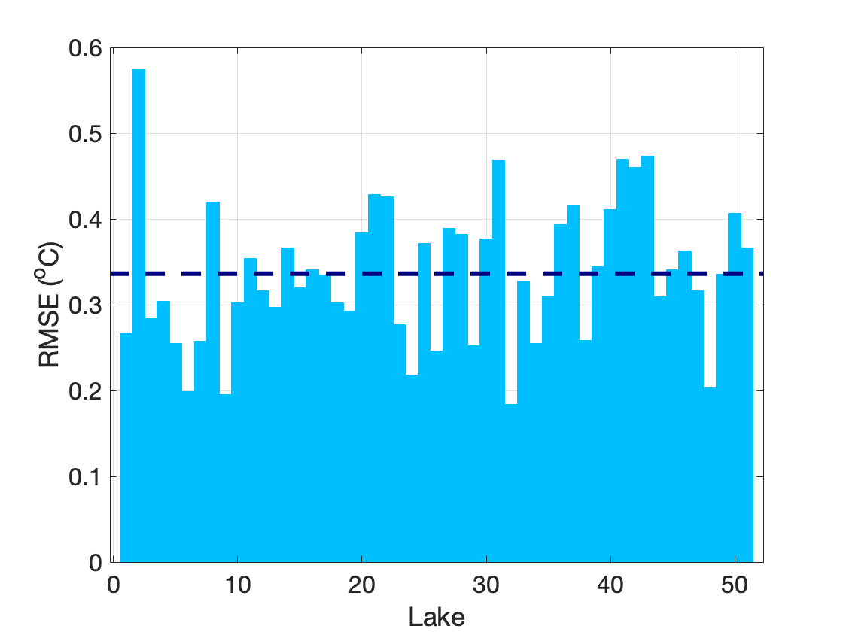
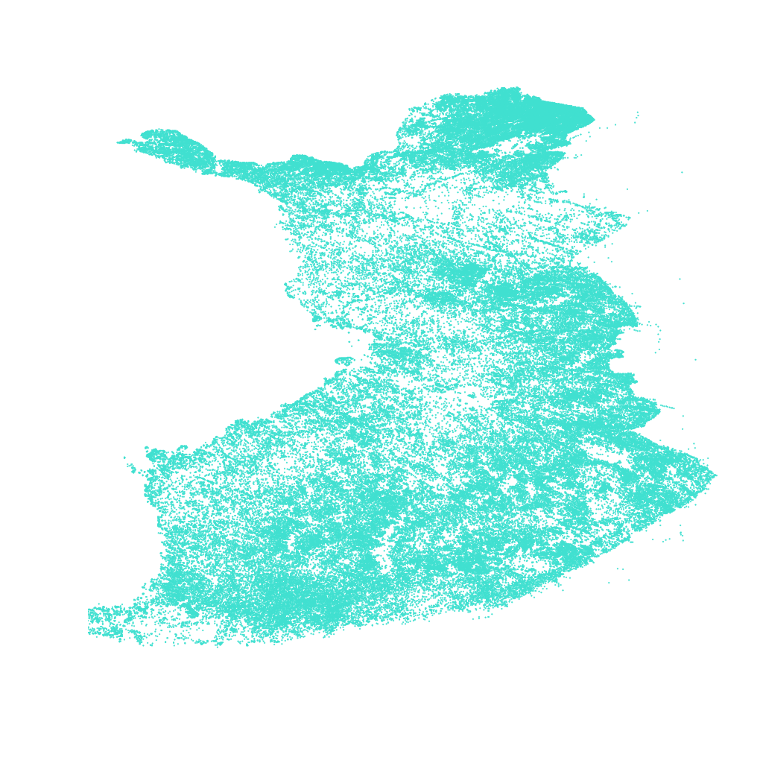
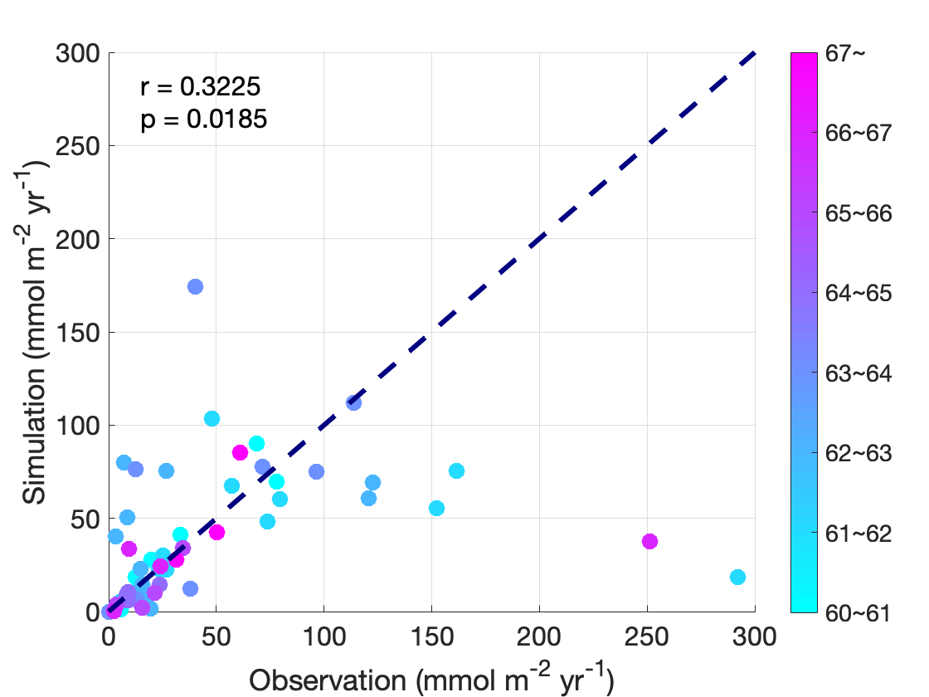
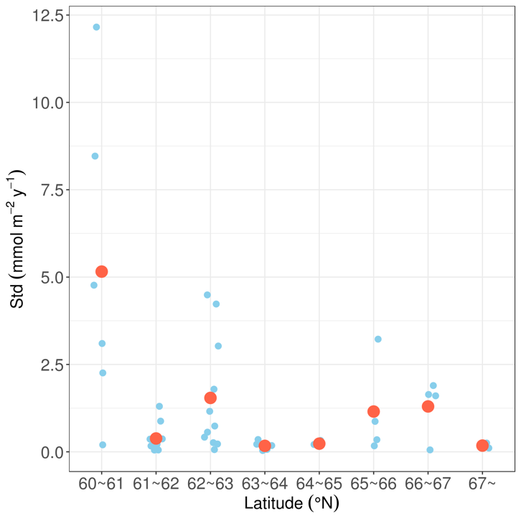
Modeling methane emissions from freshwater systems
Introduction
Our research is to simulate lake methane emissions using a one-dimensional process-based model, called the Arctic Lake Biogeochemistry Model (ALBM).
Model calibration using Monte-Carlo simulation
53 lakes (~1/4 of the total) randomly selected from the observation data and 5000 parameter sets run for each.
Model uncertainty quantification
Uncertainties caused by both input forcing data and model parameterization are evaluated
Motivation
As climate changing going on , freshwater systems are receiving accumulating attention as important global methane sources, especially for the Arctic.
Data
Physical information of 214995 lakes in Finland. Observation of methane fluxes of 177 lakes 1998-1999.

Slide 2
The Arctic Lake Biogeochemical Model
(ALBM)

