Slide 1
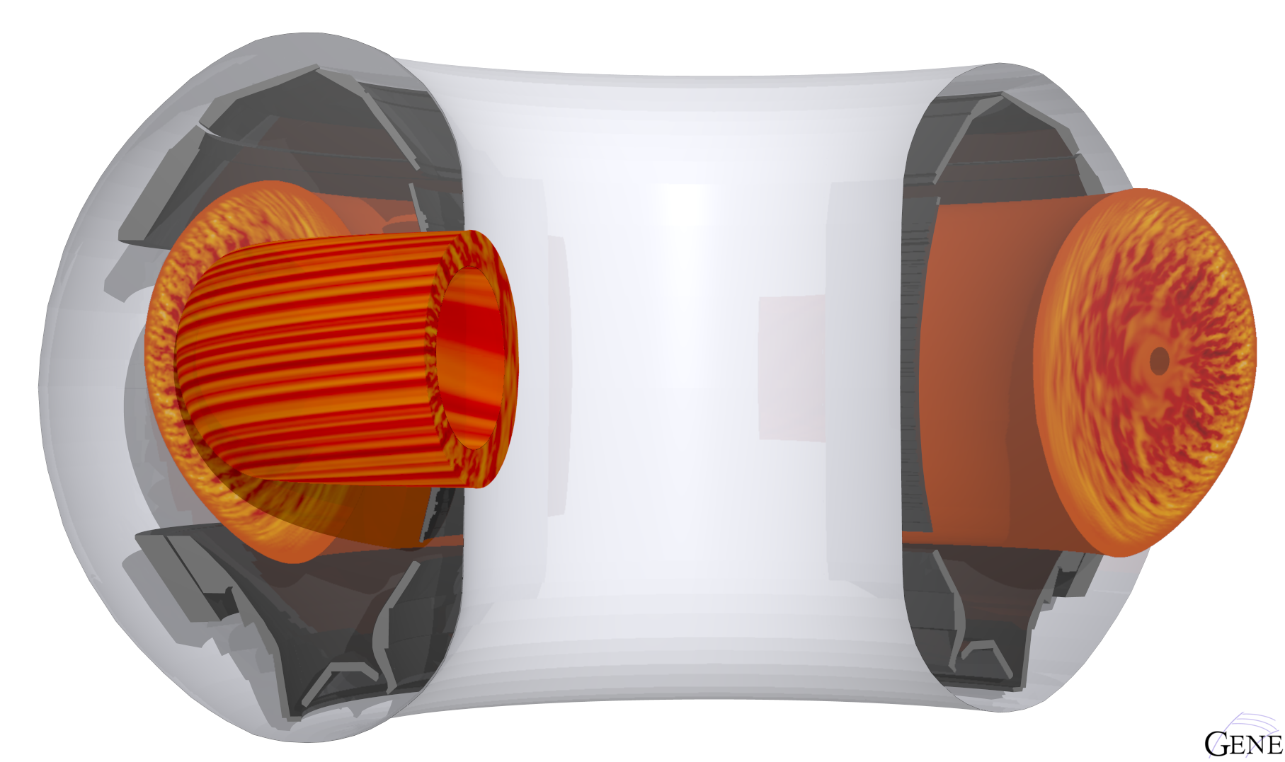
Gyrokinetic Turbulence in the Scrape-Off Layer with the GENE code
Dominik Michels
Max-Planck-Insitut für Plasmaphysik

Slide 2
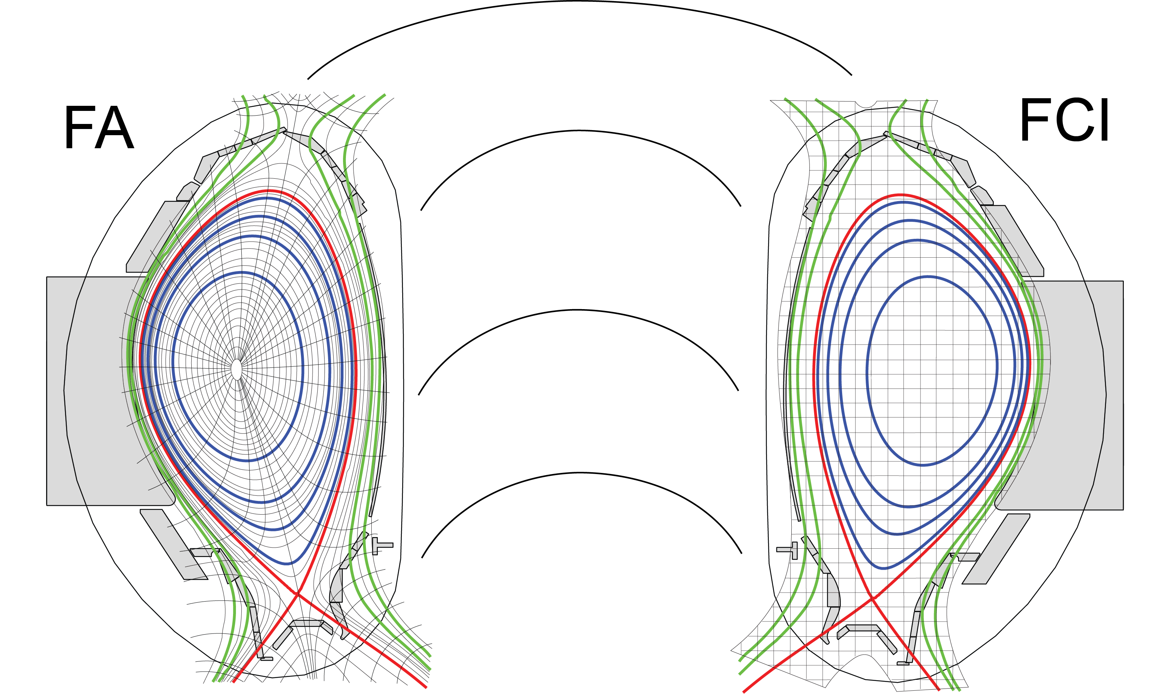
Magnetic configuration
Courtesy Thomas Body, Max-Planck-Institut für Plasmaphysik

Slide 3
Model
Along the magnetic field
In velocity space
Perpendicular to the magnetic field

Slide 4
Numerics
Finite differences
Parallel terms
Orthogonal terms
Electromagnetics
WENO
Arakawa
Mimetic methods

Slide 5
How to exascale?

