Slide 1

HPC Challenges in Seismology:
There’s a Whole Lotta Shakin’ Goin’ On
Scott Callaghan
scottcal@usc.edu
Thursday, July 13, 2023
2023 IHPCSS

Slide 2
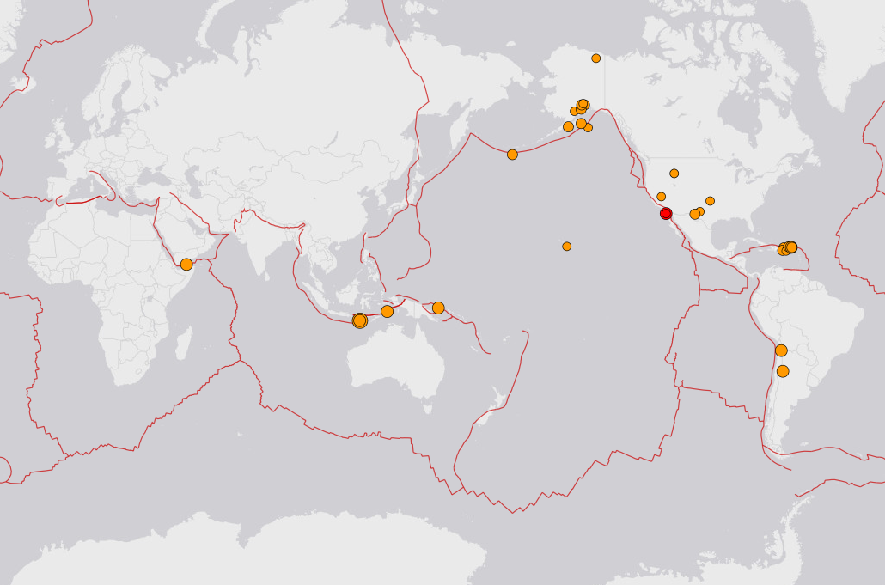
In 2023 so far:
  M7-8: 13
  M8+: 0
Potential for large societal impact
  2023 Turkey (M7.8 & M7.5)
  2021 Haiti (M7.1)
  2011 Tohoku (M9.1)
So far, prediction is elusive
35 earthquakes, M2.5+, last 24 hrs, max M5.0

Slide 3
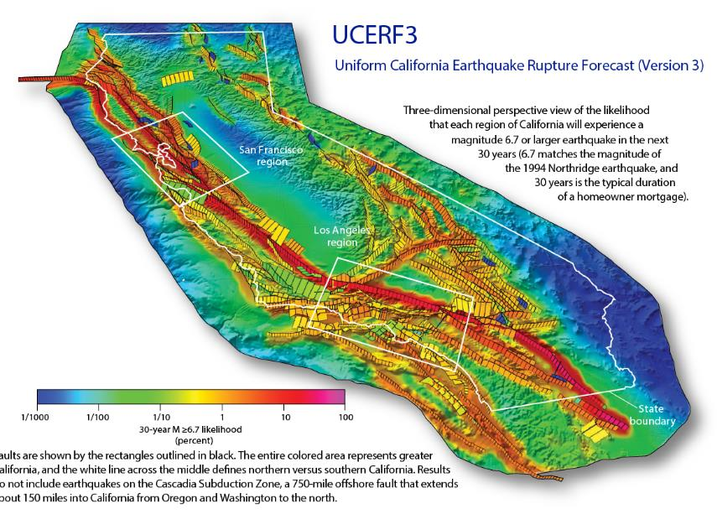
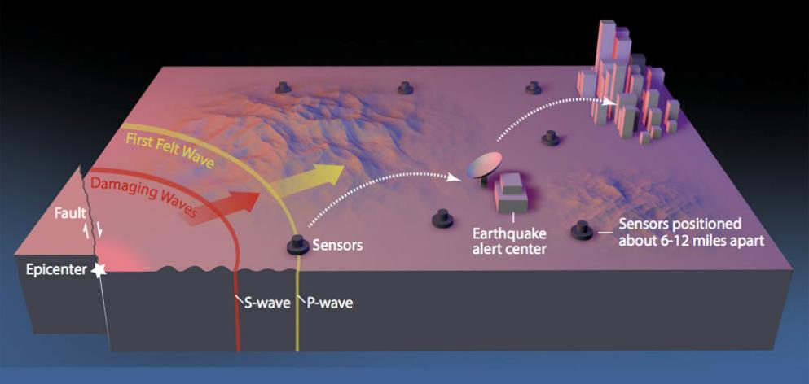
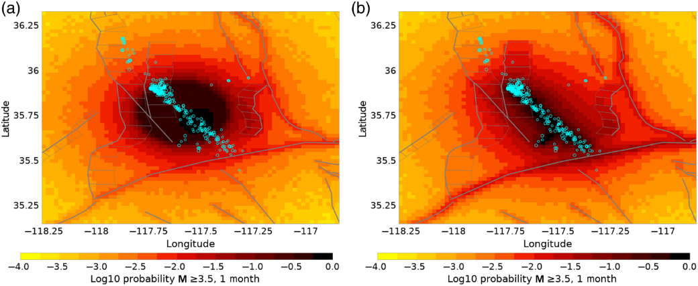
Earthquake Forecasting
If we can’t predict, what can we do?
Earthquake forecasts
  Long-term
  Short-term
Earthquake early warning
Simulations of individual events

Slide 4
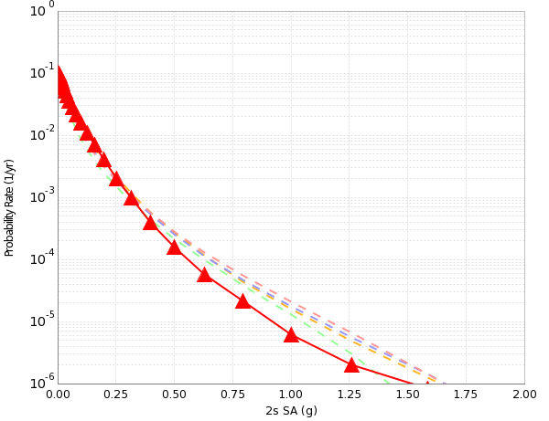

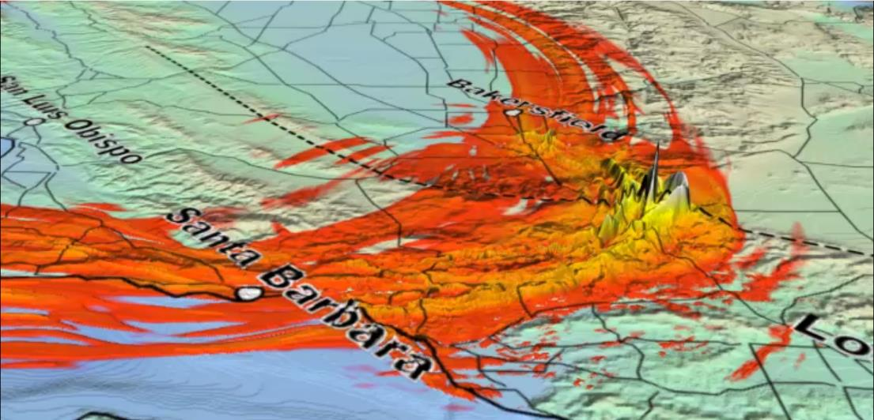
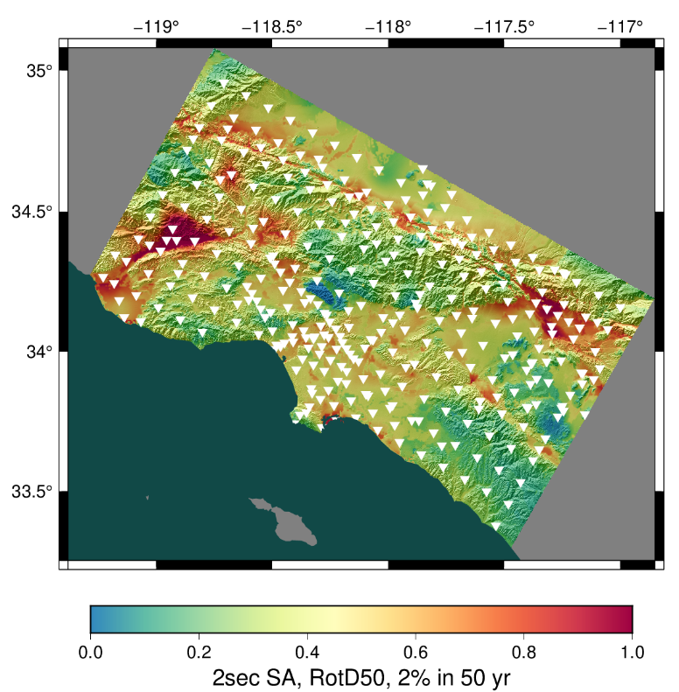
Seismic Hazard
What ground motions can I expect in the next 50 years?
  Building engineers
  Insurance companies
  Disaster planners
Answered via Probabilistic Seismic Hazard Analysis (PSHA)
  Get a list of all possible earthquakes
  Determine how much shaking each earthquake causes
  Combine shaking with earthquake probability to generate hazard estimates
2% in 50 years
0.4 g

Slide 5
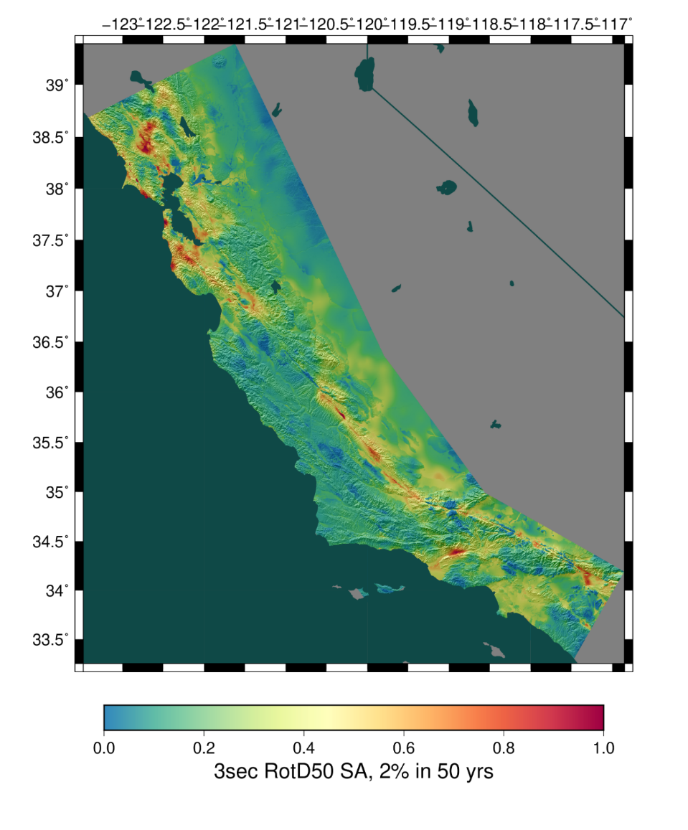
CyberShake platform
CyberShake was developed by SCEC to perform 3D physics-based PSHA
Uses wave propagation simulations to determine shaking from each earthquake
To reduce computational cost, utilizes reciprocity
  2 simulations per site rather than 1 per event
  (# of sites) << (# of events)
Shaking measures derived from seismograms
Shaking measures combined with probabilities for site and regional hazard

Slide 6
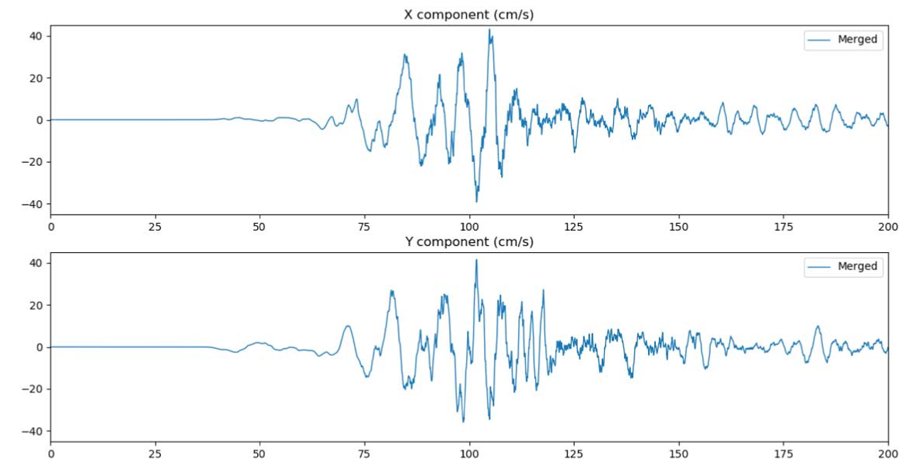
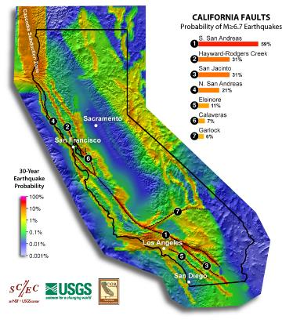
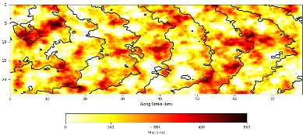
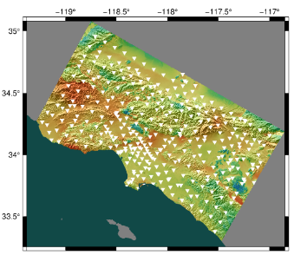
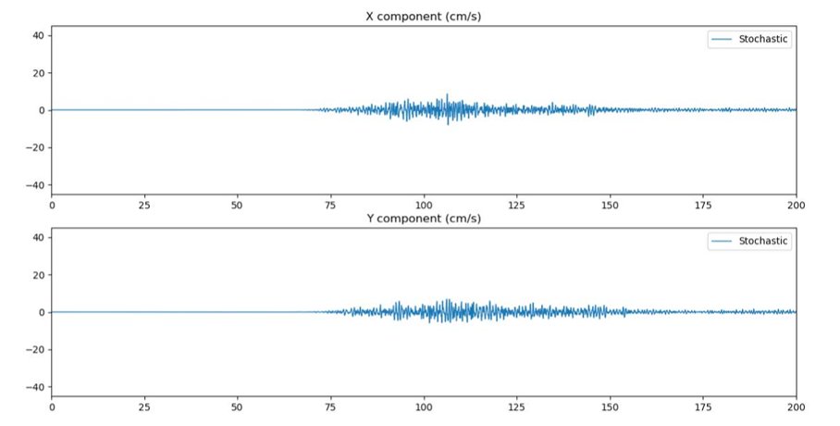
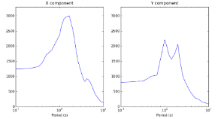
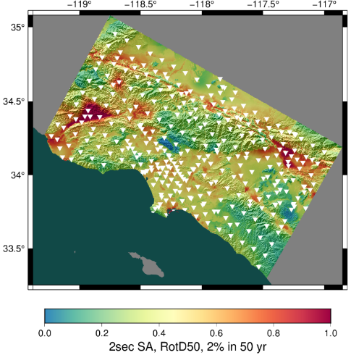
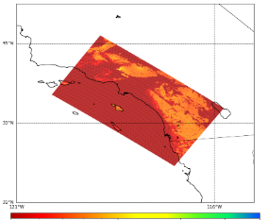
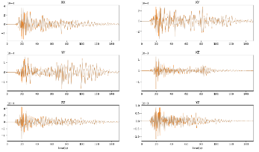
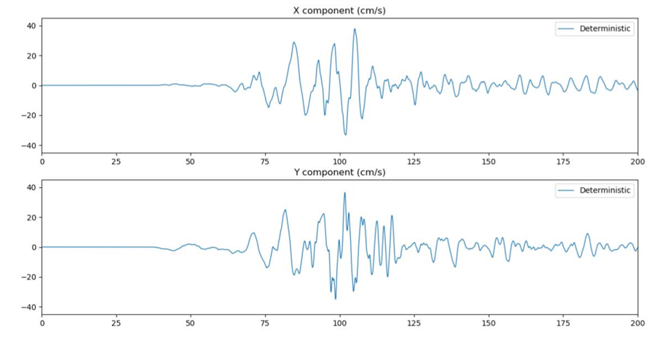
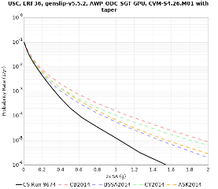
Parallel Jobs
Serial
Jobs
Rupture generator
High-frequency seismogram synthesis
Merge and combine
0-50 Hz broadband data products
600,000+ events
in memory
Uniform California Earthquake Rupture Forecast
1-50 Hz seismograms
190 GB
Period-dependent shaking measures
<1 GB
Velocity mesh generator
Wave propagation
code
(4th order FD, GPU)
Low-frequency seismogram synthesis
Intensity measures
Aggregate
data products
0-1 Hz low-frequency seismograms
40 GB
Period-dependent shaking measures
<1 GB
Velocity Mesh
300 GB
Strain Green Tensors
2 x 750 GB
Hazard Curve
Hazard Map

Slide 7
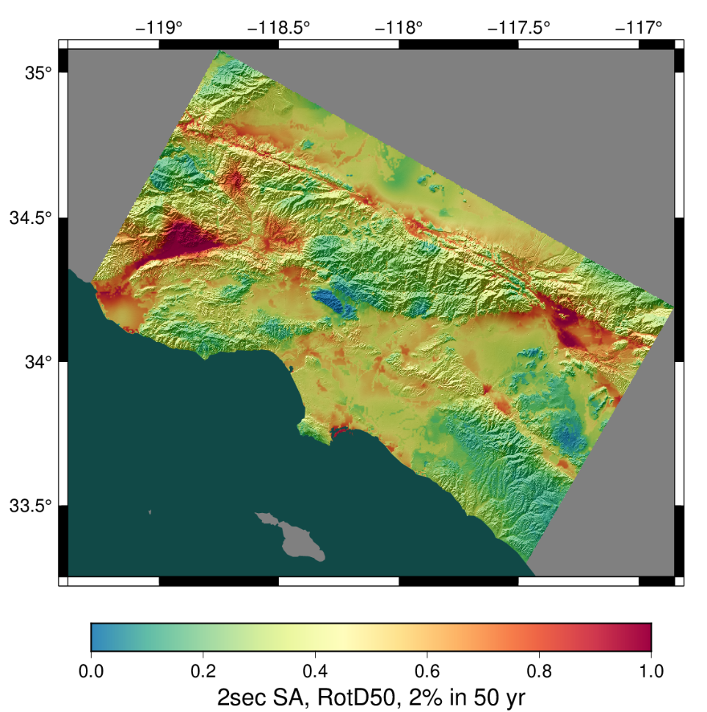
Recent Results
Regional hazard calculation for Southern California
95 days of around-the-clock execution
Used 772,000 node-hours on Summit
  Peak of 73% of the system (3382 nodes)
26 million computational tasks run
in 28,130 workflow jobs
2.5 PB of total data
Staged 74 TB / 19 M files
to long-term storage

Slide 8
Resolved Technical Challenges – pre & post processing
Additional codes not included in the flow chart
  Create configuration files
  Write metadata needed to parse data files
  Reorder files to be fast in time instead of fast in space
As we scaled up, each of these became a bottleneck
  Parallelized them with straightforward MPI
    Manager process reads in configuration information
    Broadcasts information to other processes to figure out their work
    Processes do their work
    Depending on size of output, either manager aggregates and writes output, or MPI collective I/O
This simple parallelism reduced runtimes back to noise

Slide 9

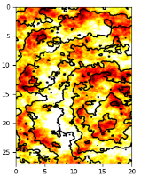

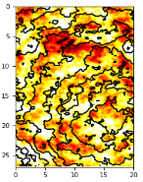
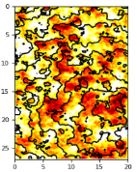
Resolved Technical Challenges – Intermediate Files
0.5 Hz simulation
Extracted SGTs,
rupture 1
Seismogram,
event 1
1 Hz simulation
Event 1
Extracted SGTs,
rupture 2
Seismogram,
event 2
Event 2
…
…
Strain Green Tensors
Seismogram,
event N_{e}
Extracted SGTs,
rupture N_{r}
Event N_{e}
40 GB
1.5 TB
18 TB
10 GB
480 GB
13 GB
40 GB
300 GB

Slide 10
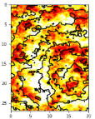
Resolved Technical Challenges – Intermediate Files
Rewrote this stage into MPI manager-worker job
Reduced I/O by 99%
Enabled 1 Hz calculations
Request
SGT Reader 1
Worker 1
Response
Strain Green Tensors
SGT Reader 2
Request
Worker 2
MPI I/O
…
Response
…
SGT Reader R
Worker W

Slide 11
Resolved Technical Challenges – Number of Files
Aggregated files to reduce total number by factor of 85
Output files relatively small: ~10 Mbps/sec write
Output data sent to manager process, then written out
  Reduces filesystem load
  Reduces challenge of synchronizing files
EQ 1
EQ 4
EQ 3
EQ 2
File per earthquake
(~600K)
File per rupture
(~7K)

Slide 12
Resolved Technical Challenges – File Integrity
Found occasional issues with files
  Sometimes subtle bugs in the code
  Sometimes filesystem hiccups
  Sometimes problems in file transfer (less of an issue now)
Added sanity checks to our workflow
  Job to check number of files, NaNs, size of files, etc.
  Calculate MD5 sums for files which will be archived
In current study, encountered new exciting errors
  Problem with OS flushing to disk?
  Additional checks needed

Slide 13
Resolved Technical Challenges – Automation + 2FA
Automated job submission is required
  Most recent CyberShake study ran ~26 million computational tasks
How do you submit jobs in an automated fashion with 2FA?
  (Without making the system administrators very angry)
Workflow tools provide two solutions:
  Push-based (get work first, then find them nodes)
  Pull-based (get nodes first, then give them jobs)
We use both approaches in CyberShake

Slide 14
Resolved Technical Challenges – Automation + 2FA
Pull-based: get resources first, then ‘pull’ work onto them
Push-based: jobs sent when ready
  Daemon required to set up connection
Workflow management system
Workflow management system
task 1
task 1
task 2
task 2
task 3
task 3
. . .
. . .
Workflow submission host
Workflow submission host
Remote compute resource
Remote compute resource
. . .
pilot job
. . .
. . .
task 1
. . .
task 1
pilot job
task 1
. . .
Long-running daemon
. . .
Remote queue
Compute node(s)
Remote queue
Compute node(s)

Slide 15
Resolved Technical Challenges – Job Throughput
Large parallel tasks
  Our target systems prefer large jobs
  Using pull-based approach, request 1000 nodes
    Run 10 100-node tasks on these nodes
  Better throughput than 10 individual jobs
Small serial tasks
  Can’t put them in the queue individually
  Use Pegasus-MPI-Cluster, a workflow tool
  Runs workflow tasks inside MPI job
  Great for high throughput or self-contained workflow
  Push-based
Bin | Node Range | Aging Boost
1 | 2765 – 4608 | 15 days
2 | 922 – 2674 | 5 days
3 | 92 – 921 | 0
4 | 46 – 91 | 0
5 | 1 – 45 | 0
OLCF Summit Scheduling Policy
PMC
workflow
manager
workers

Slide 16
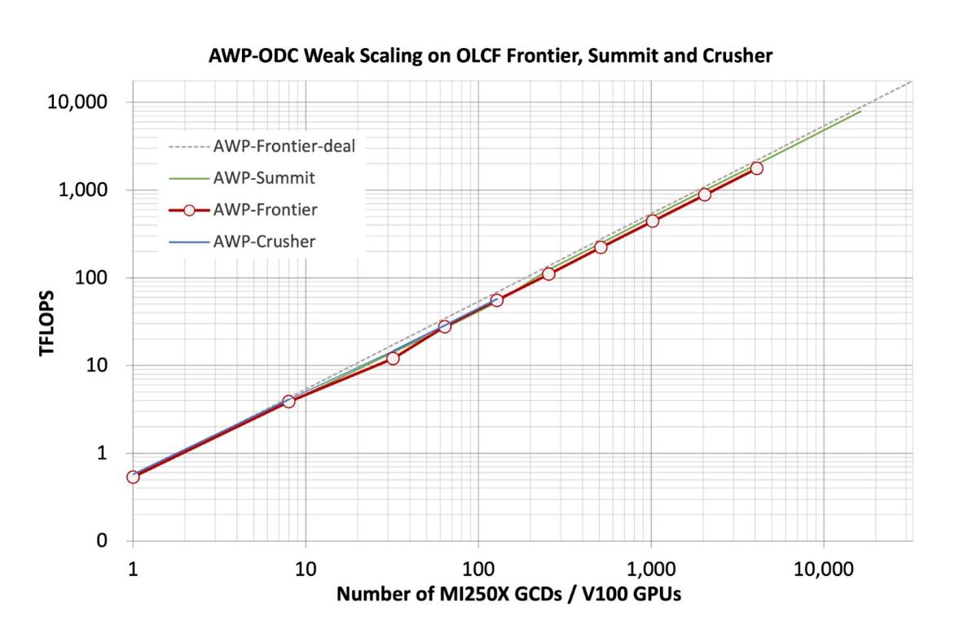
What about the wave propagation code?
Collaborators continue to enhance with new physics
  Planning to migrate to faster discontinuous mesh version
  Will also enable higher-frequency simulations
Optimizing for new architectures
  Currently being ported to HIP
  for AMD GPUs
  Successfully tested last week
  on almost full-system Frontier
Value of collaborations and
leaning on expertise

Slide 17
What are my current challenges?
Improve access to output data
  So people don’t have to email me for the seismograms!
  Data access tool to be released shortly
  Seismograms delivered through Globus Collection
Better database solution
  We insert shaking metrics into database to support data products
  Upwards of 12 billion rows (3 TB) for most recent study
  MySQL performance is poor
  Looking for alternative approaches
Reduce storage footprint of seismograms
  ~200 TB of seismograms from CyberShake various studies
  Looking at lossy compression: what metrics are needed to evaluate?

Slide 18
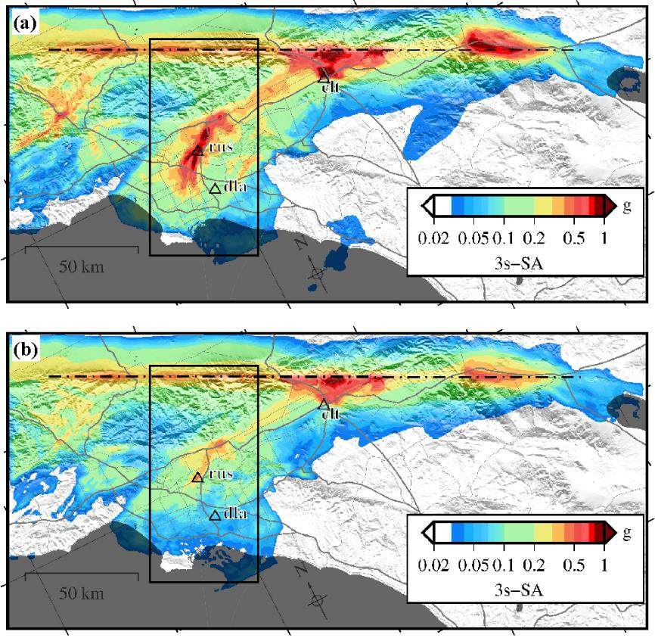
What are my future challenges?
Nonlinearity
  Rocks don’t always exhibit linear response
  Current reciprocal approach is linear
  Will need to combine some nonlinear simulations
  with reciprocity
Improve reproducibility
  A few parameters are still hard-coded
  Common configuration file to track parameters
GPU versions of additional codes
  Some systems are requiring GPU codes
  GPU versions give us greater flexibility (and hopefully greater performance)

Slide 19

Closing Thoughts
Your time and resources are limited
  Evaluate what’s interfering with getting science results
  What will get you the best payoff?
  May not be typical code optimization
Incremental improvement is still improvement
If you’re in an earthquake:

Slide 20









Thanks!

