Slide 1
Simplify Your Science with Workflow Tools
Scott Callaghan
scottcal@usc.edu
2022 IHPCSS
June 22, 2022

Slide 2
Overview
What are scientific workflows?
What problems do workflow tools solve?
Overview of available workflow tools
Real-world seismic hazard application (SCEC CyberShake)
Computational overview
Challenges and solutions
Ways to simplify your work
Goal: Help you figure out if this would be useful

Slide 3
Scientific Workflows
Formal way to express a scientific calculation
Multiple tasks with dependencies between them
No limitations on tasks
Capture task parameters, input, output
Workflow process and data are independent
Often, run same workflow with different data
Could take the same workflow and run it on different systems
Actually, you use workflows all the time…

Slide 4
Perhaps your workflow is simple…
stage-in
parallel job
post-process
stage-out

Slide 5
…or maybe a bit more complicated…
Job 1
pre-process
Job 2
visualize
publish
Job 3
Job 4

Slide 6
…or maybe just confusing
edit file names
post-process again if it failed
stage-in
stage-out
parallel job
post-process
stage-in that other file
do you still need this job?
job you always forget
job from past post-doc
email your supervisor

Slide 7
Workflow Components
Task executions with dependencies
Specify a series of tasks to run
Outputs from one task may be inputs for another
Task scheduling
Some tasks may be able to run in parallel with other tasks
File management
Inputs must be present for tasks to run
Metadata
Track when a task was run, key parameters
Computational resource provisioning
Computational resources (CPUs, GPUs) are needed to run jobs

Slide 8
What do we need help with?
Task executions with dependencies
Dependencies may be complex
What if something fails in the middle?
Task scheduling
Minimize execution time while preserving dependencies
File management
Make sure inputs are available for tasks
Metadata
Automatically capture and track
Matching jobs to processors (across multiple systems?)

Slide 9
Workflow tools can help!
Automate your pipeline
Define your workflow via programming or GUI
Run workflow on local or remote system
Can support all kinds of workflows
Use existing code (no changes – can still run code the old way)
Provide many kinds of fancy features and capabilities
Flexible, but can be complex
Will discuss one set of tools (Pegasus-WMS) as example, but concepts are shared

Slide 10
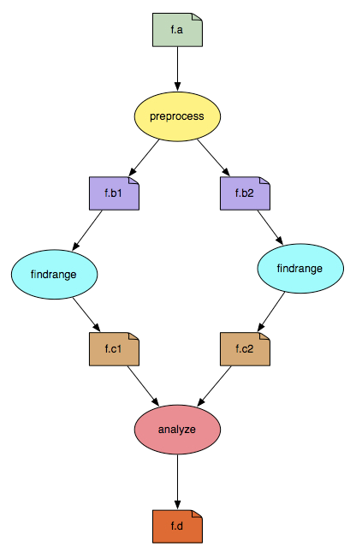
Pegasus-WMS
Developed at USC’s Information Sciences Institute
Used in many science domains, including LIGO project
Workflows are executed from local machine
Jobs can run on local machine or on distributed resources
You use API to write code describing workflow (“create”)
Python (recommended), Java, or R
Define tasks with parent / child relationships
Describe files and their roles
Pegasus creates YAML file describing workflow
Workflow represented by directed acyclic graph

Slide 11
Sample Workflow Creation
input.txt
//Create workflow object
wf = Workflow("test_wf")
//Define my job
my_job = Job("MyGreatJob")
//Input and output files to my job
input_file = File("input.txt")
output_file = File("output.txt")
//Arguments to my_job (./my_job input=input.txt output=output.txt)
my_job.add_args("input=input.txt", "output=output.txt")
//Role of the files for the job
my_job.add_inputs(input_file)
my_job.add_outputs(output_file)
//Add the job to the workflow
wf.add_jobs(my_job)
//Write to file
wf.write(file="test_wf.yaml")
my_job
output.txt

Slide 12
Getting ready to run
YAML representation is “abstract workflow” – system-independent
Logical filenames and executables
Algorithm description
Use Pegasus to prepare abstract workflow for execution (“plan”)
Uses catalogs to resolve logical names, compute info
Pegasus automatically augments workflow
Staging jobs (if needed) using scp, wget, Globus, Docker Hub, Amazon S3, …
Registers output files in a catalog to find later
Wraps jobs in pegasus-kickstart for detailed statistics
Generates a DAG
Top-level workflow description (tasks and dependencies)
Submission file for each job with specifics for the execution system

Slide 13
Abstract Workflow
Concrete Workflow
input.txt
/local_machine/home/input.txt
/cluster/home/input.txt
stage in
my_job
Plan
pegasus-kickstart my_job
Replica Catalog
register
stage out
/local_machine/home/output.txt
/cluster/home/output.txt
output.txt
Local Machine
Remote Machine

Slide 14
Pegasus Workflow Path
Create workflow description (you write this)
Plan
Run
Jobs Execute
Pegasus API
Scheduler
(HTCondor)
Abstract workflow
Logical names, algorithm
job name=“MyGreatJob”
Concrete workflow
Physical paths, job scripts
executable=/path/to/directory/my_job

Slide 15
Other tools in stack
HTCondor (University of Wisconsin Madison)
Pegasus submits workflow to HTCondor (“run”)
Supervises runtime execution of DAG files
Maintains job queue
Monitors dependencies
Schedules jobs
Retries failures
Writes checkpoint
Tools for remote job submission to clusters and clouds
SSH, BOSCO, CREAMCE, glideins/pilot jobs, …
Condor uses these tools to match jobs to resources

Slide 16
Full workflow stack
Local machine
Remote machine
What you do:
Create workflow description
Remote scheduler
What the tools do:
HTCondor
Pegasus
SSH,
etc.
local queue
remote queue
DAG

Slide 17
Other Workflow Tools
Regardless of the tool, same basic elements
Describe your high-level workflow (Pegasus “Create”)
Prepare your workflow for the execution environment (Pegasus “Plan”)
Schedule and run your workflow (HTCondor)
Send jobs to remote resources (SSH, pilot jobs)
Monitor the execution of the jobs (HTCondor DAGMan)
Brief overview of some other available tools
All support large-scale workflows

Slide 18
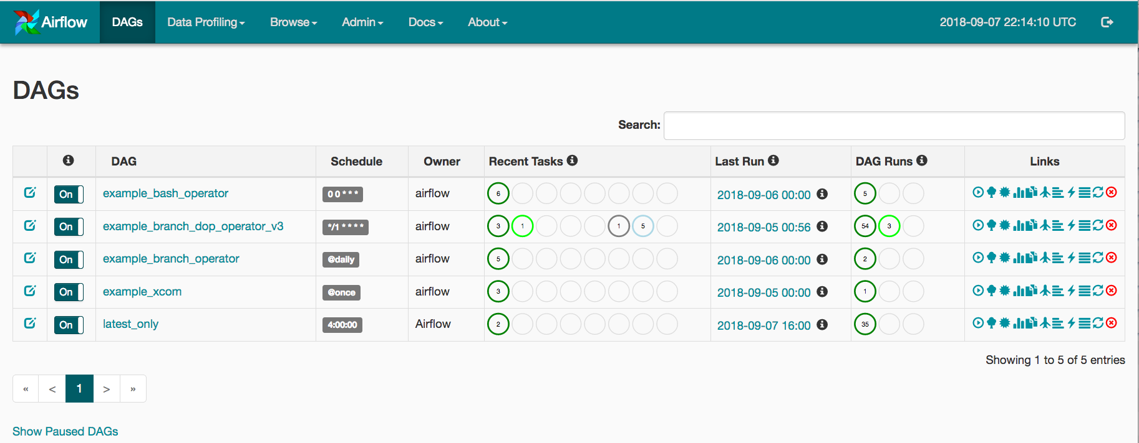
Other Workflow Tools
Parsl (U of Chicago/Argonne NL)
Parallelize Python by annotating functions or external apps
Integrated with Jupyter notebooks
Link outputs and inputs of annotations to describe workflow
Focus on large data, many tasks
Airflow (Apache project / Airbnb)
Workflow defined with Python API
Description used to write DAGs
Internal scheduler triggers tasks
Support for Kubernetes (deploys containers)
Web UI for getting status
@bash_app
def mysim(stdout=("output/p1.out", "w"), stderr=("output/p1.err", "w")):
#Call a bash command-line app ‘simulate’
return "app/simulate"
# call the mysim app and wait for the result
mysim().result()
# open the output file and read the result
with open('output/p1.out', 'r') as f:
print(f.read())

Slide 19
Other Workflow Tools
JUBE (Jülich Supercomputing Center)
Designed for automating benchmarks and testing on multiple systems
Workflow described via XML files
FireWorks (LBNL/NERSC)
Workflows described through Python, JSON, or YAML, stored in MongoDB database
Submit batch scripts to launch workflow
Monitor through web interface
Makeflow (Notre Dame)
Makefile-type syntax to specify workflow
Targets are output files, dependent on input files, with execution string to run
Can work with Work Queue for management of compute resources (workers)
Multiple clusters, pilot jobs, dynamic worker pool
Nextflow (Barcelona Centre for Genomic Regulation, now Seqera Labs)
Uses dataflow paradigm: tasks write/read from channels (not always a file), can be piped
Custom scripting language for defining workflows
Many more! Ask me about specific use cases

Slide 20
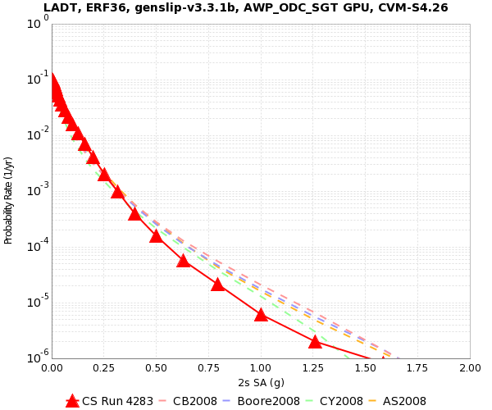
Workflow Application: CyberShake
What will peak earthquake shaking be over the next 50 years?
Used in building codes, insurance rates, disaster planning
Answered via Probabilistic Seismic Hazard Analysis (PSHA)
Get list of all possible earthquakes
Figure out how much shaking each causes
Combine shaking levels with probabilities
2% in 50 years
0.4 g

Slide 21
CyberShake Computational Requirements
Determine shaking of ~500,000 earthquakes per site
2 large parallel jobs
Perform wave propagation
400 GPUs x 30 min
1.5 TB total output
500,000 small serial jobs
Calculate seismograms and shaking measures
1 core x 4 min
17 GB total output
Need hundreds of sites for hazard map

Slide 22
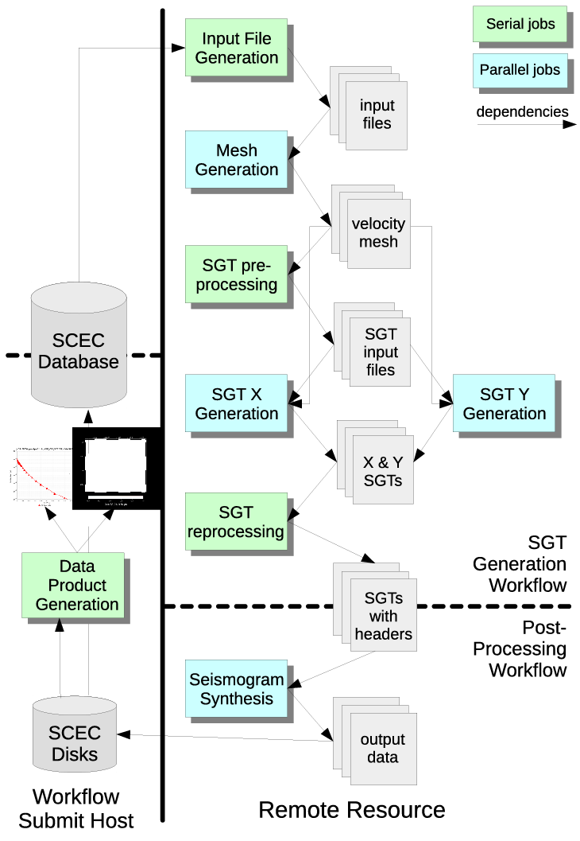
CyberShake Challenges
Automation
Too much work to run by hand
Data management
Input files need to be moved to cluster
Output files transferred back for archiving
Error recovery
Detect and recover from basic errors automatically
Resource provisioning
How to execute large numbers of small tasks?
Decided to use scientific workflows
Selected Pegasus-WMS

Slide 23
Challenge: Resource Provisioning
For large parallel GPU jobs, submit to remote scheduler
SSH (or other tool) puts jobs in remote queue
Runs like a normal batch job
Can specify either CPU or GPU nodes
For small serial jobs, need high throughput
Putting lots of jobs in the batch queue is ill-advised
Scheduler isn’t designed for heavy job load
Scheduler cycle is ~5 minutes
Policy limits number of job submissions
Solution: Pegasus-mpi-cluster (PMC)

Slide 24
Pegasus-mpi-cluster (PMC)
MPI wrapper around serial or thread-parallel jobs
Manager-worker paradigm
Preserves dependencies
HTCondor submits job to multiple nodes, starts PMC
Specify jobs as usual, Pegasus does wrapping
Uses intelligent scheduling
Core counts
Memory requirements
Can combine writes
Workers write to manager, manager aggregates to fewer files
Developed for our application

Slide 25
Challenge: Data Management
Millions of data files
Pegasus provides staging
Symlinks files if possible, transfers files if needed
Transfers output back to local archival disk
Supports running parts of workflows on separate machines
Cleans up temporary files when no longer needed
Directory hierarchy to reduce files per directory
We added automated checks to check integrity
Correct number of files, NaN, zero-value checks, correct size
Included as new jobs in workflow

Slide 26
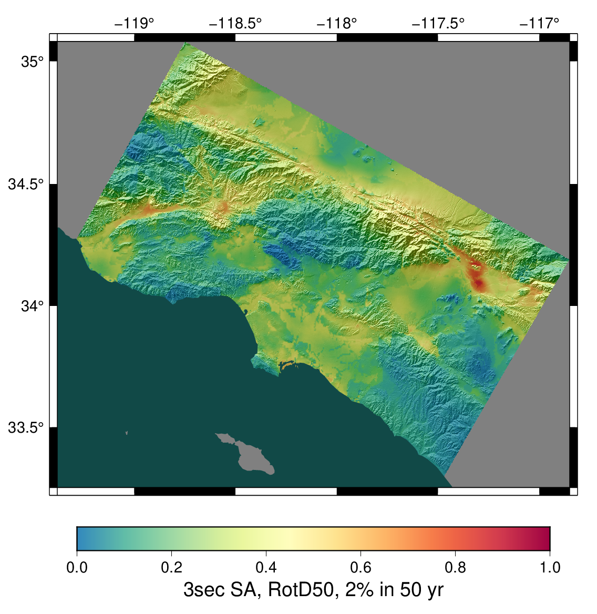
CyberShake Study 21.12
Used a new simulation approach to generate (smaller) list of earthquakes (~75,000/site)
Hazard results for 335 sites
Used OLCF Summit for 65k node-hrs
At peak, utilized 46% of Summit
29 days around-the-clock
Workflow tools scheduled 16,415 jobs
Tools managed 166 TB data
1.2 TB / 103M files automatically archived
Workflow tools scale!

Slide 27
Problems Workflows Solve
Task executions
Workflow tools will retry and checkpoint if needed
Data management
Stage-in and stage-out data for jobs automatically
Task scheduling
Optimal execution on available resources
Metadata
Automatically track runtime, environment, arguments, inputs
Getting computational resources
Whether large parallel jobs or high throughput

Slide 28
Should you use workflow tools?
Probably using a workflow already
Replaces manual hand-offs and polling to monitor status
Provides framework to assemble community codes
Also useful for training new teammates
Scales from local computer to large clusters
Provide portable algorithm description independent of data
CyberShake has run on 10 systems since 2007 with same workflow
Does add additional software layers and complexity
Some development time is required

Slide 29
Final Thoughts
Automation is vital, even without workflow tools
Eliminate human polling
Get everything to run automatically if successful
Be able to recover from common errors
Put ALL processing steps in the workflow
Include validation, visualization, publishing, notifications
Avoid premature optimization
Consider new compute environments (dream big!)
Larger clusters, XSEDE/PRACE/RIKEN/SciNet, clouds
Tool developers want to help you!

Slide 30
Links
SCEC: http://www.scec.org
Pegasus: http://pegasus.isi.edu
Pegasus-mpi-cluster: http://pegasus.isi.edu/wms/docs/latest/cli-pegasus-mpi-cluster.php
HTCondor: http://www.cs.wisc.edu/htcondor/
Parsl: https://parsl-project.org/
Apache Airflow: https://airflow.apache.org/
JUBE: https://www.fz-juelich.de/en/ias/jsc/services/user-support/jsc-software-tools/jube
FireWorks: https://github.com/materialsproject/fireworks
Makeflow: http://ccl.cse.nd.edu/software/makeflow/
Work Queue: http://ccl.cse.nd.edu/software/workqueue/
Nextflow: https://www.nextflow.io/
CyberShake: http://scec.usc.edu/scecpedia/CyberShake
Notes:
Update links

Slide 31
Questions?

